Slide 1
Analyzing Influences

Slide 2
Identify: the Influence

Slide 3
Identify:
Internal
Influences
Feelings
Wants and needs
Likes and dislikes
Personal values and beliefs
Perception of social norms
Internal Influences:

Slide 4
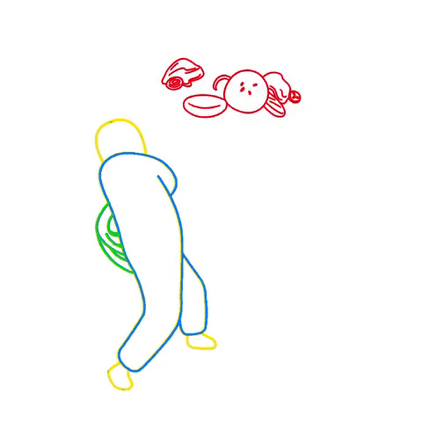
Identify:
External
Influences
External Influences:
Family
Peers/Friends School
Community
Media: TV, books, music
Technology
Culture
Policies Laws/policies
Social norms

Slide 5
Analyze:
The Influence
How the influence has an impact on behaviors, thoughts, values and beliefs?

Slide 6
Analyze:
How do I know it is influencing me?
What messages am I receiving from this influence?
How much is this influencing my thoughts, values, beliefs or actions?

Slide 7
Analyze: Positive and Negative Consequences
Positive (+)
Negative (-)
Create a list

Slide 8
Examine:
Factors & Impact
How are other factors interacting with this influence?
How might these factors affect my thoughts, values, beliefs and behaviors choices?

Slide 9
Consider:
An Action Plan
Do I need to do anything about this influence?
What is the best plan of action for handling this influence in my life?

Slide 10
Choose the positive influences counteract the negative influences

Slide 11
Reflection
Notes:
(Benes & Alperin, 2016)
Rmc.org/healthskills

