Slide 1

Nutrition Stations
You Are What You Eat!

Slide 2
Do Now Activity:
What factors influence your diet on a daily basis?
Notes:
As students walk into class they will discuss the Do Now Activity with a partner. What factors influences your diet on a daily basis? Examples: Family, friends, environment, school, culture, social economics

Slide 3
http://bit.ly/nutritionyouarewhatyoueat
Log into URL
Start on the slide that corresponds to your station number. Take notes and fill out worksheet based on station #.
Station #1 Portion Distortion [Slides: 4-5]
Station #2 Organic Foods: Are they safer? More... [Slide 6]
Station #3 Supplements: Vitamins, weight loss...[Slides:7-8]
Station #4 Cereal [Slides: 9-12]
Station #5 Michael Pollan’s 10 Food Rules [Slide: 13]
Station #6 Eating in Season [Slide: 14]
Station #7 Product Placement [Slide: 15-16]
Station #8 MyPlate [Slide: 17]
Station #9 Juice [Slides: 18-21]
Station #10 Bread [Slides: 22-25]
Station #11 Leading Causes of Death in the US [Slide: 26-27]
Do not move head or rotate until instructed to.

Slide 4
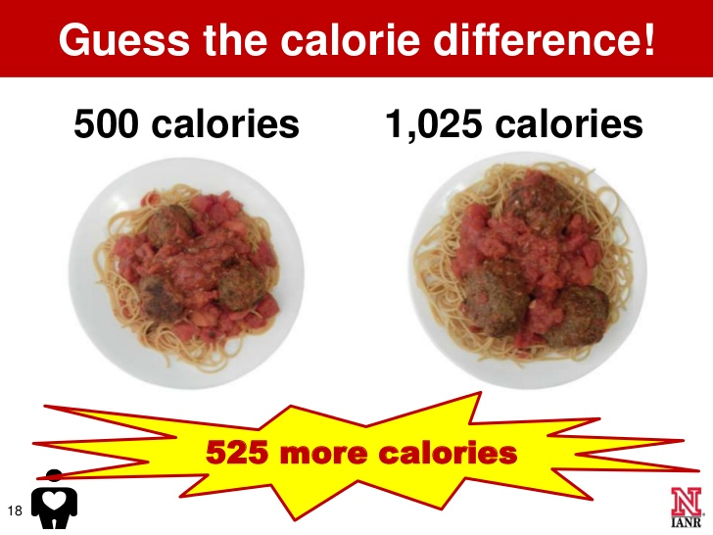
Portion Distortion
1
Key Message:
Eat less
Share a meal
  Split it in half
Eat slow
Enjoy your food
Stop eating when full

Slide 5
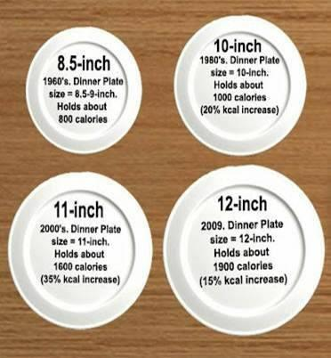
Portion Distortion
1
Key Message:
Avoid multitasking
Avoid eating out of a bag
Mindless eating (ex. watching tv)
Eat on a smaller plate
Serve one portion at a time

Slide 6

Organic Foods: Are they safer? More nutritious?
2
Read article here
Question:
Why is organic better?
Notes:
https://www.mayoclinic.org/healthy-lifestyle/nutrition-and-healthy-eating/in-depth/organic-food/art-20043880

Slide 7
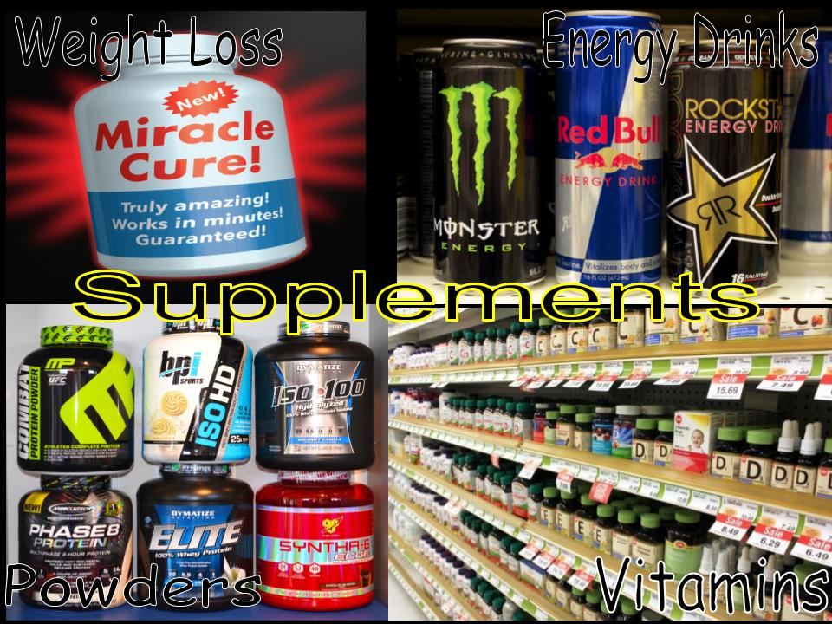
Supplements: Vitamins, weight loss products,
energy drinks
3
Key Message & Use Caution:
Not regulated by government (Food and Drug Administration)
Not tested for safety, effectiveness, or efficacy
Can give false claims:
  Stronger
  Larger
  Faster

Slide 8
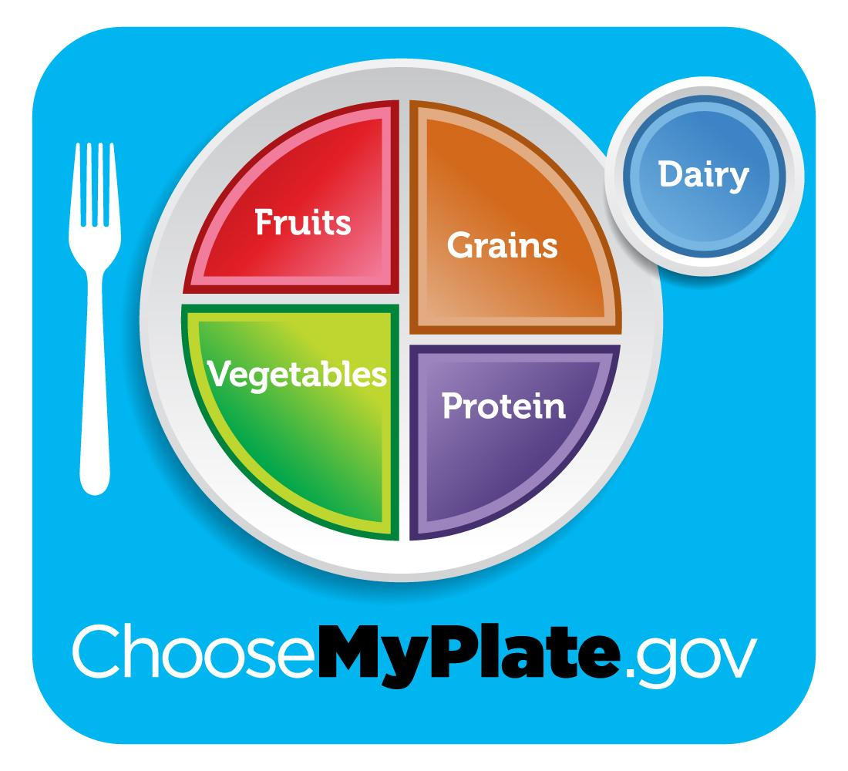
Do you need supplements in your diet?
3
No. If you are eating a well balanced diet of real whole foods. You do not need supplements!
*You do not need protein powder (expensive $$$$ urine). Your body can only process so much protein and your kidneys will filter rest out. Talk to your dr. before taking any supplements.

Slide 9
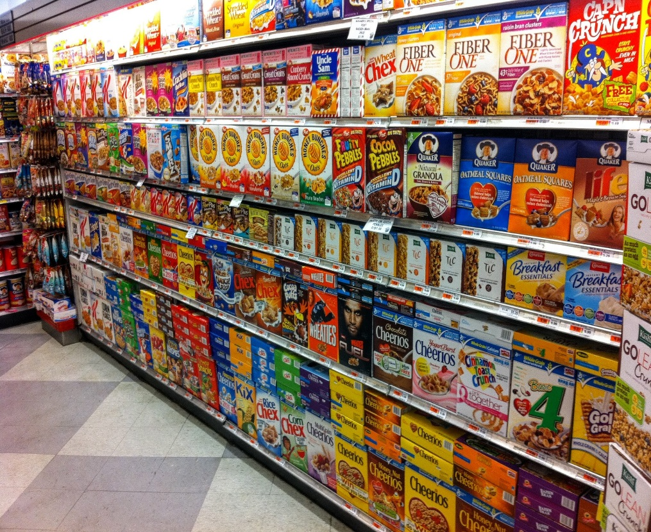
Cereal
4
Key Message:
Low in sugar
High in fiber
Less ingredients the better
Less artificial colors

Slide 10

Cereal
4
Use Caution:
Advertised to kids
Makes claims on box except:
  Natural
  Protein
  Nourish
  Weight loss
Food label & ingredient list: is the only place the company has to be truthful.

Slide 11
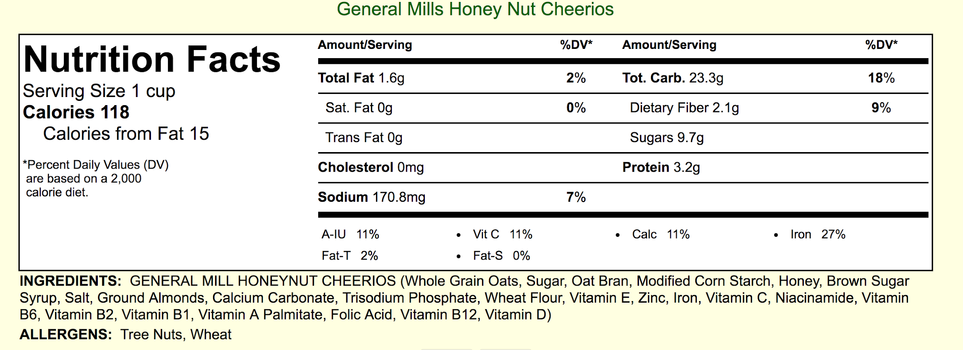
Which cereal is the better choice? Why?
4
A

Slide 12
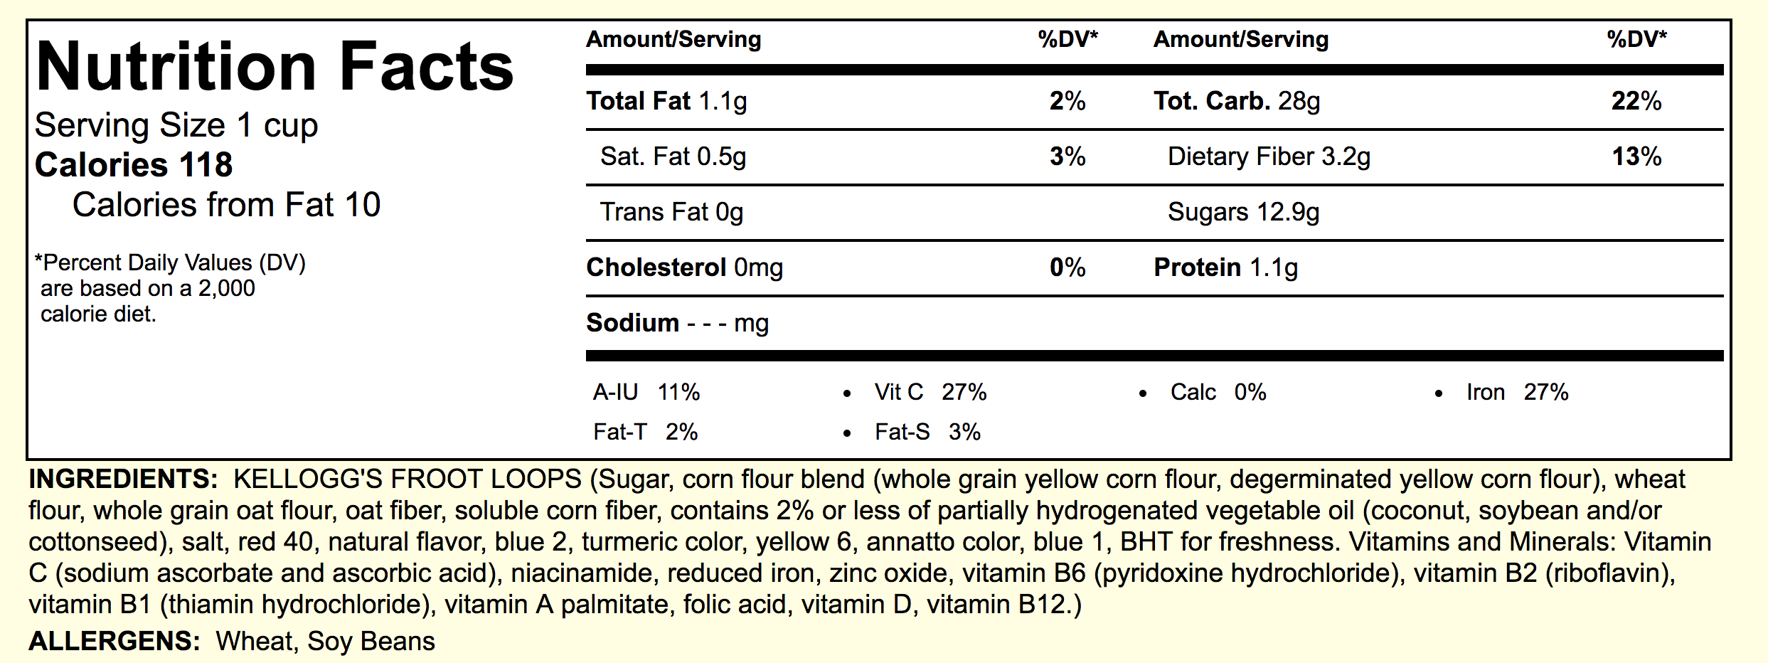
Which cereal is the better choice? Why?
4
B

Slide 13
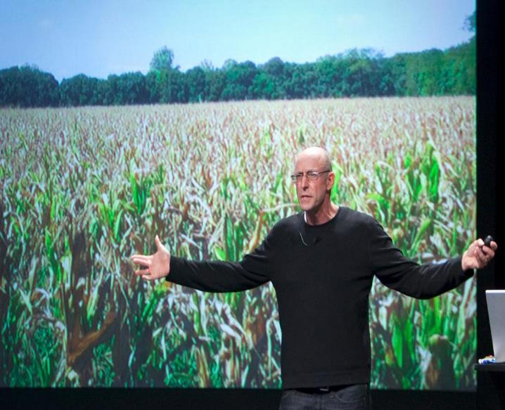
Michael Pollan’s 10 Food Rules
5
Read article click here
Write out Michael Pollan’s 10 Food Rules
Notes:
http://www.eatingwell.com/article/16276/10-food-rules-you-should-follow/

Slide 14
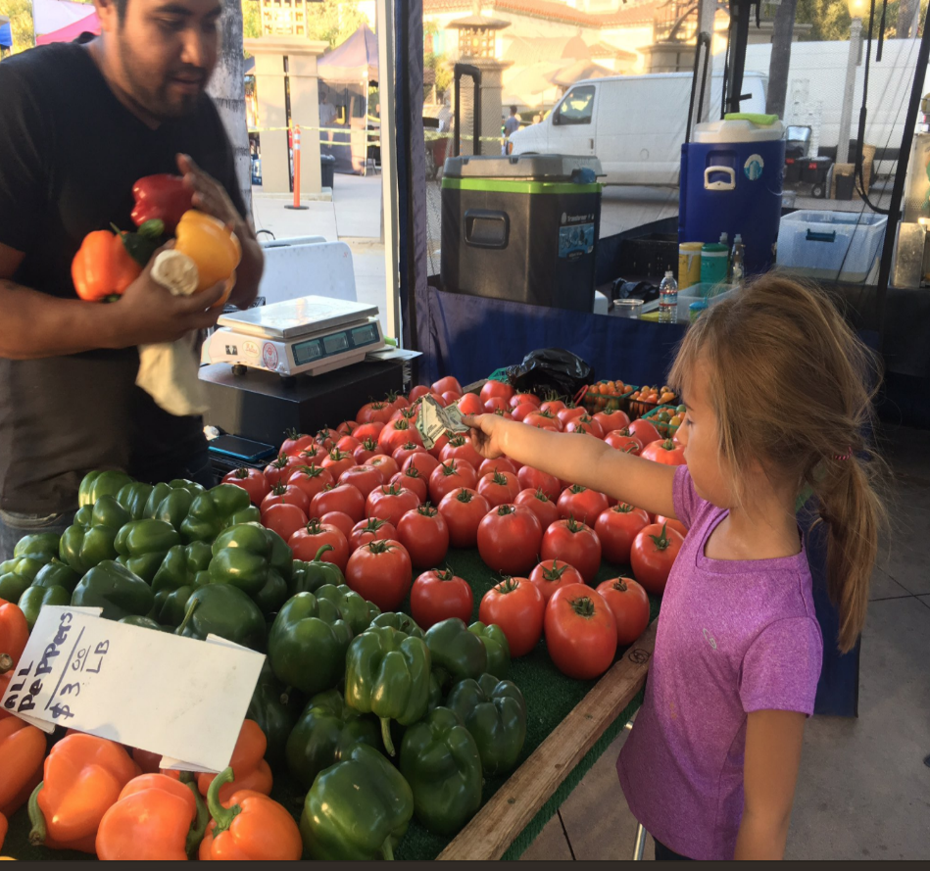
Eating in Season
6
Read, 10 Reasons to eat in season
Notes:
https://www.mindbodygreen.com/0-4807/10-Reasons-To-Eat-Whats-In-Season.html

Slide 15
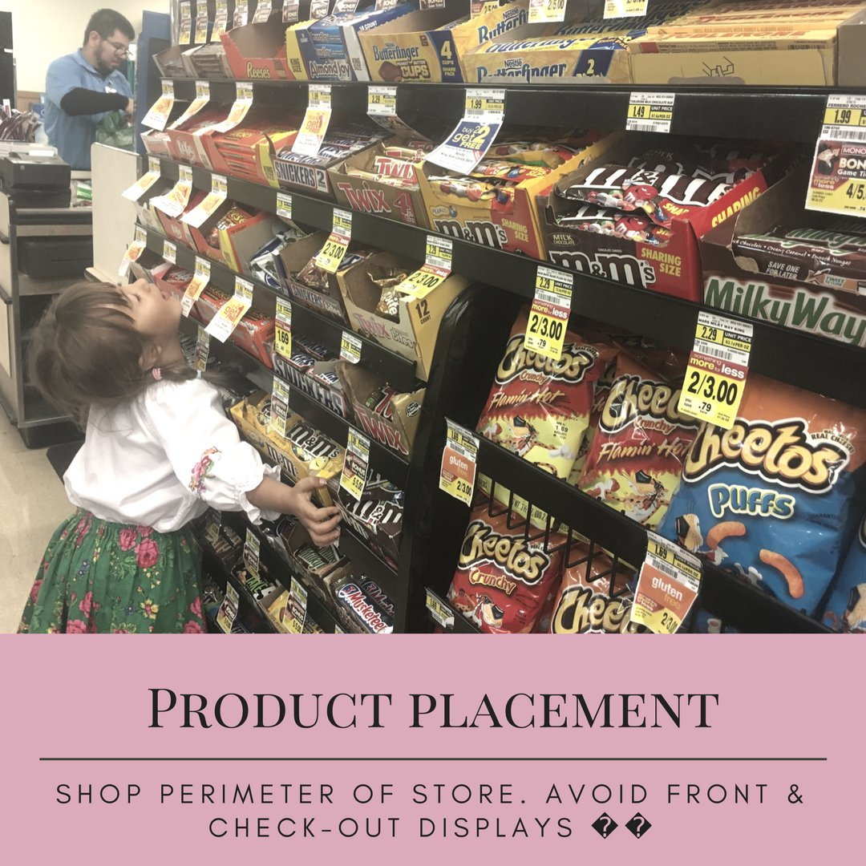
Product Placement
7
Key Message:
Products are placed where you are more likely to buy them
  Checkout (Impulse buy)
  In the front of the store
  In the front of aisles
  Eye-level
“especially advertised to kids”
Companies pay more money for product placement

Slide 16
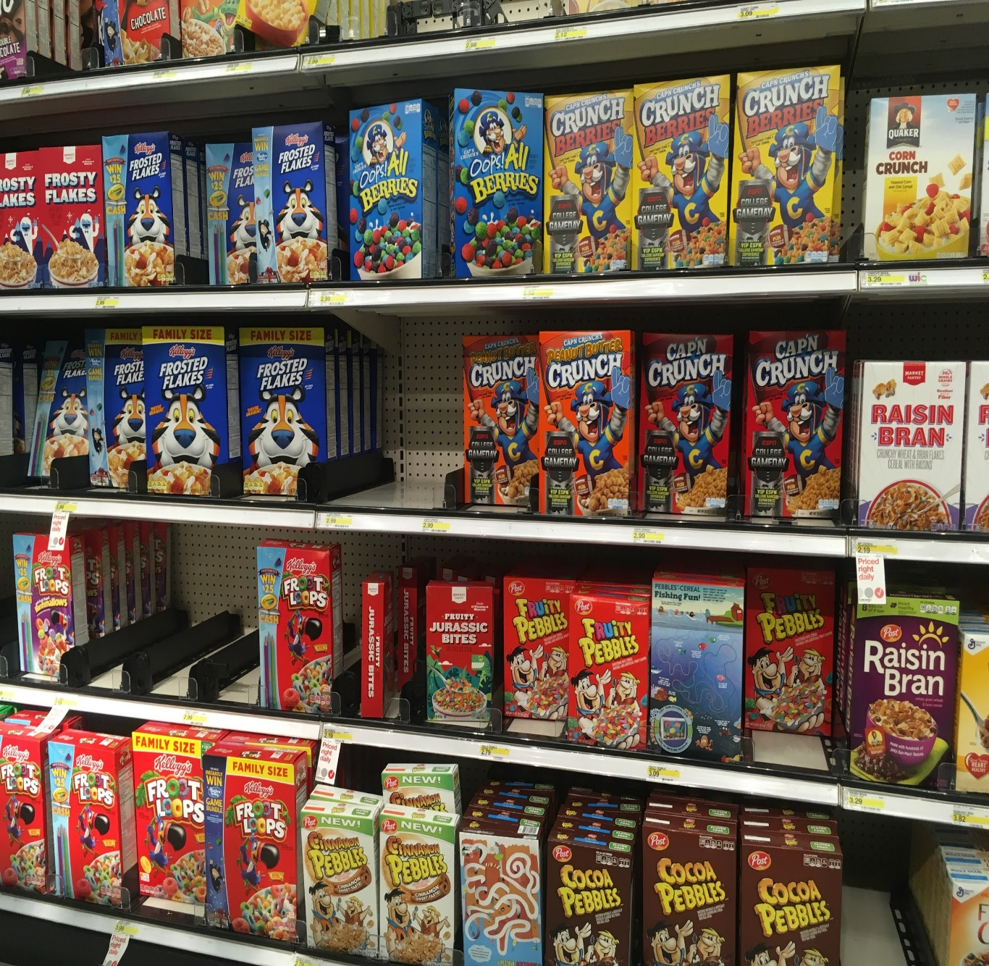
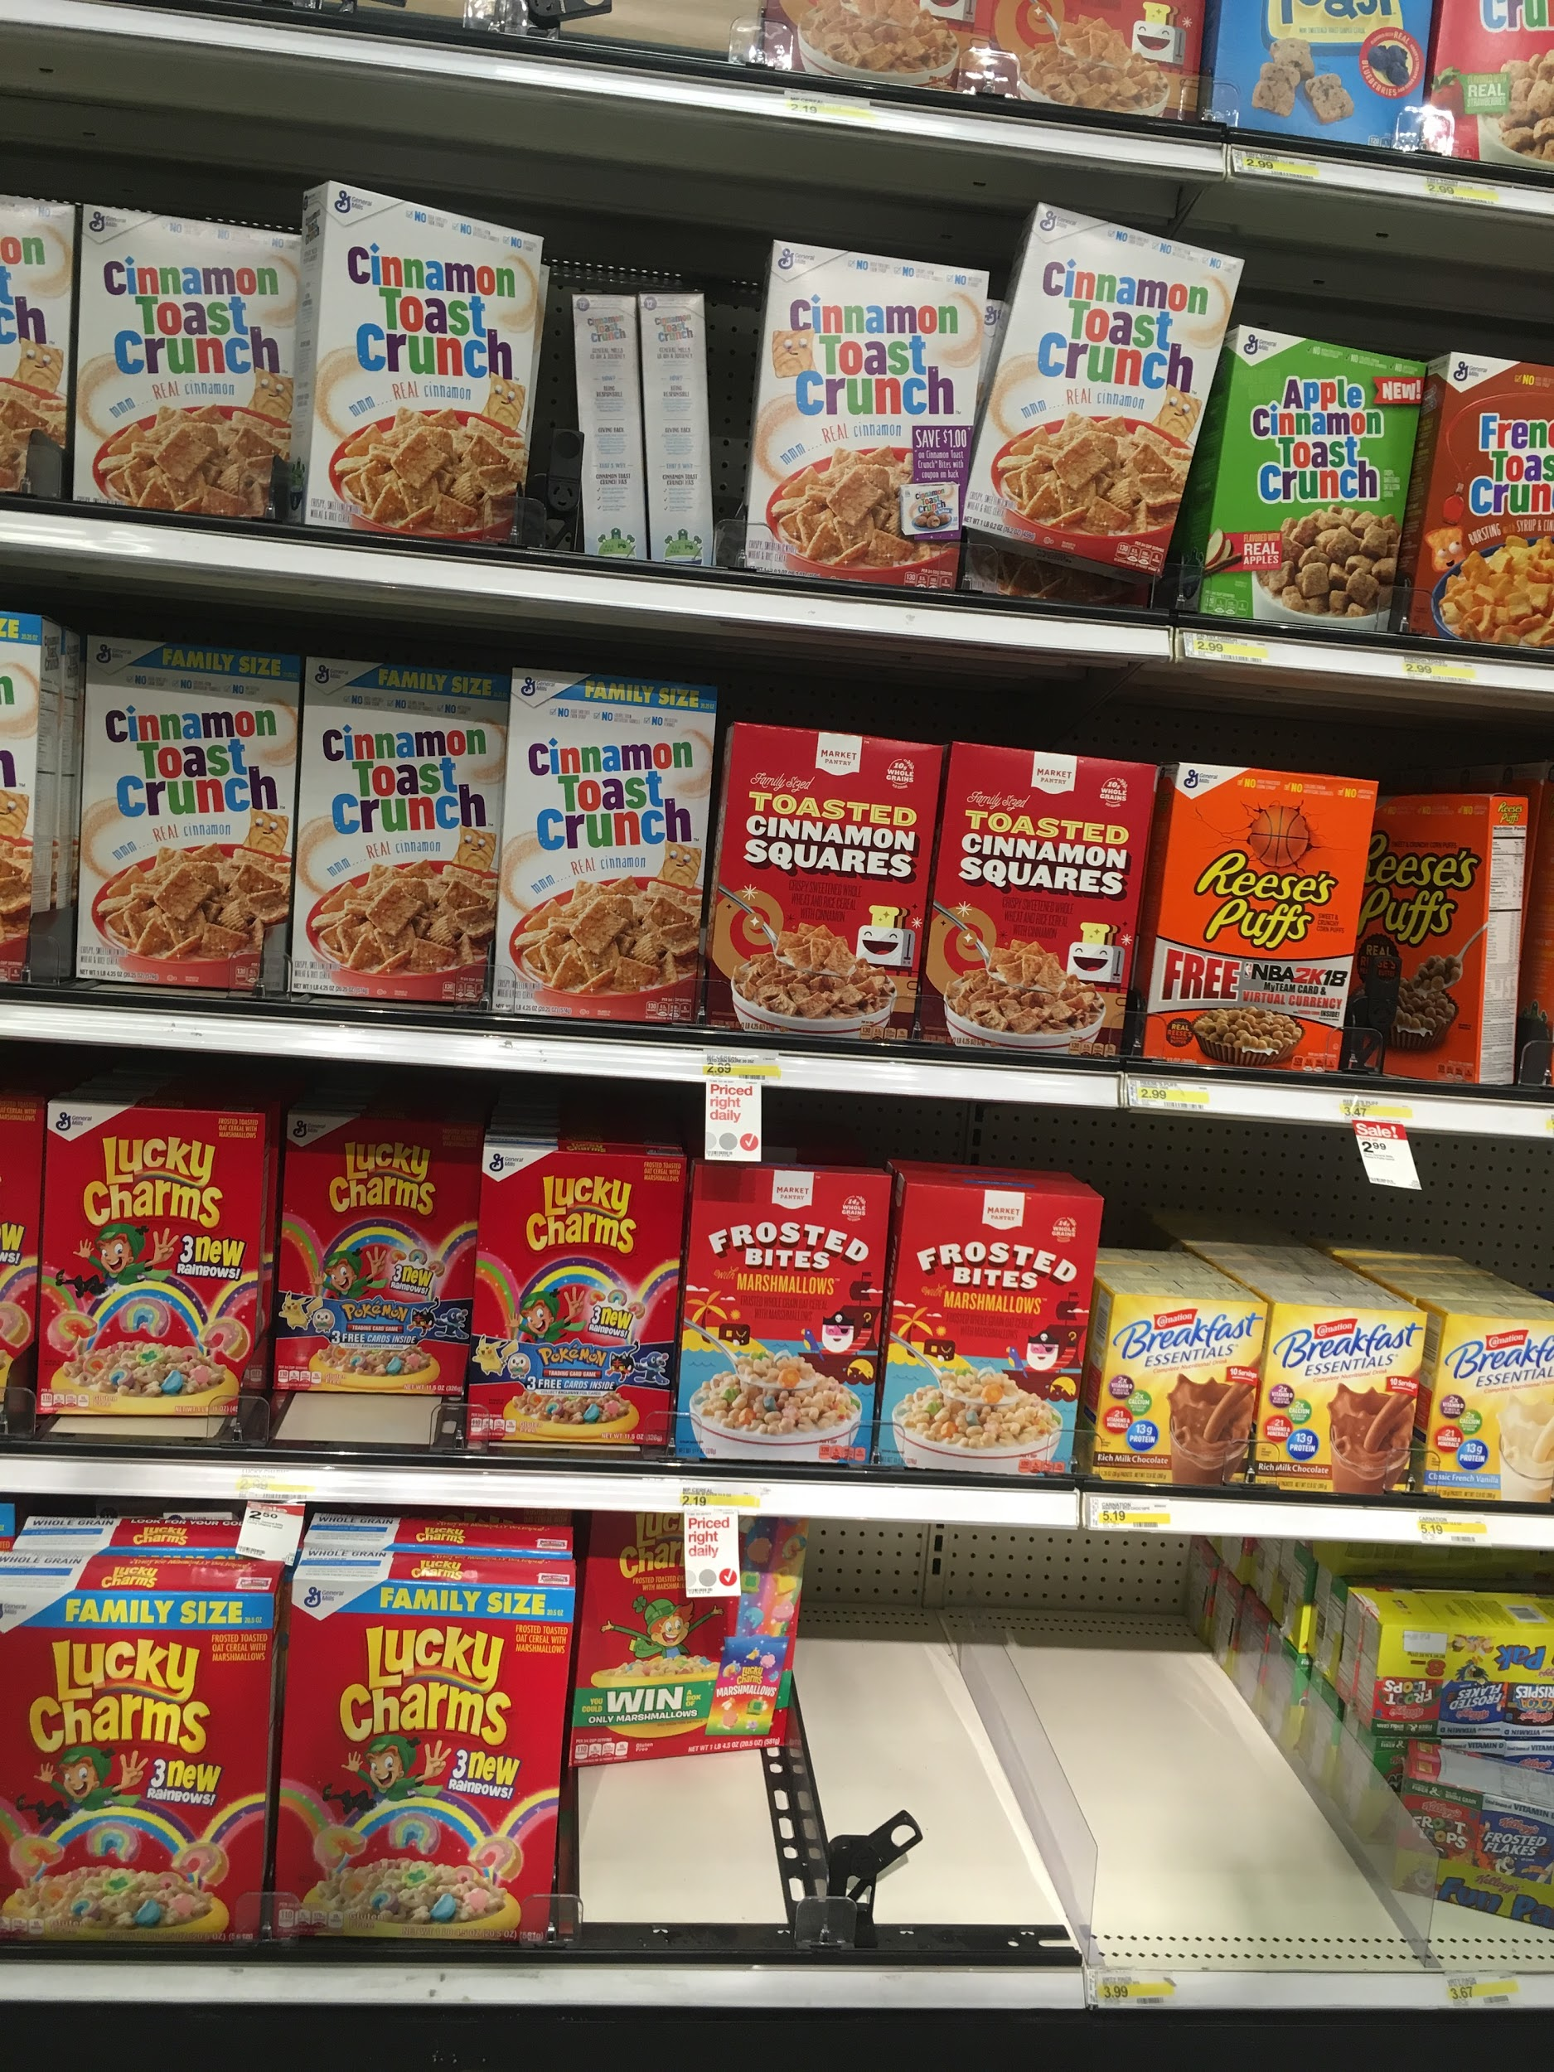
Product Placement
7

Slide 17
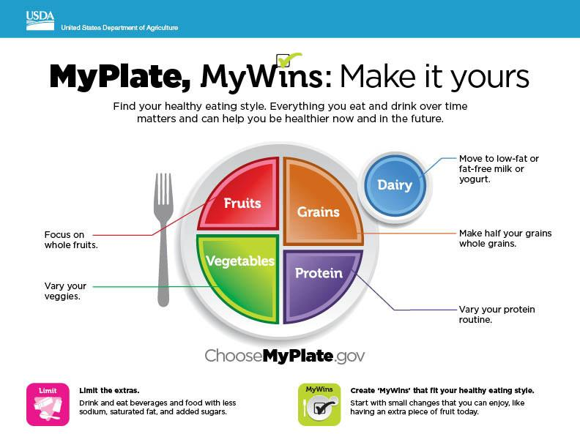
8
MyPlate
Key Messages:
½ your plate should contain fruits and vegetables
Move to low fat or fat-free milk or yogurt
Make ½ your grains “whole grains”
Vary your protein
Notes:
https://www.choosemyplate.gov/

Slide 18
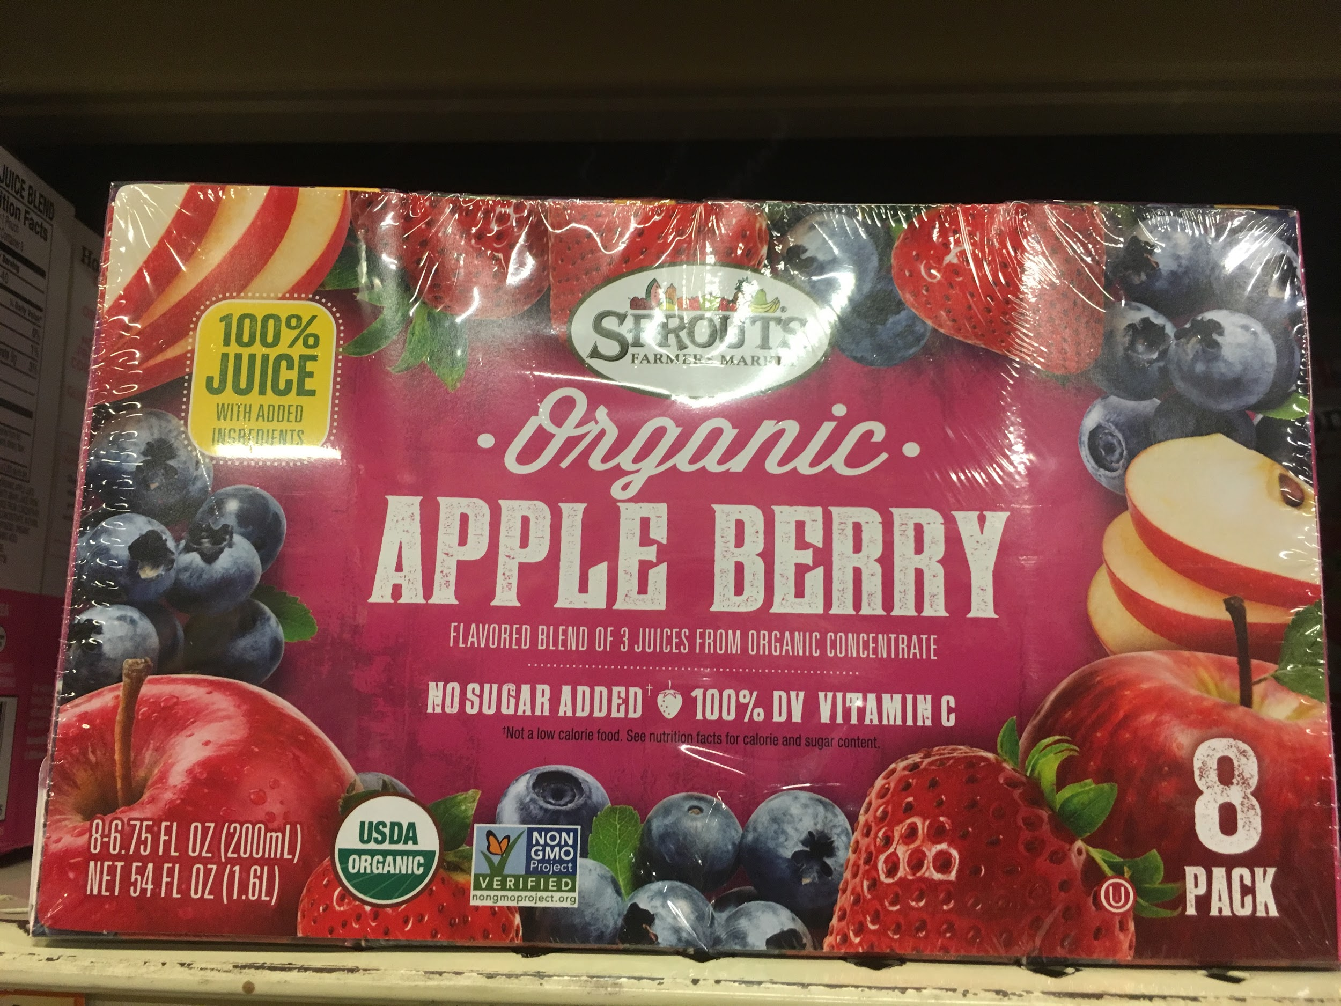

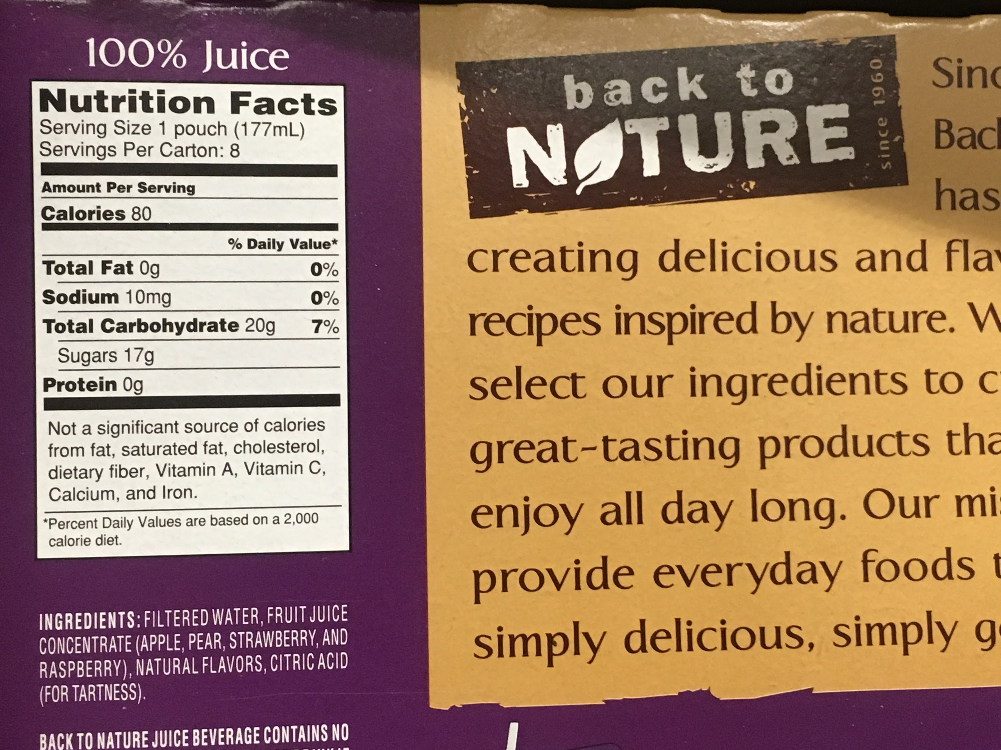
Juice
9
Key Message:
100% Fruit Juice
Fresh squeezed not from concentrate is better
  With the pulp is even better
In place of juice eat the real fruit or vegetable (with the skin more fiber)
Drink water, milk or sparkling water with lemon

Slide 19
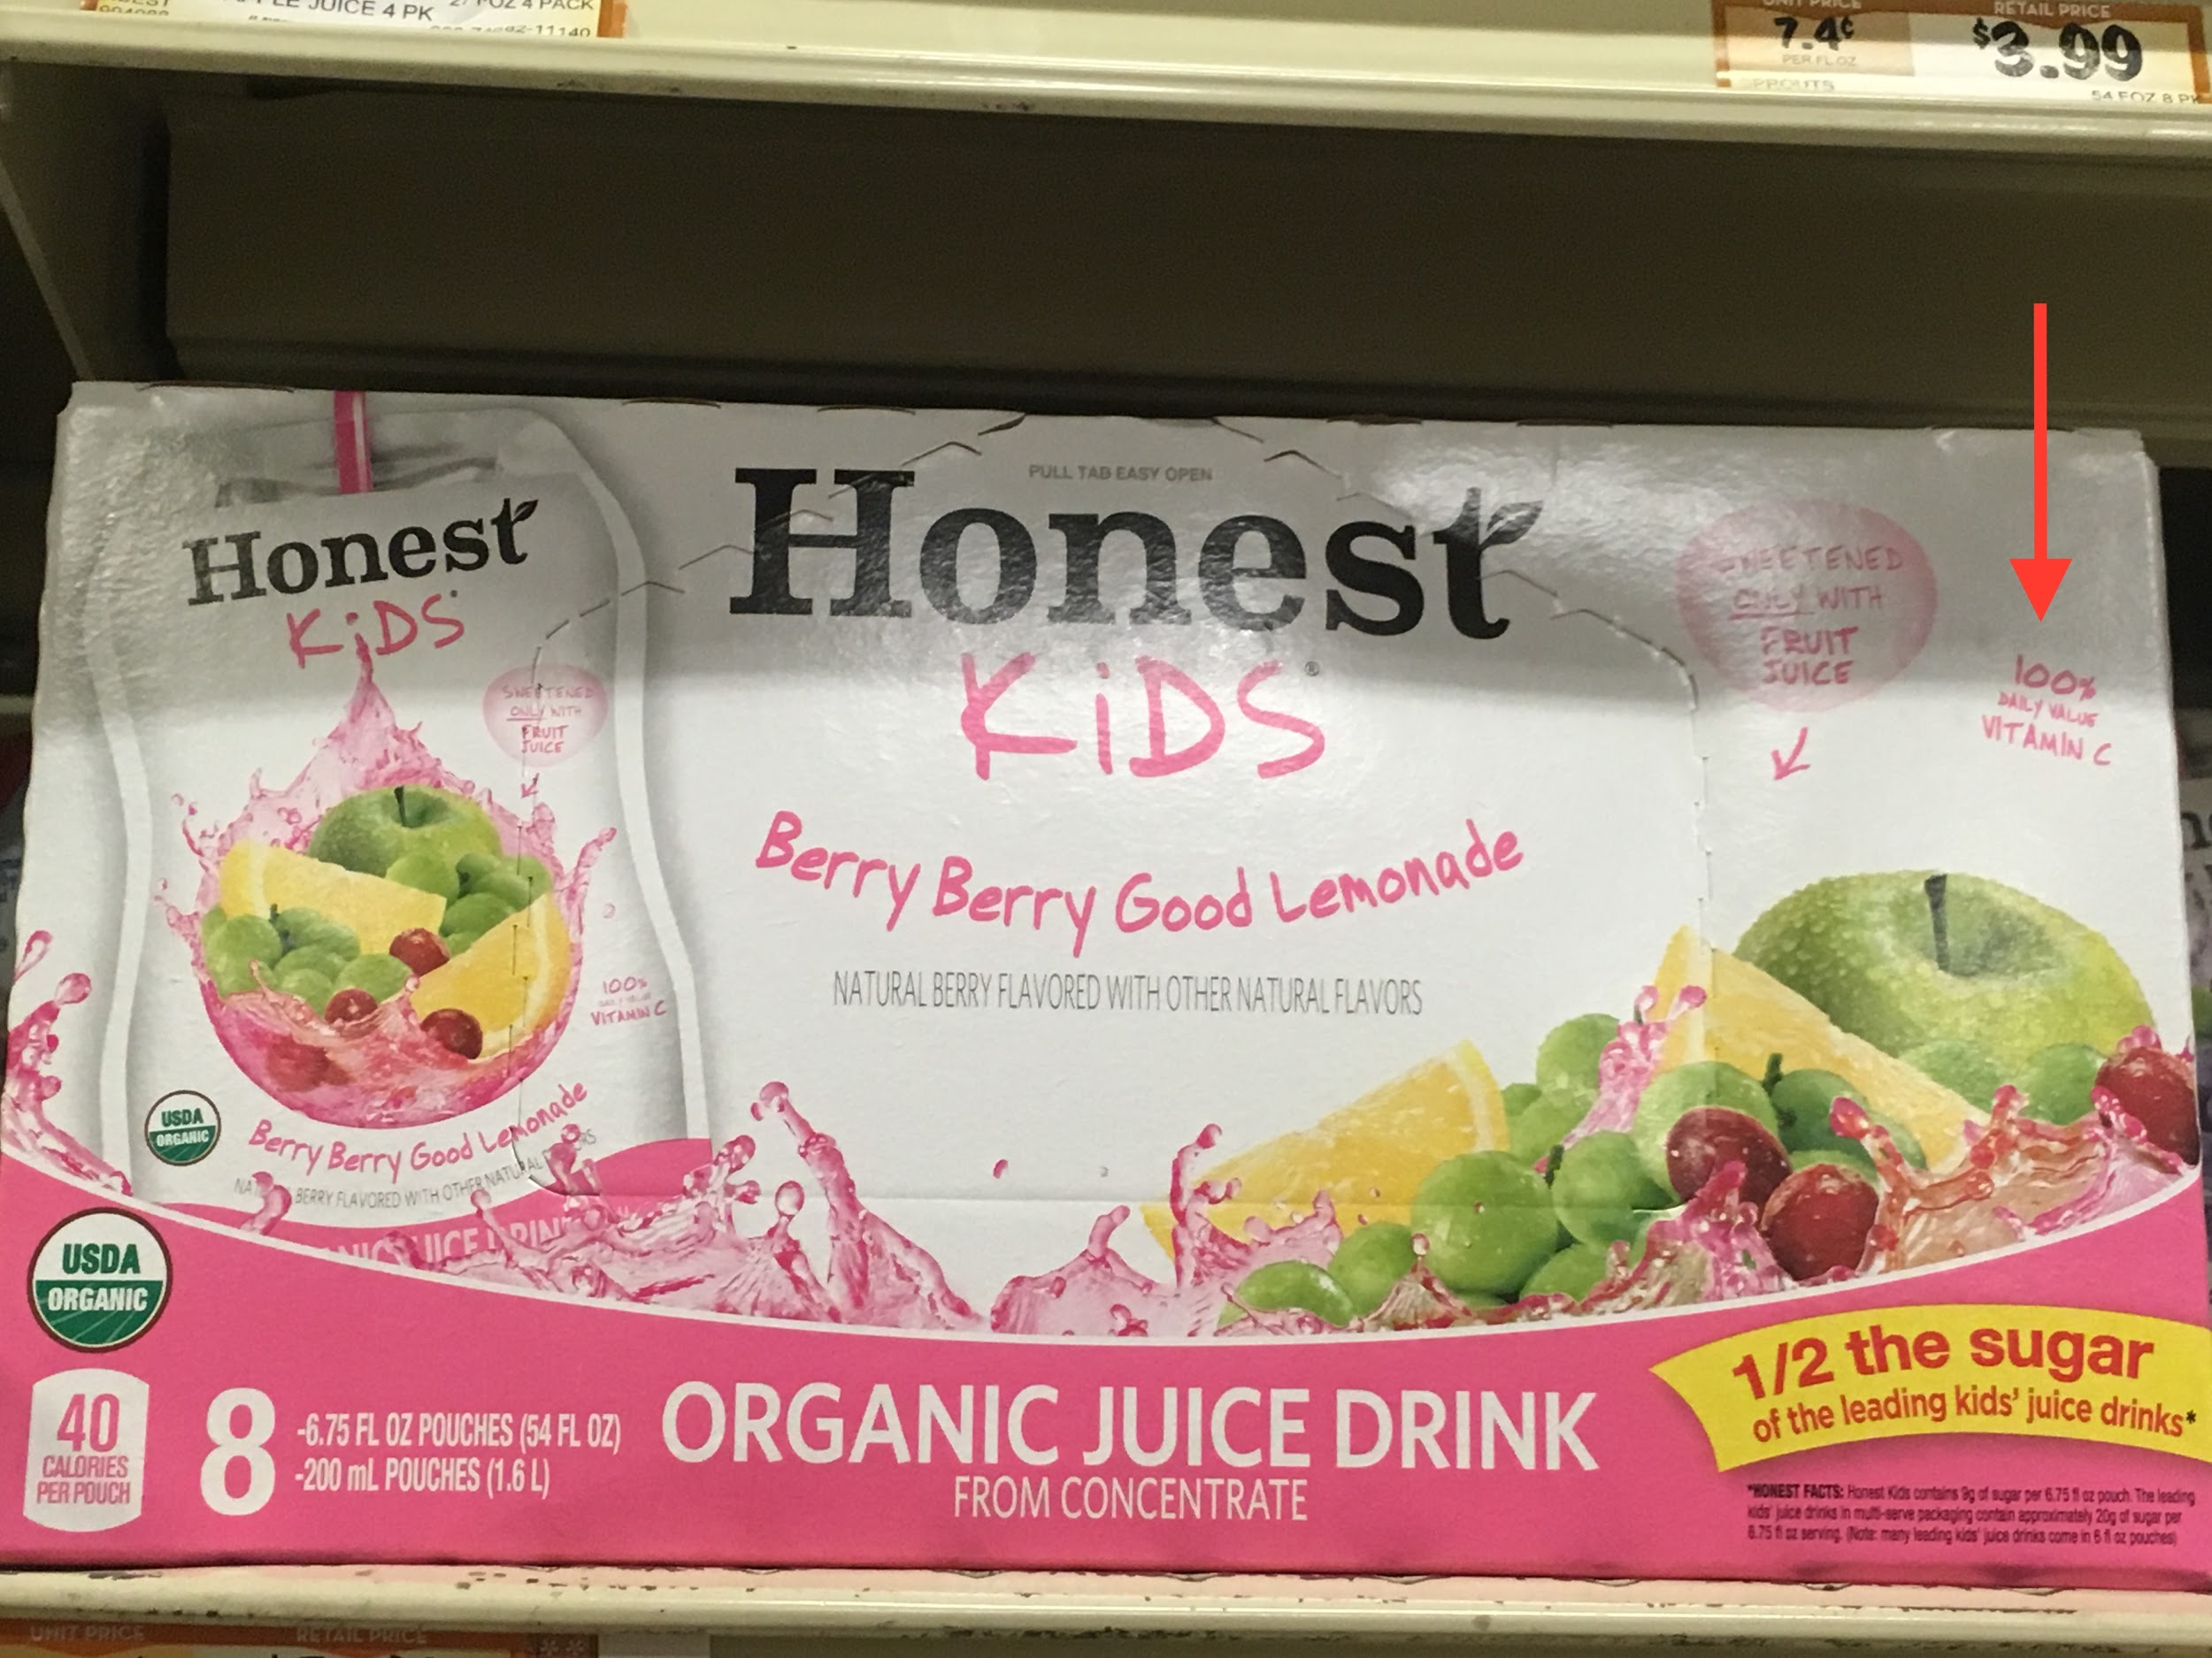
Juice
9
Caution (When you see):
100% Vitamin C
Less than 100% Fruit Juice
“Natural”
Just because it is organic doesn’t make it healthier
Any claims on the package other than on the label and ingredients list

Slide 20
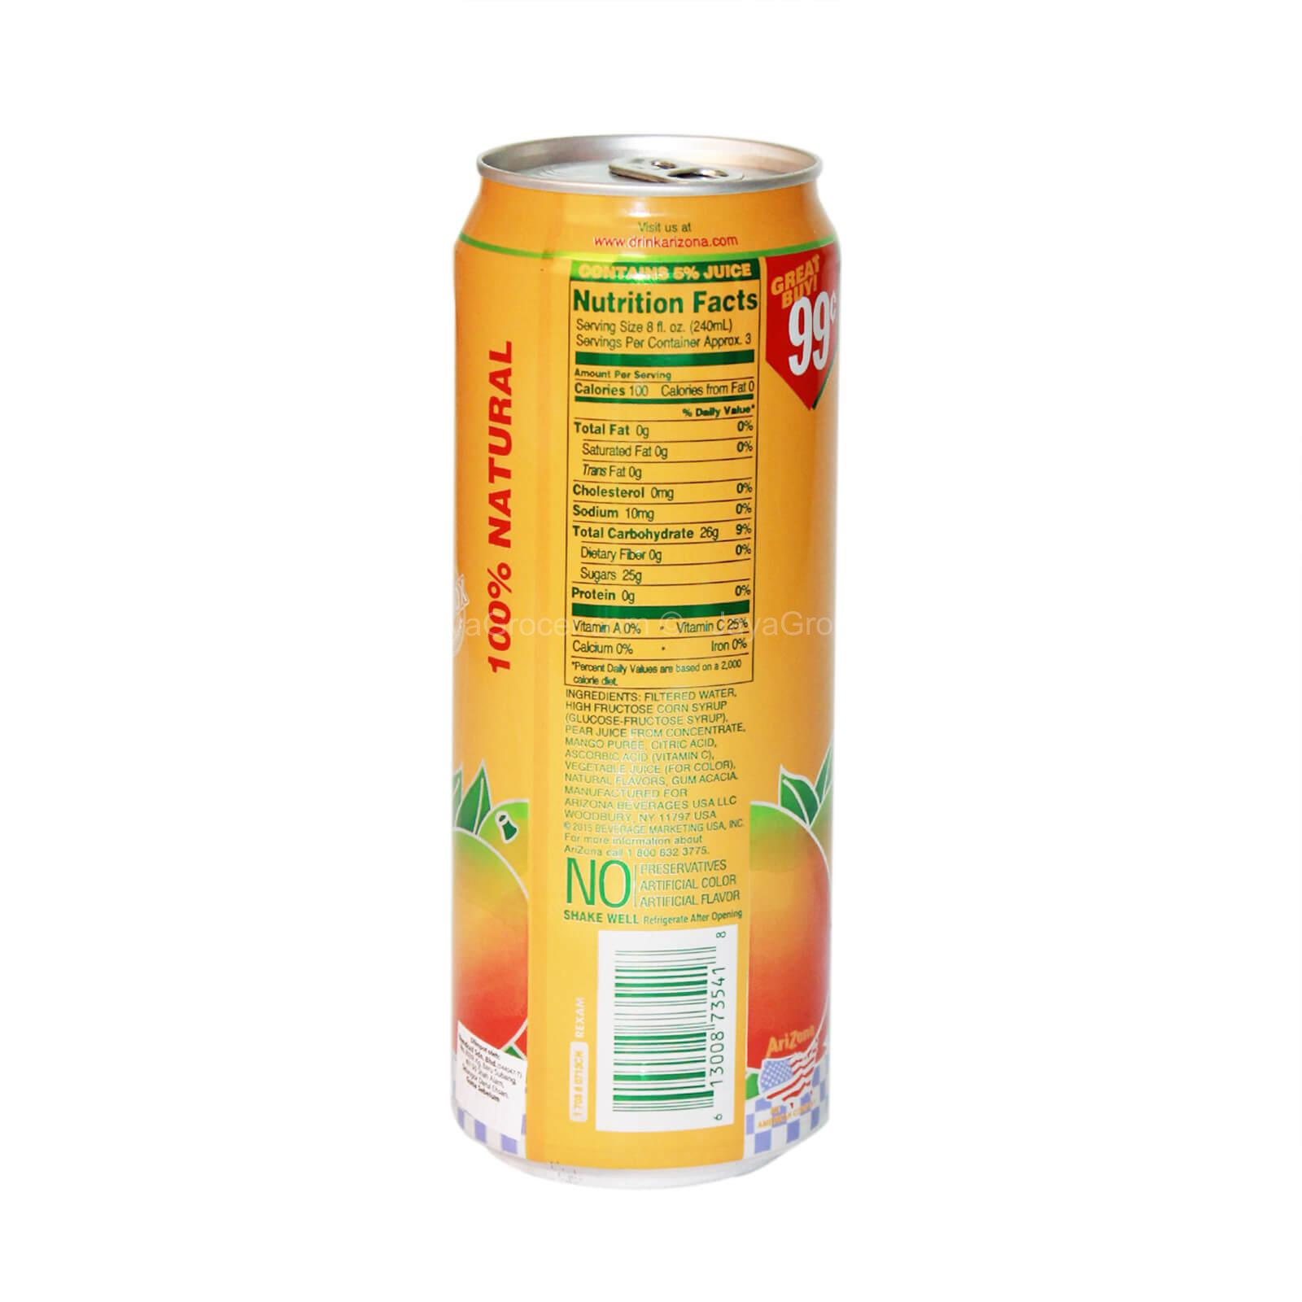
9
Use Caution:
5% Juice
Juice
“Natural” means nothing. Many companies use this word to fool consumers.

Slide 21
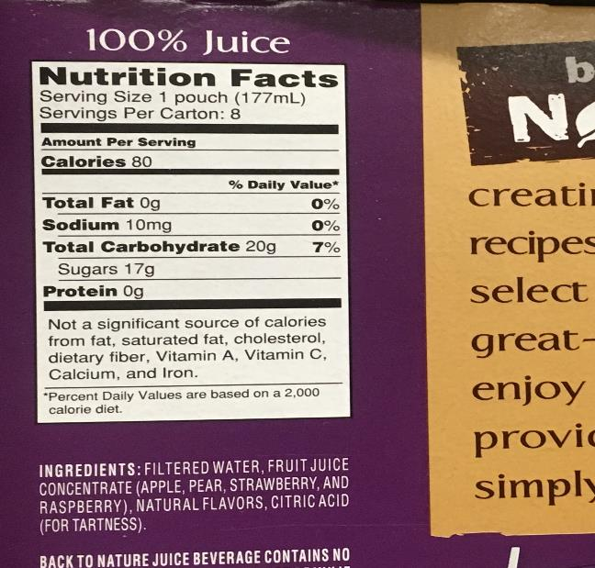
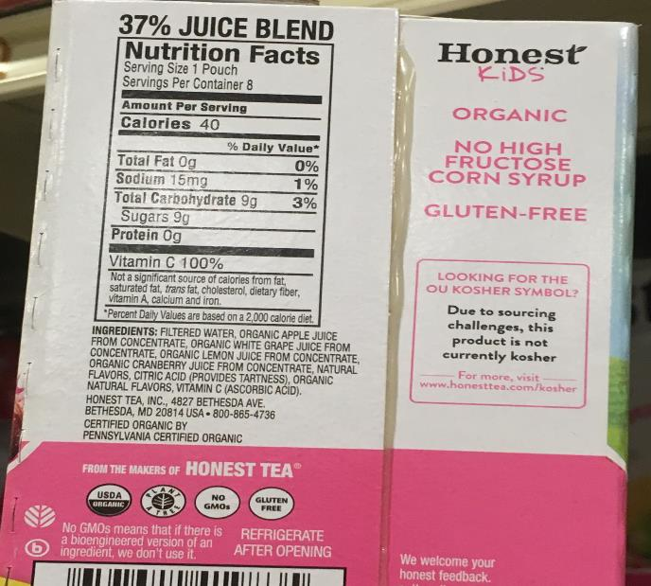
Which juice is the better choice? Why?
9
A
B

Slide 22
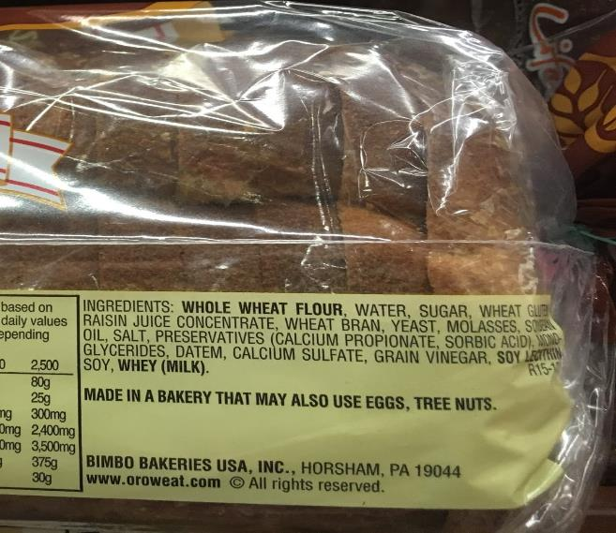
Bread
10
Key Message:
First ingredient:
  “Whole Wheat” or
  “Sprouted Whole Wheat”
Less ingredients the better
More fiber the better
Less sugar the better

Slide 23
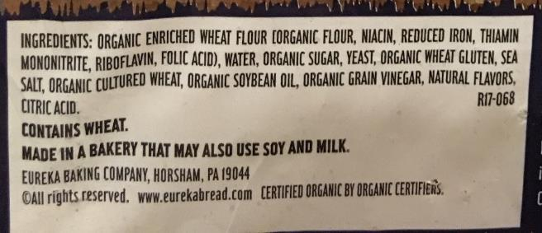
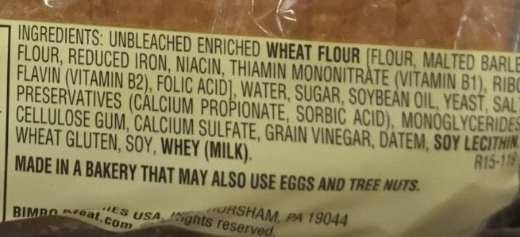
Bread
Caution (When you see):
10
Natural
“Enriched”
Enriched flour
Any claims on the package other than on the label and ingredients

Slide 24
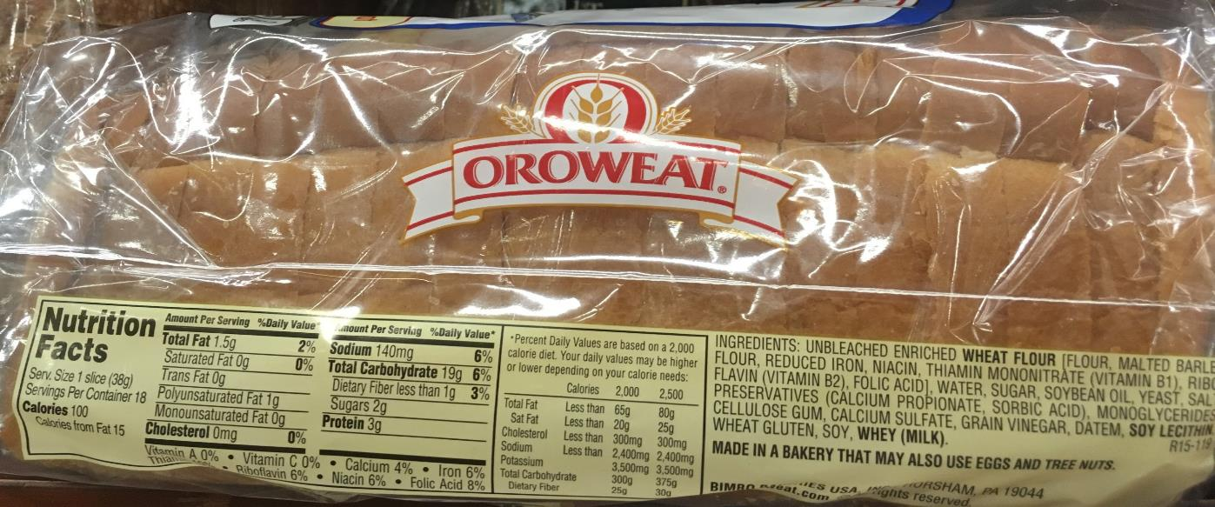
Which bread is the better choice? Why?
10
A

Slide 25
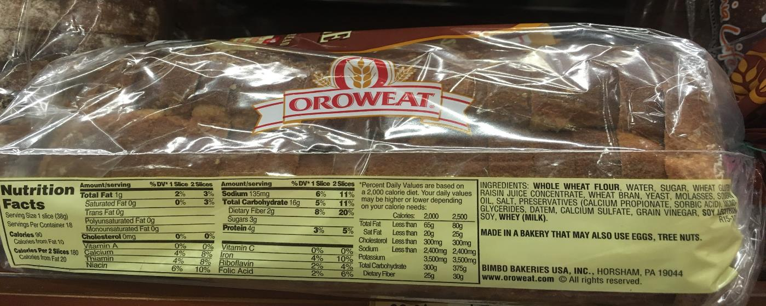
Which bread is the better choice? Why?
10
B

Slide 26
Leading Causes of Death in the US
11
#1 Heart Disease
# 2 Cancer
#3 Chronic Lower Respiratory Diseases
#4 Accidents
#5 Stroke
#6 Alzheimer’s Disease
#7 Diabetes
Source: Centers for Disease Control: National Center for Health Statistics final from 2015
Notes:
https://www.cdc.gov/nchs/fastats/leading-causes-of-death.htm

Slide 27
Which causes of death could be diet related?
Leading Causes of Death
11
#1 Heart Disease
# 2 Cancer
#3 Chronic Lower Respiratory Diseases
#4 Accidents
#5 Stroke
#6 Alzheimer’s Disease
#7 Diabetes
Source: Centers for Disease Control: National Center for Health Statistics final from 2015
Notes:
https://www.cdc.gov/nchs/fastats/leading-causes-of-death.htm

