Slide 1
Attitude of Gratitude
The greatest Love of All...
Notes:
In this lesson, students will think critically, make meaningful personal connections and engage with others to share and develop ideas.
https://heartmindonline.org/resources/lesson-plan-what-is-gratitude

Slide 2
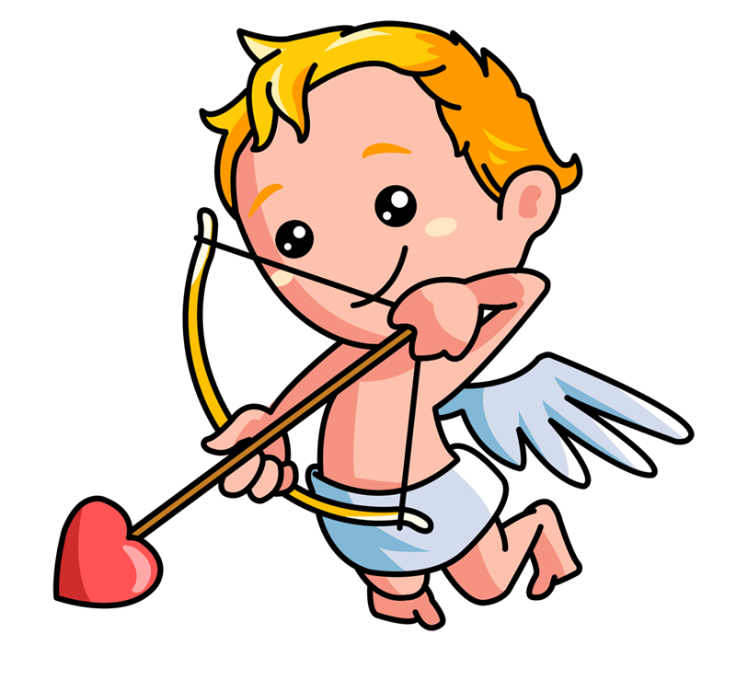
Cupids Confidence
I was really happy when…
Something that my friends like about me…
I am proud of…
My family was happy when…
In school, I am good at…
Something that makes me unique...

Slide 6
Benefits of showing Gratitude
Increased feelings of well-being and reduced feelings of depression and disconnection.
Positive relationships
Improved School Satisfaction

Slide 8
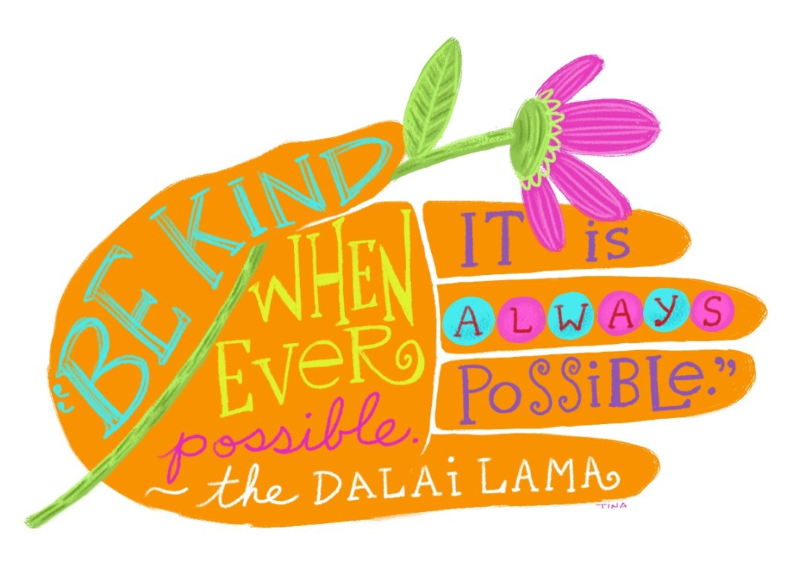
Categories
Administrators
Custodians
Lunch Workers
Teachers/Paras
Secretaries
Security/SRO
School Counselors

Slide 9
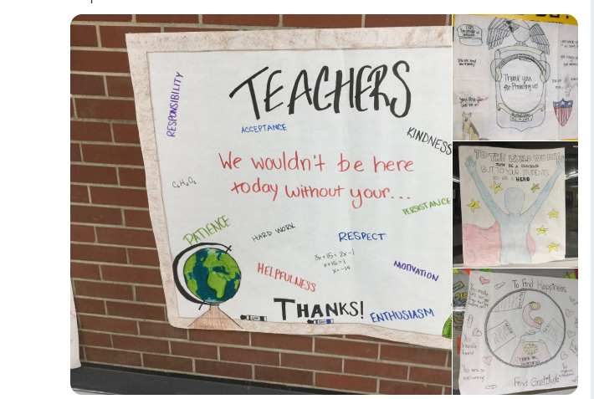

Slide 10
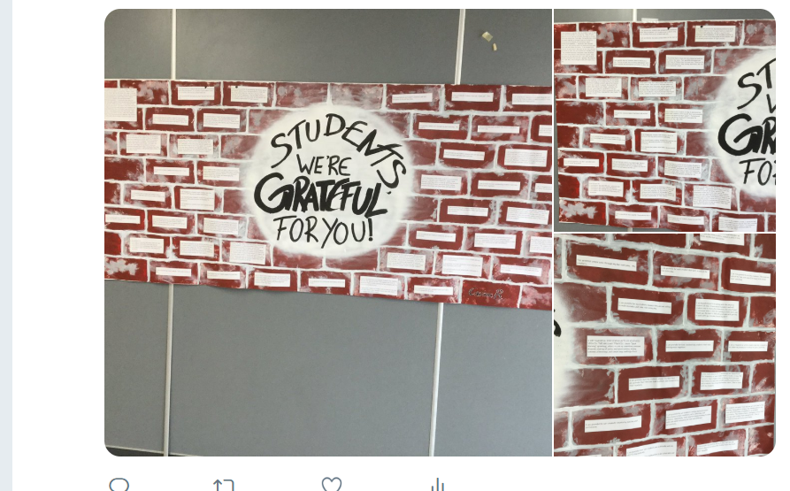

Slide 11
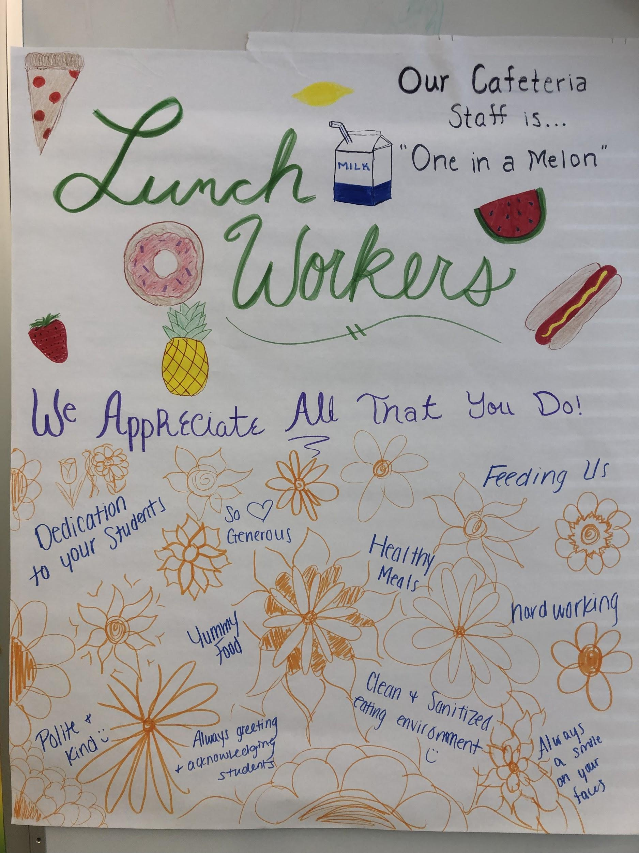
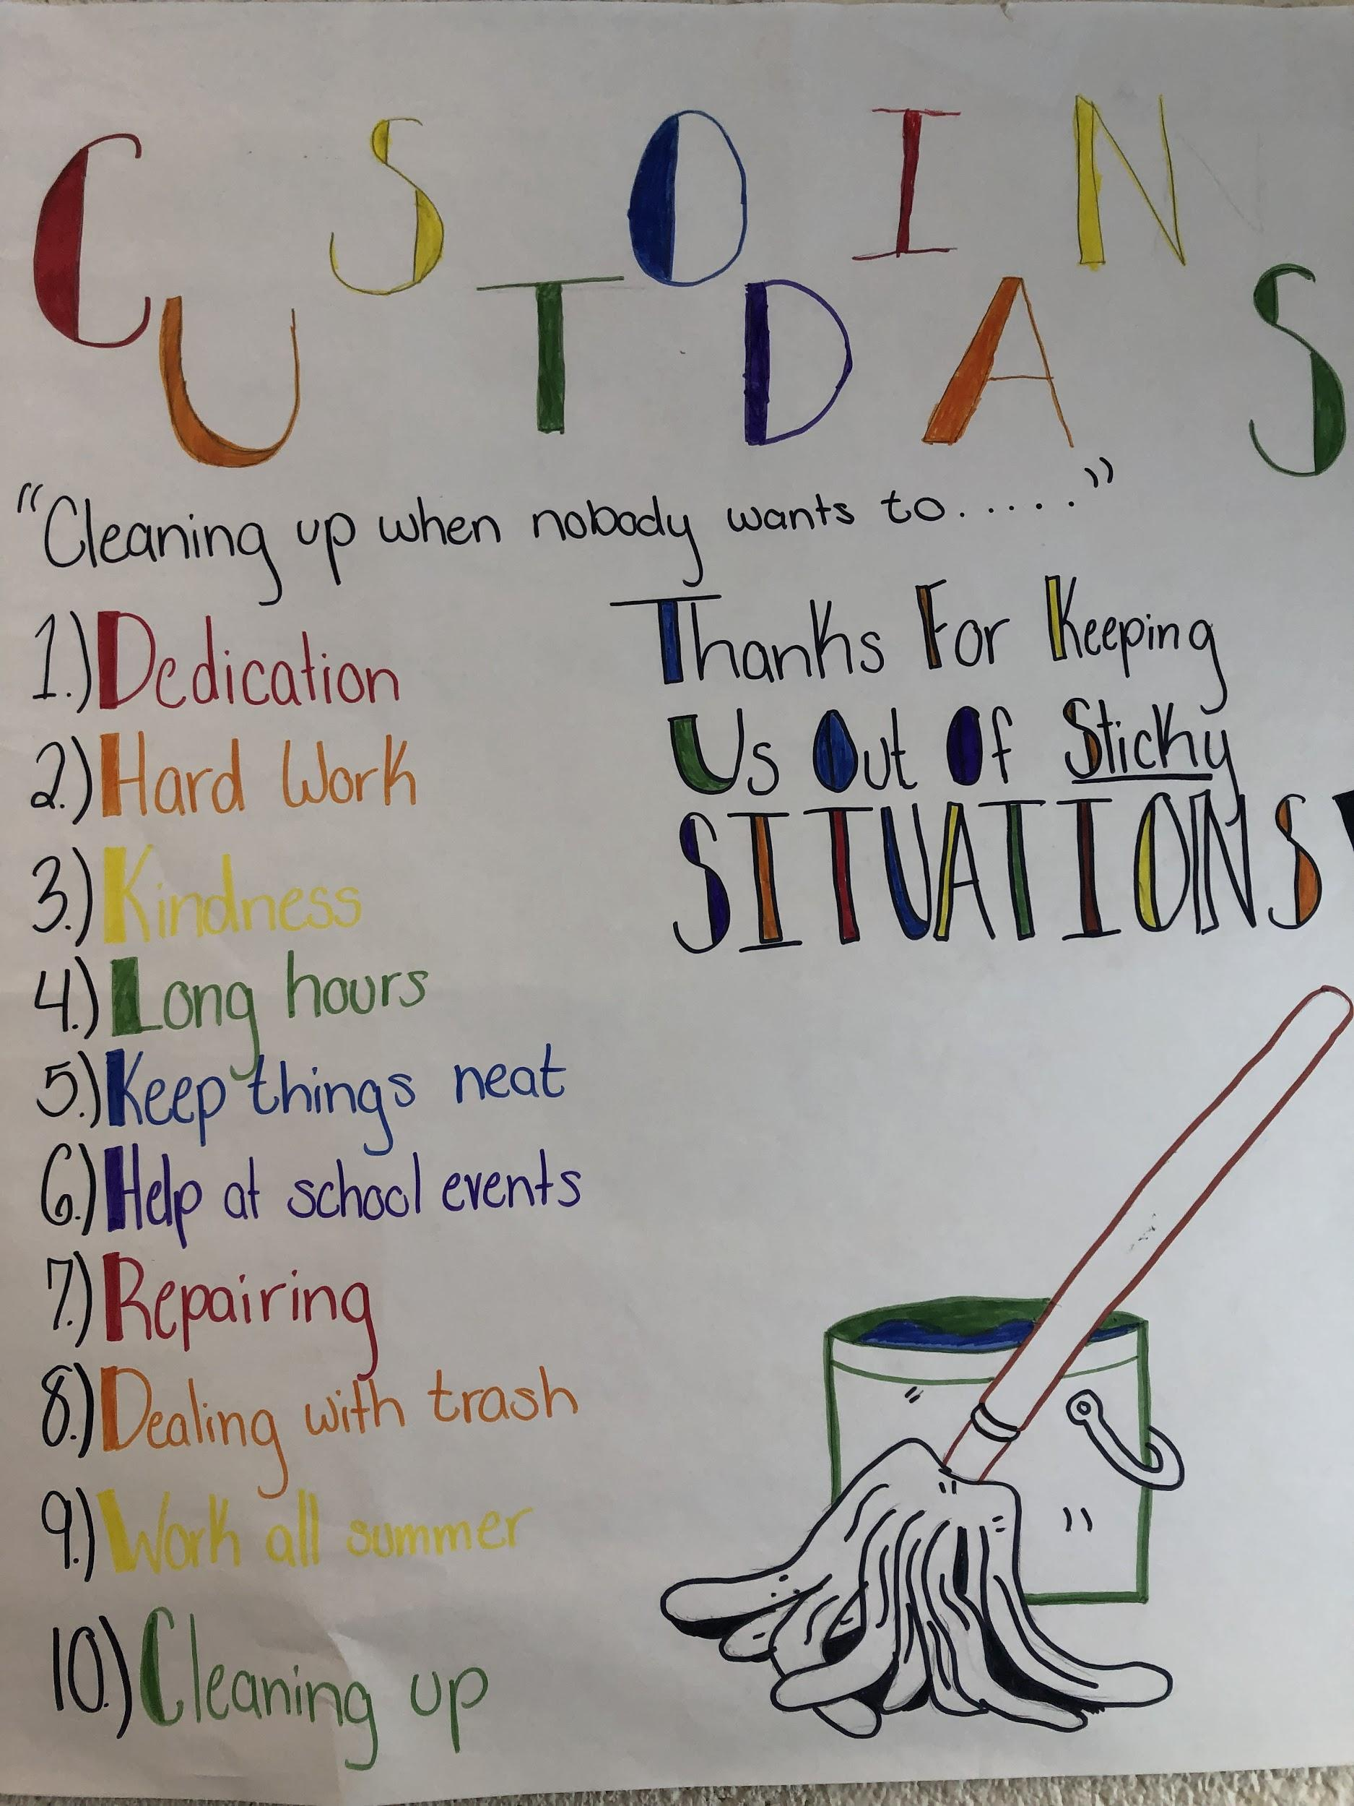

Slide 14
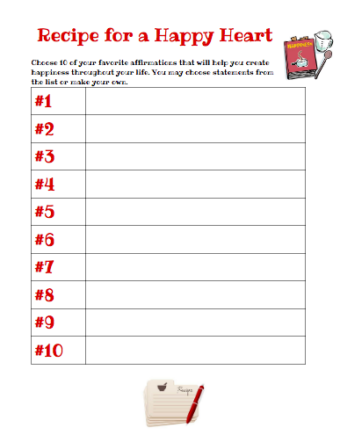
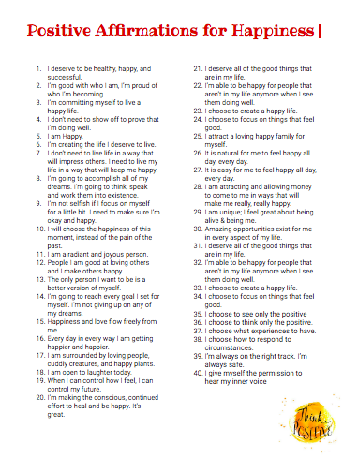
Recipe for a Happy Heart

Slide 15
Love takes time to grow
Accept who you are right now
Forgive yourself for mistakes
Make a list of accomplishments and future goals
Challenge yourself outside your comfort zone
Take care of yourself
Do not compare yourself to others
Notes:
It is so easy to focus on your faults and everyone can dwell on their insecurities instead of the things about themselves that they are happy with. Doing this can cause you to dislike yourself. You may also be too busy focusing on others around you and not focusing on loving yourself. Some people don’t want to be alone and fear to do things on their own. This can really hinder your journey to self-love, as you have to learn to be comfortable being with yourself.

Slide 16
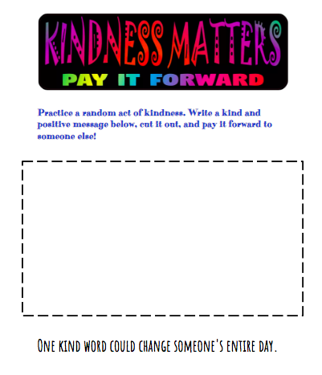
KINDNESS MATTERS PAY IT FORWARD

Slide 17
