Slide 1
Eating Disorders 101
www.NationalEatingDisorders.org
Helpline: 800-931-2237 Business Line: 212-575-6200
Notes:
Welcome to Eating Disorders 101. Thank you for attending!
This presentation will cover the causes, warning signs, symptoms, health consequences, and treatment information for eating disorders.
This slide deck was put together by the National Eating Disorders Association. If you have questions, visit their website at www.nationaleatingdisorders.org.
Some of the topics we’ll be covering may be difficult to hear about; please feel free to take a break at any time.

Slide 2
What Are Eating Disorders?
Real, life-threatening illnesses with potentially fatal consequences.
Involve extreme emotions, attitudes, and behaviors surrounding weight, food, and size.
Caused by a range of biological, psychological, and sociocultural factors
Notes:
There is a false belief that most people with eating disorders are privileged young white women. While eating disorders do affect young women, they also affect men, transgender people, people of color, older people, young children, people with disabilities, and people from every walk of life. Stereotyping eating disorders as exclusive to one group is a disservice to the diverse group of people who are affected by eating disorders, and perpetuates a stigma that prevents people from getting help.
Sources:
Hudson JI, Hiripi E, Pope HG Jr, and Kessler RC. (2007). The prevalence and correlates of eating disorders in the National Comorbidity Survey Replication. Biological Psychiatry, 61(3):348-58.

Slide 3
Who Do Eating Disorders Affect?
Everyone. People of all genders, ages, races, religions, ethnicities, and sexual orientations can be affected.
As many as 20 million women and 10 million men will struggle with an eating disorder at some point in their lives.
Notes:
There is a false belief that most people with eating disorders are privileged young white women. While eating disorders do affect young women, they also affect men, transgender people, people of color, older people, young children, people with disabilities, and people from every walk of life. Stereotyping eating disorders as exclusive to one group is a disservice to the diverse group of people who are affected by eating disorders, and perpetuates a stigma that prevents people from getting help.
Sources:
Hudson JI, Hiripi E, Pope HG Jr, and Kessler RC. (2007). The prevalence and correlates of eating disorders in the National Comorbidity Survey Replication. Biological Psychiatry, 61(3):348-58.

Slide 4
Biopsychosocial Disorders
Biological Factors:
Family history
History of dieting
Type One (Insulin-dependent) Diabetes
Genetic predisposition
Psychological Factors:
Low self esteem
Relationship with self
Feelings of inadequacy
Depression, anxiety, fear, or loneliness
Social Factors:
Cultural norms that overvalue appearance
Body dissatisfaction
Drive for perceived ideal body type
Historical trauma
Weight stigma/bullying
Notes:
Eating disorders are complex, bio-psycho-social conditions, with multiple causes. Eating disorders arise from a combination of established social, psychological, biological, and interpersonal factors. While they may begin with preoccupations with food and weight, they are most often about much more than food. It is important to understand that the factors that contribute to eating disorders are complex and multifaceted; they are not simply about weight and they are certainly not choices.

Slide 5
The 9 Truths About Eating Disorders
1. Many people with eating disorders look healthy, yet may be extremely ill.
2. Families are not to blame, and can be the patients’ and providers’ best allies in treatment.
3. An eating disorder diagnosis is a health crisis that disrupts personal and family functioning.
Notes:
While there are varying opinions about eating disorders, the field has agreed upon 9 truths that they want the public to know.
Sources:
Produced in collaboration with Dr. Cynthia Bulik, PhD, FAED and the Academy for Eating Disorders, along with other major eating disorder organizations (Families Empowered and Supporting Treatment of Eating Disorders, National Association of Anorexia Nervosa and Associated Disorders, National Eating Disorders Association, The International Association of Eating Disorders Professionals Foundation, Residential Eating Disorders Consortium, Eating Disorders Coalition for Research, Policy & Action, Multi-Service Eating Disorders Association, Binge Eating Disorder Association, Eating Disorder Parent Support Group, International Eating Disorder Action, Project HEAL, and Trans Folx Fighting Eating Disorders).
Learn more and download a PDF of the 9 Truths about Eating Disorders.

Slide 6
The 9 Truths About Eating Disorders
4. Eating disorders are not choices, but serious biologically influenced illnesses.
5. Eating disorders affect people of all genders, ages, races, ethnicities, body shapes and weights, sexual orientations, and socioeconomic statuses.
6. Eating disorders carry an increased risk for both suicide and medical complications.

Slide 7
The 9 Truths About Eating Disorders
7. Genes and environment play important roles in the development of eating disorders.
8. Genes alone do not predict who will develop eating disorders.
9. Full recovery from an eating disorder is possible. Early detection and intervention are important.

Slide 8
WARNING SIGNS, SYMPTOMS, & HEALTH CONSEQUENCES
An Overview to Eating Disorders

Slide 9
Common Warning Signs
EMOTIONAL/BEHAVIORAL
PHYSICAL
Weight loss, dieting, and control of food are primary concerns
Food rituals
Social withdrawal
Frequent dieting, body checking
Extreme mood swings
Noticeable weight fluctuations
Gastrointestinal complaints
Dizziness upon standing
Difficulty concentrating, sleeping
Issues with dental, skin, hair, and nail health
Notes:
The above list describes some of the general warning signs of an eating disorder. Detecting an eating disorder can be tricky, and a big indicator can be noticeable change in a person’s attitudes towards food and their body. While there are more specific signs depending on diagnosis, not everyone fits neatly into these categories. All eating concerns deserve immediate attention.

Slide 10
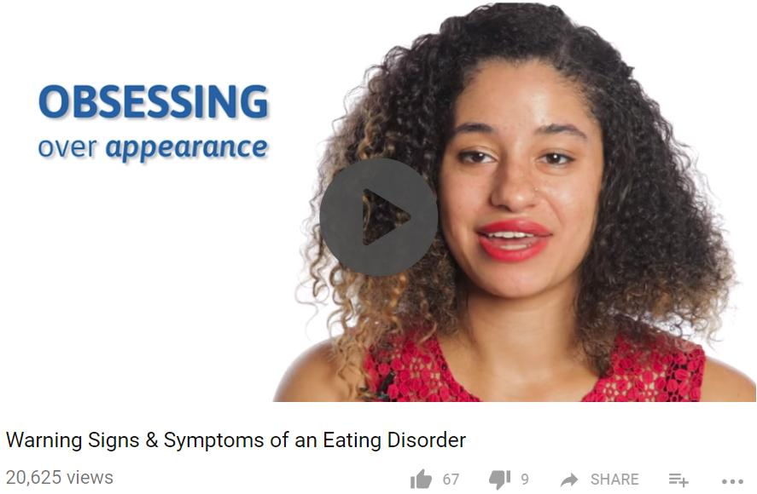
Warning Signs & Symptoms
https://www.youtube.com/watch?time_continue=133&v=nJMtReAg1DI

Slide 11
DSM-5 Diagnoses
Anorexia Nervosa (AN)
Bulimia Nervosa (BN)
Binge Eating Disorder (BED)
Avoidant-Restrictive Food Intake Disorder (ARFID)
Other Specified Feeding or Eating Disorder (OSFED)
Eating disorders are complex and some eating issues will not meet diagnostic criteria. All must be taken seriously.
Notes:
The term eating disorders covers a variety of conditions. What they all have in common is that they involve extreme emotions, attitudes, and behaviors surrounding weight, food, and size.
Eating disorders are rooted in uniquely low self-esteem and disruption in one’s relationship with self.
Eating disorders are extremely serious and potentially life-threatening. They have both emotional and physical effects, and they can affect anyone, regardless of gender, age, race, or any other descriptor.
The eating disorders we will be talking about are anorexia, bulimia, binge eating disorder, avoidant-restrictive food intake disorder, and other specified feeding or eating disorder. Please keep in mind that this list is not exhaustive, and many of these conditions have variations, such as atypical anorexia. We won’t be able to cover every eating disorder but we do encourage you to look into them further; you can visit the NEDA website for more information.

Slide 12
Anorexia Nervosa (AN)
Characterized primarily by self-starvation and excessive weight loss
Symptoms include:
Inadequate food intake leading to a weight that is clearly too low
Disturbance in the experience of body weight or shape
Intense fear of weight gain, obsession with weight, and persistent behavior to prevent weight gain
Inability to appreciate the severity of the situation
Notes:
Anorexia nervosa is likely the best-known eating disorder. It is primarily characterized by self-starvation.
The primary symptoms include inadequate food intake, a disturbance in the experience of body weight or shape, intense fear of weight gain, and an inability to appreciate the severity of the situation.
Warning signs of AN: Familiarity with eating disorder warning signs is vital to early intervention.
Dramatic weight loss
Preoccupation with weight, food, calories, and dieting
Refusal to eat certain foods, progressing to restrictions against whole categories of food
Consistent excuses to avoid mealtimes or situations involving food
Withdrawal from usual friends and activities
Inappropriate and/or extreme exercise
Health consequences of AN: In anorexia nervosa, the cycle of self-starvation denies the body of essential nutrients it needs to function properly. The body is therefore forced to slow down all of its processes to conserve energy, resulting in serious medical consequences.
Dry hair, hair loss
Fainting and fatigue
Muscle loss, overall weakness
Abnormally low heart rate, low blood pressure, risk of heart failure
Severe dehydration, kidney failure
Osteoporosis or osteopenia (reduction in bone density)

Slide 13
Bulimia Nervosa (BN)
Characterized by binge eating and compensatory behaviors, such as self-induced vomiting, in an attempt to undo the effects of binge eating.
Symptoms include:
Frequent episodes of consuming very large amounts of food followed by behaviors to prevent weight gain, such as vomiting, laxative abuse, and excessive exercise
Feeling of being out of control during the binge-eating episodes
Extreme concern with body weight and shape
Most people are of a normal weight
Notes:
Bulimia is primarily characterized by binge eating and compensatory behaviors. Compensatory behaviors include anything meant to reverse the effects of the binge, such as vomiting, laxative abuse, and excessive exercise. Concern with body weight and shape and feeling out of control during the binges are also symptoms. Most people struggling with bulimia appear to be of an average weight. It’s important to keep in mind that you cannot tell if someone is struggling with an eating disorder based on weight alone.
Warning signs of BN:
Frequent trips to bathroom after meals
Excessive, rigid exercise regimen; compulsive need to “burn off” calories taken in
Discoloration or staining of the teeth
Withdrawal from usual friends and activities
Continued exercise despite injury
Calluses on the back of hands and knuckles from self-induced vomiting
Health consequences of BN: The recurrent binge-and-purge cycles of bulimia nervosa can affect the entire digestive system and lead to electrolyte and chemical imbalances in the body that affect the heart and other major organ's functionality. One health consequence of bulimia nervosa is electrolyte imbalance leading to an irregular heartbeat and possible heart failure and death. These imbalances are caused by dehydration and loss of potassium, sodium, and chloride from the body as a result of purging behaviors. Other potential health consequences are gastric rupture during periods of binging, inflammation and possible rupture of the esophagus from frequent vomiting, tooth decay and staining from the stomach acids released during vomiting, chronic irregular bowel movements and constipation as a result of laxative abuse, and calluses on hands and knuckles from self-induced vomiting.

Slide 14
Binge Eating Disorder (BED)
Characterized by recurrent binge eating without the regular use of compensatory measures to counter the binge eating.
Symptoms include:
Indications that the binge eating is out of control, such as eating when not hungry, eating to the point of discomfort, or eating alone because of shame about the behavior
Feelings of strong shame or guilt regarding the binge eating
Notes:
Binge eating disorder, or BED, is characterized by sessions of binge eating. It differs from bulimia in that there is no compensatory behavior like purging. An important component of BED is that the person feels out of control during the binge, and distressed following it. BED is the most common eating disorder in the United States, and it’s often misunderstood as just overeating. It’s important to know that BED is not a choice, and it has a significant psychological impact on the person suffering.
A person struggling with BED can be of any weight or size, and you cannot tell if someone has BED just by looking at them. There is a correlation between BED and weight gain, and many of the physical effects of BED are similar to those of obesity. Still, it is important to remember that we are built differently based on a variety of factors. Our society perceives “thinness” as a positive quality, stigmatizing those who are not perceived as having the right body shape. Challenging this perception is an important step in creating a more inclusive culture.
Warning signs of BED:
Secretive about eating or binge episodes
Repeated episodes of dieting or attempts at weight loss
Large amounts of food may be missing from pantry or found in trash
Larger than normal amounts of money spent on food
Secret stashes of food or empty wrappers
Health consequences of BED:
Musculoskeletal problems
Gallbladder disease
High blood pressure; high cholesterol; heart disease
Type II diabetes

Slide 15
Avoidant-Restrictive Food Intake Disorder (ARFID)
Characterized by lack of interest in food, fears of negative consequences of eating, and selective or picky eating.
Symptoms include:
Reduced food intake and frequent complaints of bodily discomfort with no apparent cause
Lack of appetite or interest in food, with a range of preferred foods narrowing over time
Notes:
Avoidant-restrictive food intake disorder (ARFID) is an eating disorder that can appear as extremely picky eating. Those struggling may demonstrate a lack of interest in food and experience unexplained bodily discomfort. The limited range of “acceptable” foods narrows over time.
Warning signs of ARFID:
Restricted or reduced food intake
Frequent complaints about bodily discomfort with no organic cause
Lack of appetite or interest in food
Fear of negative effects of eating food (e.g., choking, vomiting)
Inability or reluctance to eat in front of others
Picky eating that is unresolved by late childhood
Health consequences of ARFID: Food restriction and lack of variety associated with ARFID may lead to severe nutritional deficiencies. Some of the potential health consequences of ARFID may include failure to thrive, which means not meeting expected levels of growth, anemia, weight loss, gallbladder disease, and malnutrition, characterized by dry hair, hair loss, brittle nails, difficulty concentrating, and Osteoporosis or osteopenia (reduction in bone density).

Slide 16
Other Specified Feeding or Eating Disorder (OSFED)
A feeding or eating disorder that causes significant distress or impairment, but does not meet the criteria for another feeding or eating disorder.
Atypical Anorexia Nervosa: criteria for AN met but weight is not below normal
Subthreshold Bulimia Nervosa: criteria for BN met but with less frequent occurrences
Subthreshold Binge Eating Disorder: criteria for BED met but occurs at a lower frequency
Purging Disorder: purging without binge eating
Night Eating Syndrome: excessive nighttime food consumption
Notes:
Other specified feeding or eating disorder (OSFED) is a broad category. It includes conditions that do not meet the criteria for anorexia, bulimia, etc., but still cause significant distress. For example, in atypical anorexia nervosa all of the criteria for anorexia is met, but the patient’s weight is not below normal. The self-starvation and disordered thinking are psychologically and physically destructive and must still be addressed. It is important that OSFED is recognized on par with other eating disorders, and that its seriousness is not underestimated.
Warning signs and health consequences of OSFED: Warning signs and health consequences of OSFED are more difficult to pinpoint, as it includes a number of conditions. Watch out for all of the signs already listed. The most important thing to look out for is attitudes about food and weight that conflict with a productive and satisfying life.
Preoccupation with weight but not as consistent as found in AN, BN, BED
Increased isolation, depression, or irritability
Compulsive or obsessive exercising

Slide 17
Co-Occurring Disorders
High prevalence rates
Can intensify eating disorders symptoms and impact treatment (recovery, level of care, drop-out)
Most common comorbidities:
Mood disorders
Anxiety disorders
Substance abuse
Treatment should address co-existing conditions and eating disorders
Notes:
Many of those who struggle with eating disorders have a co-occurring condition, such as anxiety, substance abuse, obsessive-compulsive disorder, depression, or post-traumatic stress disorder. All conditions should be identified and treated by someone with expertise in both eating disorders and any co-occurring conditions.
-Up to 50% of individuals with eating disorders abused alcohol or illicit drugs, a rate five times higher than the general population. (National Center on Addiction & Substance Abuse)
-Depression and other mood disorders co-occur with eating disorders quite frequently. (Mangweth et al., 2003 & McElroy et al., 2006)
-Up to 69% of patients with anorexia and 33% of patients with bulimia have a coexisting diagnosis of obsessive-compulsive disorder. (National Center on Addiction and Substance Abuse)

Slide 18
Health Consequences
Cardiovascular (muscle loss, low or irregular heartbeat)
Gastrointestinal (bloating, nausea, constipation)
Neurological (difficulty concentrating, sleep apnea)
Endocrine (hormonal changes – estrogen, testosterone, thyroid)
Notes:
Eating disorders can affect every organ system in the body. The body is generally resilient at coping with the stress of eating disordered behaviors, and laboratory tests can generally appear perfect even as someone is at high risk of dying. Electrolyte imbalances can kill without warning; so can cardiac arrest. Therefore, it’s incredibly important to understand the many ways that eating disorders affect the body.
Cardiovascular system
Muscle loss due to calorie restriction
Risk of heart failure as blood pressure and heart rate drop
For physicians, the slow pulse of an athlete (due to a strong, healthy heart) can be confused with the slow pulse of an eating disorder (due to malnourishment).
Electrolyte imbalance can lead to an irregular heartbeat and possibly heart failure and death. The electrolyte potassium plays an important role in helping the heart beat and muscles contract, but is often depleted by purging.
Gastrointestinal system
Slowed digestion known as gastroparesis. Food restriction and/or purging by vomiting interferes with normal stomach emptying and the digestion of nutrients, which can lead to:
Stomach pain and bloating
Nausea and vomiting
Blood sugar fluctuations
Blocked intestines from solid masses of undigested food
Bacterial infections
Feeling full after eating only small amounts of food
Constipation, which can have several causes:
Inadequate nutritional intake, which means there’s not enough in the intestines for the body to try and eliminate
Long-term inadequate nutrition can weaken the muscles of the intestines and leave them without the strength to propel digested food out of the body
Laxative abuse can damage nerve endings and leave the body dependent on them to have a bowel movement
Binge eating can cause the stomach to rupture, creating a life-threatening emergency.
Vomiting can wear down the esophagus and cause it to rupture, creating a life-threatening emergency.
Frequent vomiting can also cause sore throats and a hoarse voice.
When someone makes themselves vomit over a long period of time, their salivary (parotid) glands under the jaw and in front of the ears can get swollen. This can also happen when a person stops vomiting.
Both malnutrition and purging can cause pancreatitis, an inflammation of the pancreas. Symptoms include pain, nausea, and vomiting.
Neurological
The brain consumes up to one-fifth of the body’s calories. Dieting, fasting, self-starvation, and/or erratic eating means the brain isn’t getting the energy it needs, which can lead to obsessing about food and difficulties concentrating.
Extreme hunger or fullness at bedtime can create difficulties falling or staying asleep.
The body’s neurons require an insulating, protective layer of lipids to be able to conduct electricity. Inadequate fat intake can damage this protective layer, causing numbness and tingling in hands, feet, and other extremities.
Neurons use electrolytes (potassium, sodium, chloride, and calcium) to send electrical and chemical signals in the brain and body. Severe dehydration and electrolyte imbalances can lead to seizures and muscle cramps.
If the brain and blood vessels can’t push enough blood to the brain, it can cause fainting or dizziness, especially upon standing.
Individuals of higher body weights are at increased risk of sleep apnea, a disorder in which a person regularly stops breathing while asleep.
Endocrine
Many hormones needed by the body are made with fat and cholesterol we eat. Without enough fat and calories in the diet, levels of hormones can fall, including:
Sex hormones estrogen and testosterone
Thyroid hormones
Lowered sex hormones can cause menstruation to fail to begin, to become irregular, or to stop completely. This can significantly increase bone loss (known as osteopenia and osteoporosis) and the risk of broken bones and fractures.
Reduced resting metabolic rate, a result of the body’s attempts to conserve energy.
Over time, binge eating can potentially increase the chances that a person’s body will become resistant to insulin, a hormone that lets the body get energy from carbohydrates. This can lead to type 2 diabetes.
Without enough energy to fuel its metabolic fire, core body temperature will drop and hypothermia may develop.
Starvation can cause high cholesterol levels, although this is NOT an indication to restrict dietary fats, lipids, and/or cholesterol.
Other
Low caloric and fat consumption can cause dry skin, and hair to become brittle and fall out.
To conserve warmth during periods of starvation, the body will grow fine, downy hair called lanugo.
Severe, prolonged dehydration can lead to kidney failure.
Inadequate nutrition can decrease the number of certain types of blood cells.
Anemia develops when there are too few red blood cells or too little iron in the diet. Symptoms include fatigue, weakness, and shortness of breath.
Malnutrition can also decrease infection-fighting white blood cells.
Sources:
Brown, CA and Mehler, PS. Medical complications of self-induced vomiting. Eating Disorders. 2013;21(4):287-94.
Brown, CA and Mehler, PS. Successful “Detoxing” From Commonly Utilized Modes of Purging in Bulimia Nervosa. Eating Disorders. 2012; 20(4): 312-20.
Mehler, PS and AE Anderson. Eating Disorders. Baltimore: Johns Hopkins UP, 2010. Print.
Mitchell, J. E., & Crow, S. (2006). Medical complications of anorexia nervosa and bulimia nervosa. Current Opinion in Psychiatry, 19(4), 438-443

Slide 19
Serious, Potentially Fatal Illnesses
A review of nearly fifty years of research confirms that AN has the highest mortality rate of any psychiatric disorder.
Risk of death from suicide or medical complications is markedly increased for individuals with eating disorders.
A study on BN and EDNOS found elevated mortality risks similar to those for AN.
Notes:
Eating disorders have the highest mortality rate of any mental illness—anorexia has a particularly high mortality rate. The numbers underscore that eating disorders must be treated as serious illnesses. People can and do recover; acknowledging the seriousness of eating disorders and the importance of recovery can be a first step in that process. While the death rate varies by study, research analysis underscores the severity and public health significance of all types of eating disorders.
Crow and colleagues studied 1,885 individuals with anorexia nervosa (N=177), bulimia nervosa (N=906), or eating disorder not otherwise specified (N=802) over 8 to 25 years.
The investigators used computerized record linkage to the National Death Index, which provides vital status information for the entire United States, including cause of death extracted from death certificates.
Crow and colleagues found that crude mortality rates were 4.0% for anorexia nervosa, 3.9% for bulimia nervosa, and 5.2% for eating disorder not otherwise specified.
Sources:
Arcelus, J., Mitchell, A.J., Wales, J., & Nielsen, S. (2011). Mortality Rates in Patients with Anorexia Nervosa and Other Eating Disorders. Archives of General Psychiatry, 68(7), 724–731.
Crow, SJ., Peterson, CB., Swanson, SA., Raymond, NC., Speckers, S., Eckert, ED., Mitchell, JE. (2009) Increased mortality in bulimia nervosa and other eating disorders. American Journal of Psychiatry, 166(12), 1342-1346.

Slide 20
SEEKING TREATMENT
Help is Available!

Slide 21
Serious, Life-Threatening, & Treatable
Eating disorders are not fads or phases, and they have the highest mortality rate of any psychiatric disorder.
Serious effects on health, productivity, and relationships
Early intervention increases likelihood of a full recovery.
Notes:
Eating disorders have the highest mortality rate of any mental illness.
While the seriousness of eating disorders should not be underestimated, eating disorders are not hopeless. Treatment is available and recovery is possible. Early intervention is vital; the earlier a person seeks treatment, the greater the likelihood of physical and emotional recovery. Detecting and treating eating disorders as soon as possible can save lives.
Help is available!
Various online resources are playing an important role in helping to those who are aware of their eating disorder, as well as identifying those who may not be aware they have an eating disorder or may be at risk.

Slide 22
Eating Disorders Treatment
Intervention
Ongoing Support
Recovery
Professional Treatment
Notes:
Eating disorder treatment and recovery involves intervention, professional treatment, and ongoing support.
Early diagnosis and intervention significantly enhance recovery.
Following intervention, professional treatment should be the first step; eating disorders require the care of a trained professional with expertise in the treatment of eating disorders.
Ongoing support from friends and family is vital. These are complex illnesses, and compassionate support throughout the treatment process is essential.
Remember that recovery is not a straight line, and everyone’s path will be different—one step forward and one step back is not unusual. Keep striving towards and respecting the recovery process.
Although more research in the field of eating disorders is needed, various evidenced-based treatment options are available.

Slide 23
Individualized Care
TREATMENT PROCESS
Initial assessment/diagnosis
Interview providers
Communicate with all involved
Develop a maintenance plan
Notes:
There is no one-size-fits-all path to treatment. Many parents find that meeting with a medical professional is a positive first step in determining what’s best for their family. They’ll want to identify both the type of treatment and the level of care that are appropriate. Because eating disorders have such wide-ranging effects on the brain and body, a team of treatment professionals is usually best. It’s important to communicate openly with everyone involved in treatment, particularly when moving from a more intensive type of treatment to a less restrictive one (e.g., leaving residential for outpatient treatment), and when developing an ongoing maintenance plan.
Initial assessment/diagnosis:
Meet with a medical professional.
Review different treatment modalities and approaches.
Determine level of care needed.
Interview providers:
Find the best fit for individual’s needs.
Recommended treatment involves a multidisciplinary team of professionals (e.g., therapist, nutritionist, psychiatrist, physician).
Communicate with all involved:
Connect with your insurance provider regarding coverage.
Read your full insurance policy in advance.
Communicate with the treatment team about how best to support your loved one.
Develop a maintenance plan:
Coordinate with treatment team to ensure ongoing treatment plan, particularly after stepping down care (e.g., leaving inpatient).
Support from loved ones is beneficial to sustaining recovery.

Slide 24
Levels of Care
Inpatient
Residential
Partial hospitalization
Intensive outpatient
Outpatient
Notes:
Only a treatment professional can determine which level of care is appropriate for someone just beginning treatment. Determining the appropriate level of care takes into consideration the patient’s medical and psychological states.
Inpatient:
Patient is medically unstable (unstable/depressed vital signs, acute health risk, complicating co-occurring conditions)
Patient is psychiatrically unstable (rapidly worsening symptoms, suicidal)
Residential:
Patient is medically stable and requires no intensive medical intervention
Patient is psychiatrically impaired and unable to respond to partial hospital or outpatient treatment
Partial hospitalization:
Medically stable with impaired functioning (no immediate risk)
Needs daily assessment of physiologic and mental status
Psychiatrically stable but unable to function in normal situations
May engage in daily binge eating, purging, restricting, or other weight control techniques
Intensive outpatient/outpatient:
Patient is medically stable and no longer needs daily medical monitoring
Patient is psychiatrically stable, able to function in normal situations, and make progress towards recovery

Slide 25
SUPPORT & RESOURCES
Where to Find Help

Slide 26
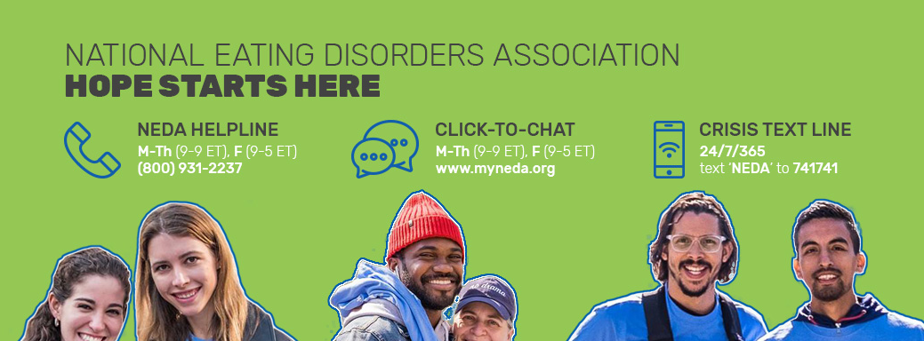
Contact the NEDA Helpline by phone or click-chat Mon-Thurs 9-9, Fri 9-5 EST
24/7 crisis support: text “NEDA” to 741741

Slide 27
Eating Disorder Screening Tool
96% of participants identified as at-risk
100,000 screenings taken since February 2017
Quick access to help
Notes:
Through NEDA’s Online Screening Tool for eating disorders, over 100,000 people participated and of that 100,000, 70% were under the age of 25.
96% of all participants were identified as at risk for an eating disorder, but 86% of them at risk were not in treatment.
Additionally, with over 24,000 calls, texts, emails, and messages to our Information and Referral Helpline, 67% of those contacting NEDA were under the age of 25 years old
1 in 5 of these Helpline contacts who were looking for treatment options reported barriers to accessing care (fear of reaching out, cost of care, etc).
Participants who screen as “at risk” with be directed to NEDA’s Helpline and other resources to help

Slide 28
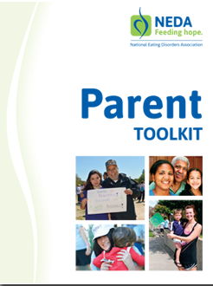
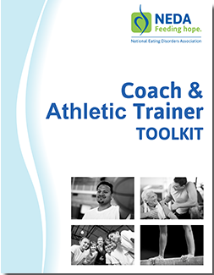
NEDA Toolkits

Slide 29
How to Help
DO:
DON’T:
Learn as much as you can about eating disorders
Be honest and vocal about your concerns
Be caring and firm
Suggest they seek help from a physician an/or therapist
Be a good role model, practice what you preach
Place shame, blame, or guilt
Make rules or promises that you cannot or will not uphold
Give simple solutions
Invalidate their experience or try to convince
Give advice about weight, exercise, or appearance
Ignore or avoid the situation until it is severe or life-threatening
Notes:
If your student is struggling with an eating disorder, education is the first step.
NEDA’s Educator Toolkit (www.myneda.org/educator-toolkit) includes extensive information for those who are concerned about a student.

Slide 30
How to Help a Loved One
https://www.youtube.com/watch?v=fX1CFDtdgbY

Slide 31
Talking about Eating Disorders
KEEP IN MIND:
Don’t provide tips or play the numbers game.
Emphasize the seriousness of eating disorders without portraying them as hopeless.
Watch out for the appearance ideal.
Don't focus on images or descriptions of the body at its unhealthiest point.
Notes:
When eating disorders come up—whether you’re giving a presentation or just chatting with a friend—keep in mind a few guidelines to make sure you’re discussing them responsibly:
Don’t emphasize numbers or tips: “He took as many as X laxatives a day” can turn a well-intentioned story into a how-to guide.
Watch out for the appearance ideal, such as a societal or cultural focus on having a certain body type. Eating disorders are mental illnesses; they are not glamorous.
Emphasize the seriousness of eating disorders without portraying them as hopeless: Recovery can be a long, hard process, but it’s always worth it. Always encourage people to seek help for themselves or their loved ones.
Don’t focus on graphic images or descriptions of the body at its unhealthiest point: “At her lowest weight, she was only X pounds” could be interpreted as a challenge (“She’s X pounds and she’s still alive…I should lose more weight.”). Overemphasizing the physical aspects of eating disorders may also overshadow the fact that they are mental illnesses.

Slide 32
The Body Project
Train-the-trainer model
300+ trained in 27 states
Repeatedly shown to effectively reduce body dissatisfaction, negative mood, unhealthy dieting, and disordered eating
Notes:
The Body Project is a evidence-based intervention program that provides a forum for women and girls to confront unrealistic beauty ideals and engages them in the development of healthy body image.
Over a four-week period, participants critique the beauty-ideal standard of female beauty in a series of verbal, written, and behavioral exercises. The program improves negative body image, reduces maladaptive dietary restraint, and reduced early stage eating disorder symptoms.
The Body Project is also only one of two programs that have been found to reduce the onset of eating disorders.
Data suggests that for every 100 high-risk young women who complete the Body Project intervention, there should be approximately nine fewer future cases of eating disorders (Stice, Marti, Spoor, Presnell, & Shaw, 2008)

Slide 33
The Body Project
“Now that I have done the Body Project, I have noticed that I see my body more positively now and I stay away from negative comments. I am also doing this with my family members and staff around me.”

Slide 34
Get Involved With NEDA!
To learn more, contact:
Business: (212) 575-6200
NEDA Helpline: (800) 931-2237
www.myneda.org/helplinechat
Email: info@myneda.org

