Slide 1
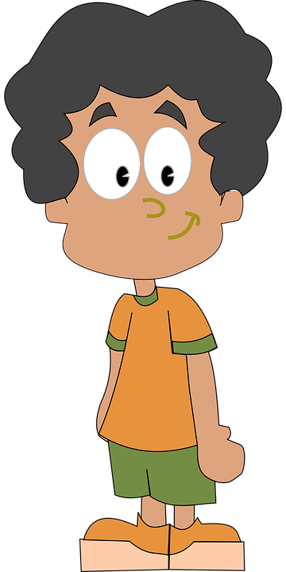
All About Me
Tobacco
Let’s Learn About Health!
4th Grade

Slide 2
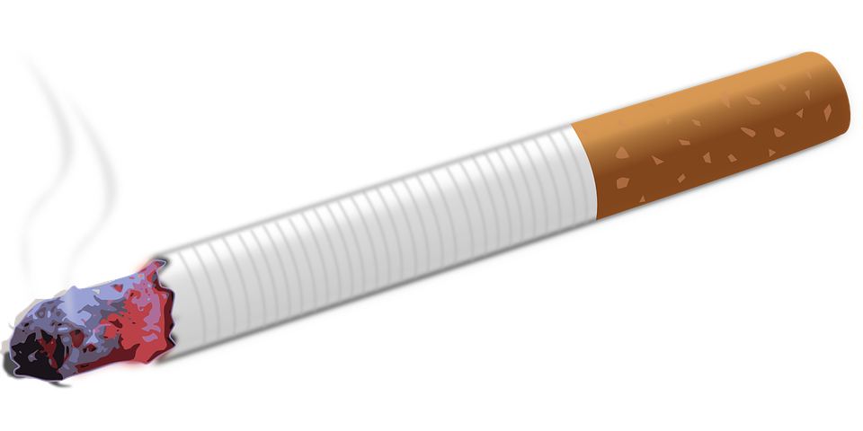
Tobacco

Slide 3
Read, Reflect, Discuss
Why would someone smoke a cigarette?
Why would someone say no to smoking a cigarette?

Slide 4
What Should I do?
I’m at my best friend Tia’s house. Her parents smoke, so we normally spend most of our time outside playing. I’ve never smoked a cigarette before, but I’ve seen older kids smoking around my neighborhood. I wonder what it tastes like or how it feels to smoke. It would be really easy for Tia and me to take two from her parents without them noticing.
What should I do?
Is it that big of a deal if I just try it?

Slide 5
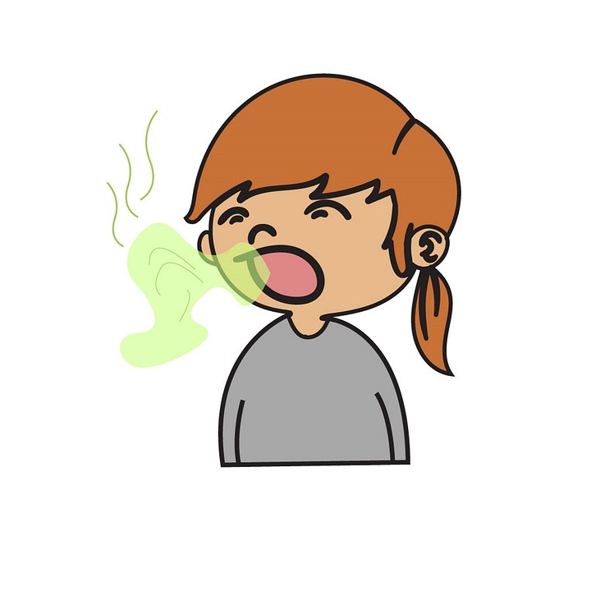
Short-term Consequences
Addiction
Shortness of breath
Impaired lung growth and function
Bad breath
Yellow teeth
Stained fingers
Foul-smelling clothes and hair

Slide 6
Long-term Consequences
Addiction
Cancer: Lung, mouth, throat, kidney, and stomach
Heart disease
Impaired immune system
Emphysema and other chronic diseases
Shorter lifespan (up to 20 years shorter)

Slide 7
Responding to Peer Pressure
https://www.youtube.com/watch?v=-4EjPLTEOIM

Slide 8
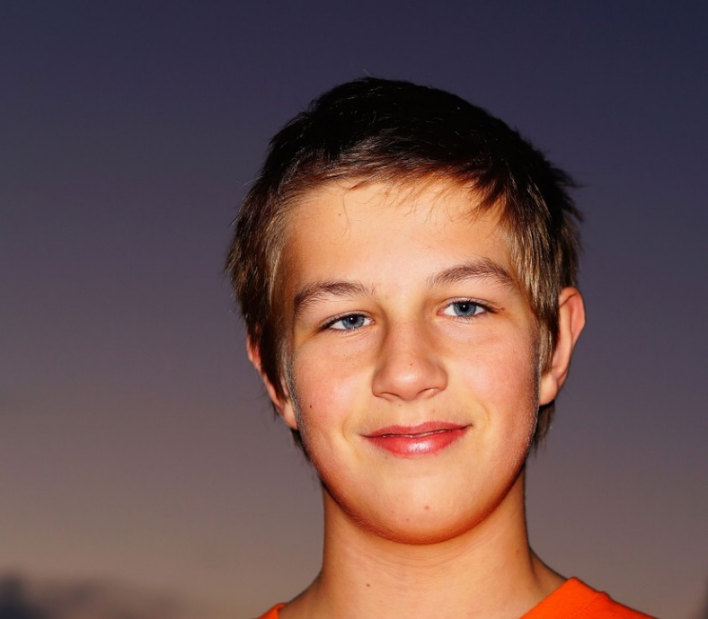
What Should I do?
On Saturdays, a group of my friends like to meet at the neighborhood basketball court to play. Sometimes older boys join us. Today, Devon brought a cigarette for us to try. I’m guessing he took it from his dad. I don’t want to smoke, but all the others seem interested. The cigarette is being passed, and I’m next...
What should I say or do?

Slide 9
How to Say “NO”
1. Self Statement: I don’t …
2. Give a Reason: No because…
3. Give a Consequence: If I do that, then _____ will happen
4. Give an Alternative: Let’s _______________ instead.
5. Reverse the Pressure: Why would you want to_______
6. Change the Subject: Did you hear ______’s new song?
7. Delay: I can’t. I have to____________________________.
8. Use Strength in Numbers: None of us want to _________.
Let’s Practice with a partner using an assertive voice…
“Here have a cigarette.”
“It’s fun. Just try it.”
“One smoke won’t hurt you and your parents won’t find out.”
What if the person continues to ask and you feel uncomfortable. What can you do?

Slide 10
Let’s Practice...
“Stop being scared and just smoke it.”

Slide 11
Let’s Practice...
“You are the only one not smoking. You should just try it.”

Slide 12
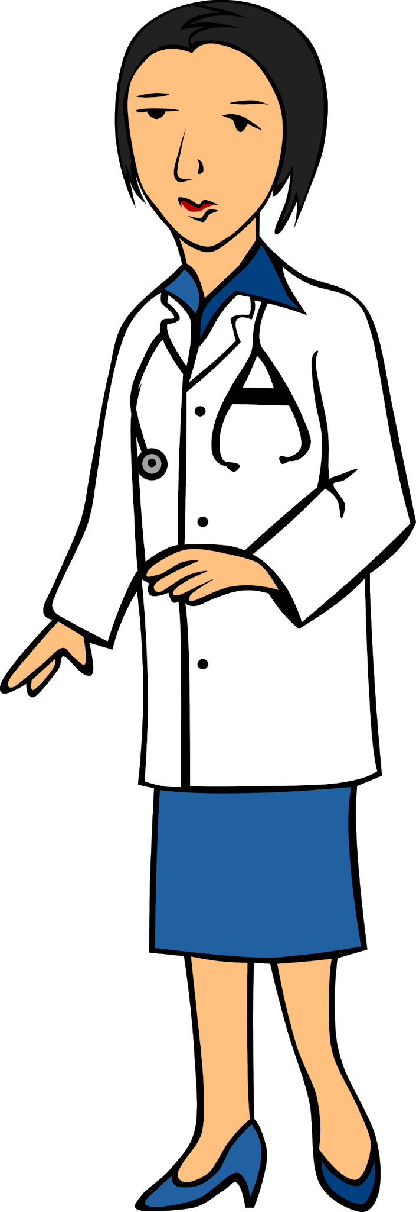
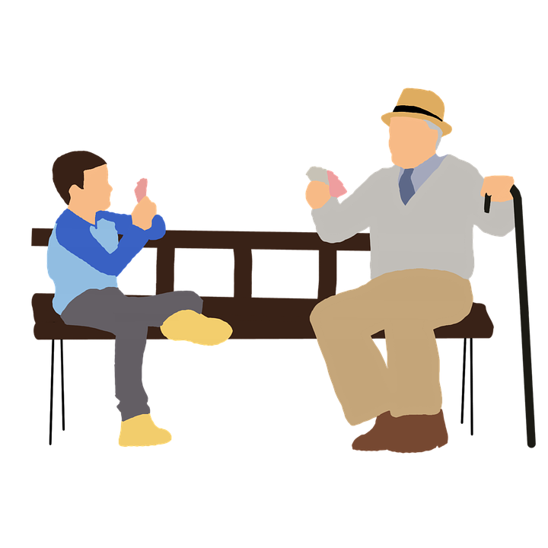
Who can I talk to?
Who are the trusted adults in your life?
If you have questions about tobacco...

Slide 13
How to Say “NO”
1. Self Statement: I don’t …
2. Give a Reason: No because…
3. Give a Consequence: If I do that, then _____ will happen
4. Give an Alternative: Let’s _______________ instead.
5. Reverse the Pressure: Why would you want to_______
6. Change the Subject: Did you hear ______’s new song?
7. Delay: I can’t. I have to____________________________.
8. Use Strength in Numbers: None of us want to _________.

Slide 14
Let’s Move!
https://www.youtube.com/watch?v=_MfYYr_TBkQ

Slide 15
The End
Take Care of Your Health!

