Slide 1
JUULs Not Cool
Health Concerns, Health Behavior & You

Slide 3
Questions to Consider
How many high school students do you think vape (or use E-cigs) across the country and/or in the state of Virginia?
Why do you think some teens start vaping?
Why is vaping hard to stop?
What are some of the health concerns with vaping?

Slide 4
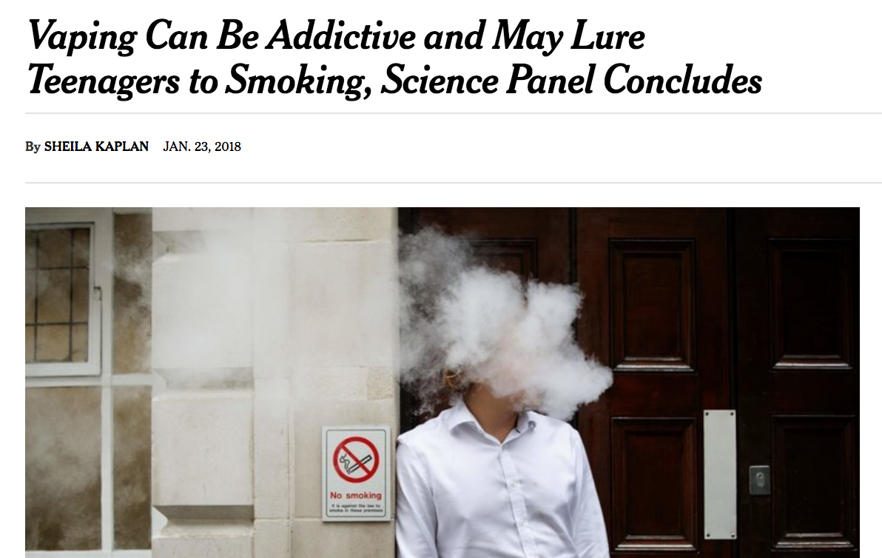

Slide 6
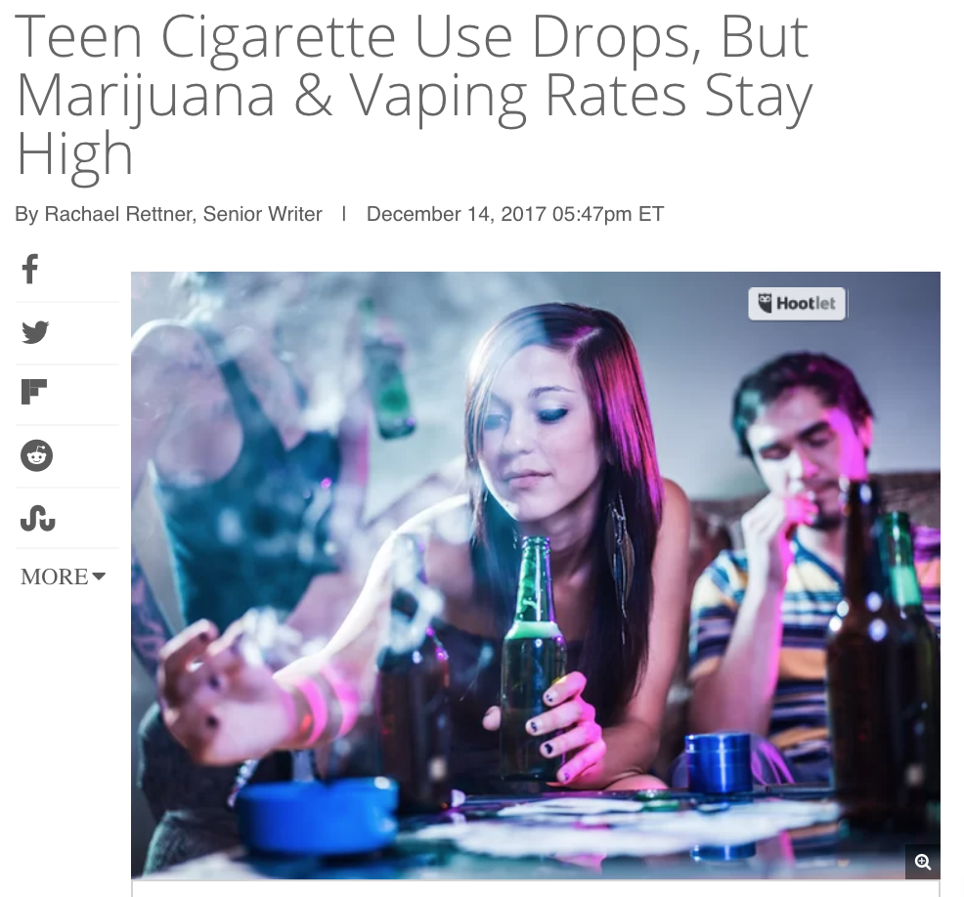

Slide 7
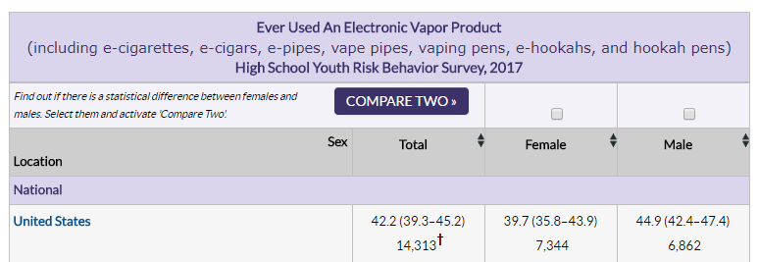

Slide 8
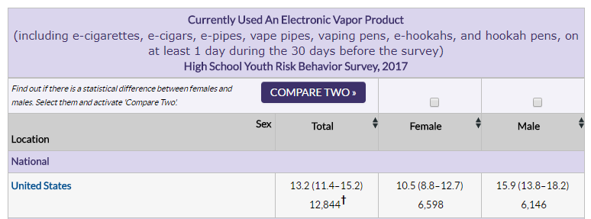

Slide 9
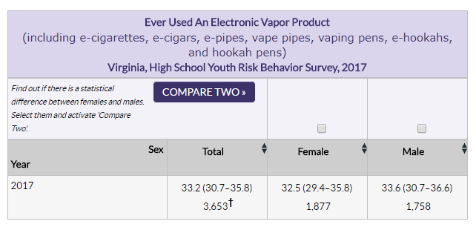

Slide 10
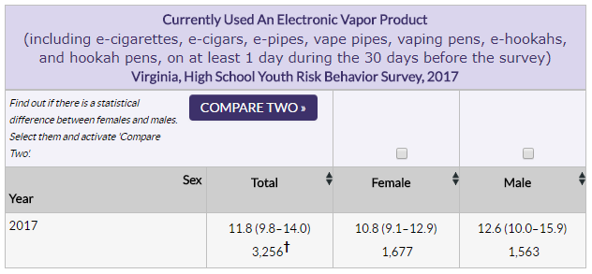

Slide 12
Vaping - Key Takeaways
Know how PERCEPTION can influence Health Behavior. Perception vaping is a safer alternative to smoking
The availability and appeal of using e-cigs as an alternative to smoking cigarettes has been growing quickly
E-cigs are promoted and marketed as being “safe” or “safer”

Slide 13
Key Takeaways
Nicotine in an e-cig is a lot more concentrated & potent
E-cigs can become a gateway to trying and developing an addiction to more serious drugs.
They have an array of other substances that cause a scarring of the tiny air sacs in the lungs resulting in the thickening and narrowing of the airways (“popcorn lung”)

Slide 15
Nicotine is dangerous for the adolescent brain. It reduces attention span, diminishes cognition, and enhances impulsivity.
A pack of cigarettes has 1.23% nicotine by weight, while the JUUL has 5% nicotine by volume, making JUUL 4x more potent. -National Institute of Health
Of 51 brands of e-cigarettes tested, 92% carried at least one chemical known to cause cancer. -Harvard School of Medicine

Slide 16
When compared to adolescents who do not use e-cigarettes, adolescents who use e-cigarettes are 4x more likely to start smoking tobacco cigarettes. -UPitt Health Sciences

Slide 17
Try this quick
Notes:
Here is the link for the Kahoot - https://play.kahoot.it/#/?quizId=b1fd7c84-9a61-4186-9496-2ffc7ffacc19

Slide 18
Health Advocacy Campaign
Notes:
Click here to see the assignment - https://docs.google.com/document/d/1ngLymr2c0QY3eyqavf1jl7pkhklFuN13ZWVNpQbNWIE/edit?usp=sharing

