Slide 1
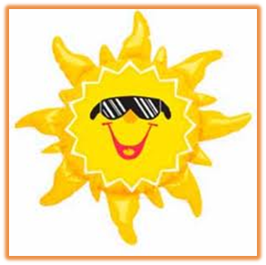
Fun in the Sun Safely

Slide 2
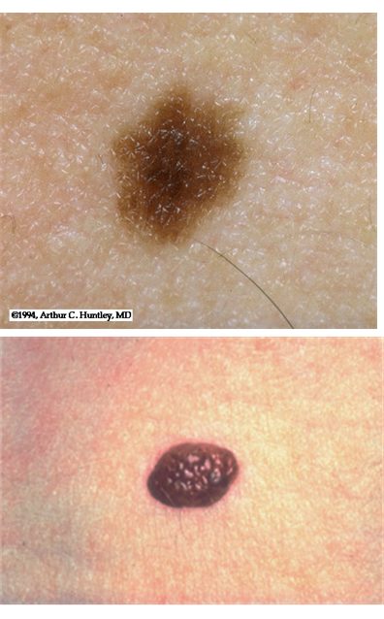
Ordinary Moles
ORDINARY MOLES have all of these features:
Round or oval shape
Sharp, even borders with skin
Uniform color (usually brown)
Less than 1/4 inch wide
Cauliflower or smooth surface
Even dome shape if mole is raised

Slide 3
Types of Skin Cancers
Melanoma
Basal cell carcinoma
Squamous cell carcinoma
Actinic Keratoses (AK)

Slide 4
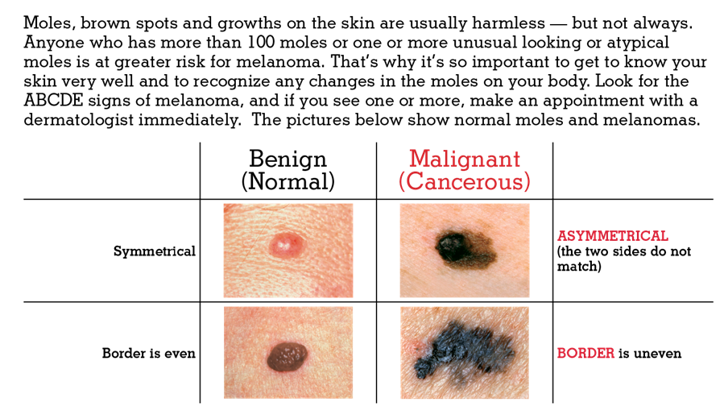
The ABCDE’s of Melanoma

Slide 5
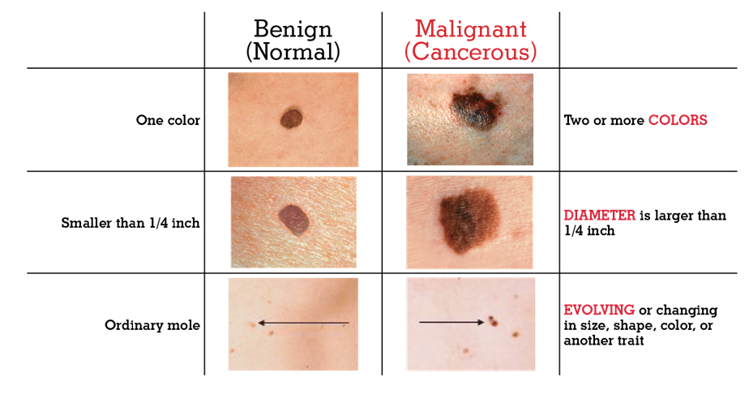
The ABCDE’s of Melanoma

Slide 6
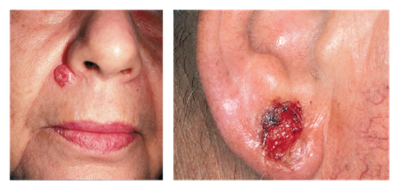
Other Forms of Skin Cancer & Pre-Cancer

Slide 7
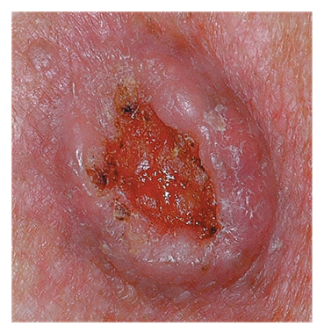
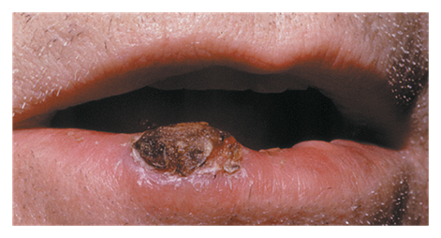
Other Forms of Skin Cancer & Pre-Cancer

Slide 8
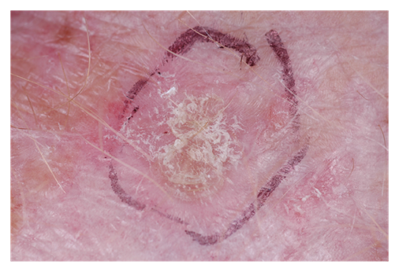
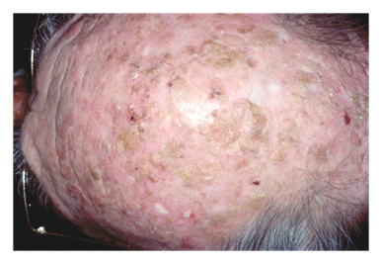
Other Forms of Skin Cancer & Pre-Cancer

Slide 9
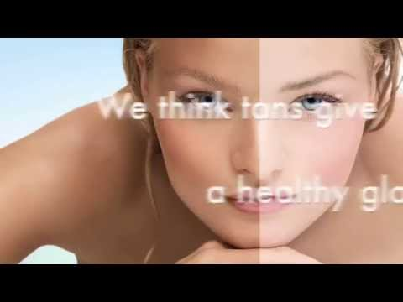
Notes:
Show this Sun Safety Rap to have students thinking about how they might be able to encourage someone to make positive choices in regard to sun safety.

Slide 10
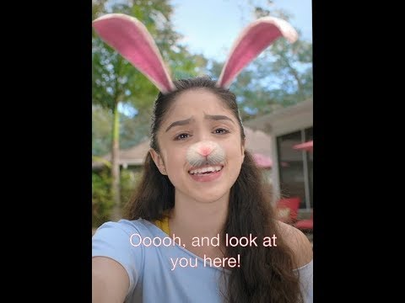
“Protect Yourselfie” PSA
Notes:
The AAD’s new PSA “Protect Yourselfie” uses social media imagery to remind teen girls that tanning can lead to skin cancer and premature aging, and encourages them to protect their skin from harmful ultraviolet rays.

Slide 11
Now It’s Your Turn to Educate Others
Your Task - Research and develop an educational campaign to encourage positive health choices and discourage risky choices regarding sun safety.
Young teens often do not take sun safety seriously. But in this activity, you’re going to use positive peer pressure to make sun safety a priority for teens by making a Sun Safety Advocacy Poster

Slide 12
Step 1: The Message
What would you like younger teens to know about skin cancer? What are some of the key takeaways?
Facts and Stats - Find and list at least ONE credible source that gives at least three supporting facts or statistics to make your message more valid.
List your source here: ______________________________________________________________
1.
2.
3.

Slide 13
Actionable Steps to Promote Health - Pick at least two health behaviors or specific idea to focus on, and brainstorm catchy or memorable ways to relay your message to encourage positive health choices and discourage risky choices regarding sun safety.
Health behaviors:
1.
2.
Catchy Slogan:

Slide 14
Step 2: The Audience
What specific group within our school community would benefit from hearing your message? Examples could include: athletes who compete outside, beach goers, teens who use tanning beds, people who travel to warm destinations, teens who have jobs outside (i.e. - summer camp counselors).
Step 3: The Design
Using Canva.com, you’ll pick a social media template and create a simple poster for your message.
Include:
at least ONE fact or stat regarding skin cancer or sun safety
at least TWO health behaviors to encourage positive health choices
a catchy slogan to get us to remember something about your message
Print out a copy to submit to your teacher.

