Slide 1

Refusal Skills: Peer Pressure

Slide 2
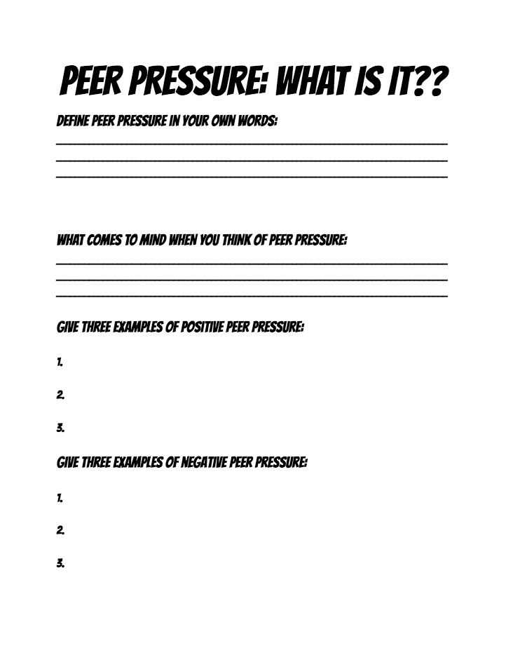

Define “Peer Pressure”
Write your definition of peer pressure in your own words

Slide 3


Define “Peer Pressure”
noun
1. social pressure by members of one's peer group to take a certain action, adopt certain values, or otherwise conform in order to be accepted.

Slide 4
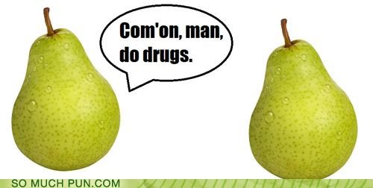

Slide 5

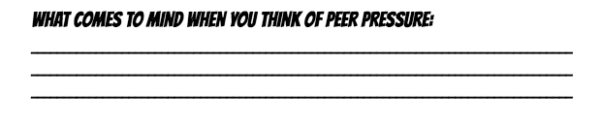

What comes to mind when you think of Peer Pressure
Notes:
Negative and positive

Slide 6

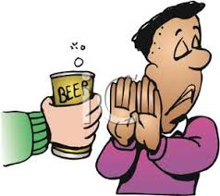
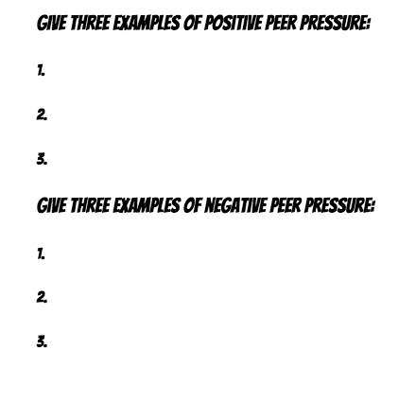
Types of Peer Pressure
Negative Peer Pressure
  Examples
Positive Peer Pressure
  Examples

Slide 7


Let’s Talk About It

Slide 8
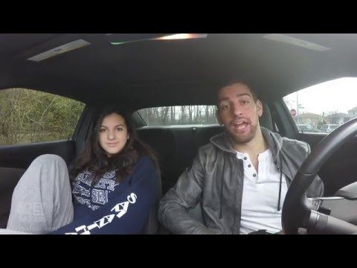

Slide 9

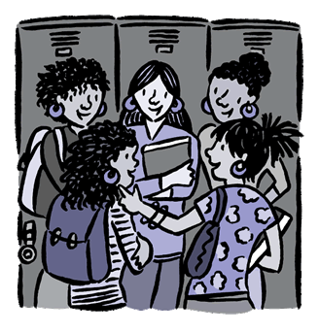
What kind of influence do peers have over each other?

Slide 10
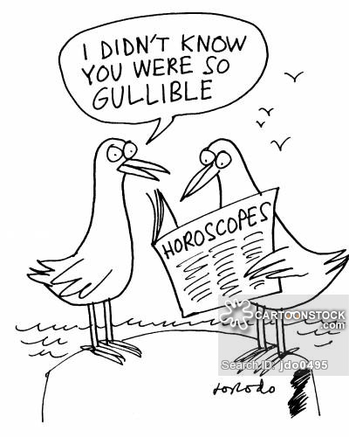
Why do some teens seem to be more susceptible than others to such pressure?

Slide 11

How do technology and social media affect the way people influence each other?

Slide 12
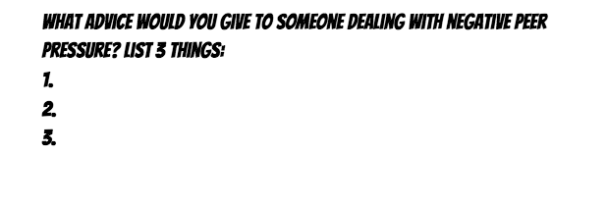


What advice would you give to someone dealing with negative peer pressure?

Slide 13
Top 5 Influences on Teens for Drugs/Alcohol
5 even groups
Each group comes up with their top 5 influences
Class vote to determine overall top 5 influences for the class

Slide 14

Class Top 5 Influences

Slide 15

Refusal Skills
What are they?
The many different ways to turn down drugs, alcohol and other subjects (Yes, there are more ways than just simply saying no).

Slide 16
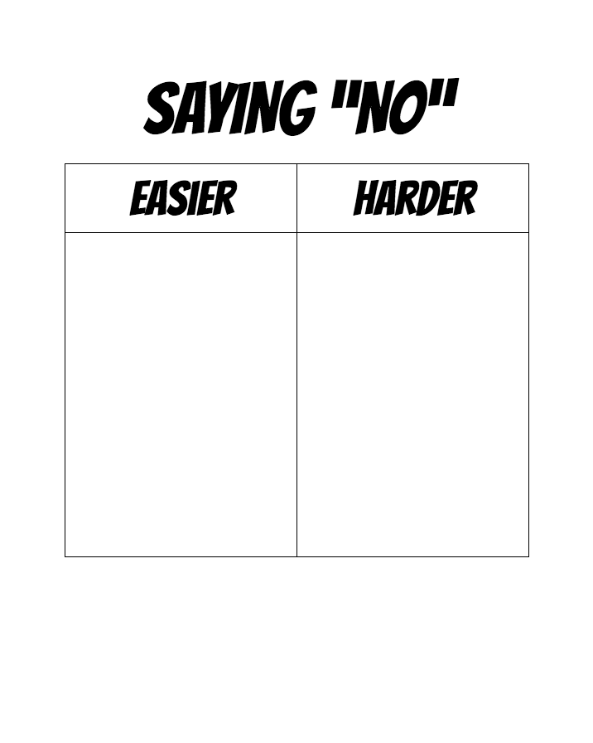

What makes it easier/harder to refuse something?

Slide 17
What makes it easier/harder to refuse something?
Easier
Preexisting morals/values relating to situation
Person is unknown to you
Experience in the situation
Harder
No current morals or values relating to situation
Person asking you is close to you
No previous experience in the situation

Slide 18
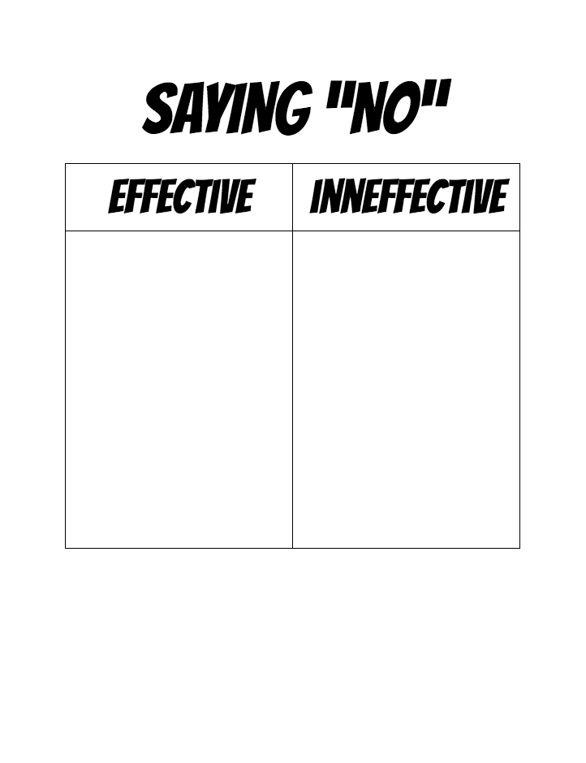

What makes a refusal effective or ineffective?

Slide 19
Effective vs. Ineffective Refusals
Effective
Specifically says “no”
Body language says “no”
Repeated refusal
Suggested alternative
Inneffective
Never specifically says “no”
Body language is unsure
Does not repeat refusal
Does not suggest alternative

Slide 20
2 types of refusals
Verbal and Nonverbal refusals
  The ability/skill to say no effectively gives us a lot of power over our lives.
    Say “NO”
    Repeat the refusal
    Suggest an alternative
    Use body language that says “NO”
    Build the relationship, if appropriate

Slide 21
    Repeat the refusal
Use repetition technique until the person stops pressuring you.
  No, I don’t want to do that. No, I don’t want to do that. No, I don’t want to do that.
Restate no, increasing intensity adding a statement about how you feel and the consequence if the pressure does not change.
  No and when you pressure me I feel angry and if you keep pressuring me I am going to leave.

Slide 22
    Suggest an Alternative
Suggest another activity that is realistic and appealing.
  Let’s go to a movie, for a walk, to a friend’s, etc.
Move toward acting on the alternative
  Get the paper to see what is at the movies, start on a walk together, call friends to see if they’re home.

Slide 23
    Use body language that says “NO”
Firm voice
  Use a strong, business-like tone
Serious expression
  “I mean it” look on face
Eye Contact
  Look directly at the person’s face
“Soldier body”
  Stand up straight and confident
Gestures that emphasize point
  Use hand, arm movement to emphasize point
Body says the same thing as your words

Slide 24

7 Refusal Skills
Blame someone else
Make an excuse
Just say no
Change the subject
Make it into a joke
Walk away from situation
Suggest to do something else

Slide 25
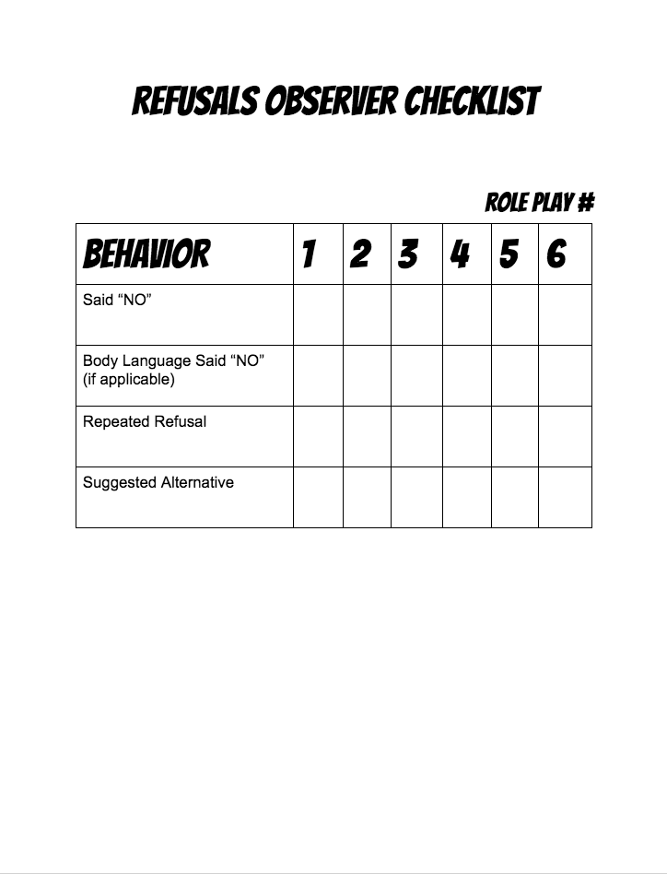
Mock Scenarios

Slide 26
Make an excuse
Alexis: My parents have a couple of old wine bottles in the basement that they’ll never notice if they’re missing. What do you think?
Lauren: I would, but I have practice in the morning at 7.
Alexis: C’mon!
Lauren: No, I really can’t tonight.
Blame someone else
Make an excuse
Just say no
Change the subject
Make it into a joke
Walk away from situation
Suggest to do something else

Slide 27
Change the subject
Jeff: Yooo what’s up Tyler how you been? I’m throwing this huge party tonight and there’s gonna be tons of weed. Everybody’s coming, you down?
Tyler: Maybe, hey did you finish the Bio homework for tomorrow?
Jeff: Who cares let’s just go to the party.
Tyler: No, I have to get this homework done.
Blame someone else
Make an excuse
Just say no
Change the subject
Make it into a joke
Walk away from situation
Suggest to do something else

Slide 28
Blame someone else
David: Hey Mike, wanna drink a couple beers at my place after practice?
Mike: Nah man, my girlfriend will be ticked if she finds out.
David: She won’t find out…
Mike: I don’t know man. I guess I can come over.
Blame someone else
Make an excuse
Just say no
Change the subject
Make it into a joke
Walk away from situation
Suggest to do something else

Slide 29
Suggest to do something else
Mark: Let’s play beer pong guys, I got a case in the fridge!
Jimmy: Heck yeah!
Austin: I’m down
Logan: Why don’t we just play cards guys? That's always a good time.
Austin: Nah, let’s drink!
Logan: No I’m going home if that’s what you’re planning on.
Blame someone else
Make an excuse
Just say no
Change the subject
Make it into a joke
Walk away from situation
Suggest to do something else

Slide 30
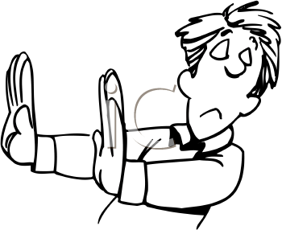
Walk away from situation
Carly: Hey sarah, wanna split this joint real quick before school?
Sarah: (Pretends to answer phone) No, Sorry my mom is calling me! I gotta go!
Blame someone else
Make an excuse
Just say no
Change the subject
Make it into a joke
Walk away from situation
Suggest to do something else

Slide 31
Make it into a joke
Conor (at party): Let’s split this 6-pack of wine coolers, Ryan.
Ryan: No way man, I’d rather not drink at all than drink those things. That’s what my mom drinks!
Conor: But that’s all we have…
Ryan: Then no, I guess I’m not drinking then.
Blame someone else
Make an excuse
Just say no
Change the subject
Make it into a joke
Walk away from situation
Suggest to do something else

Slide 32
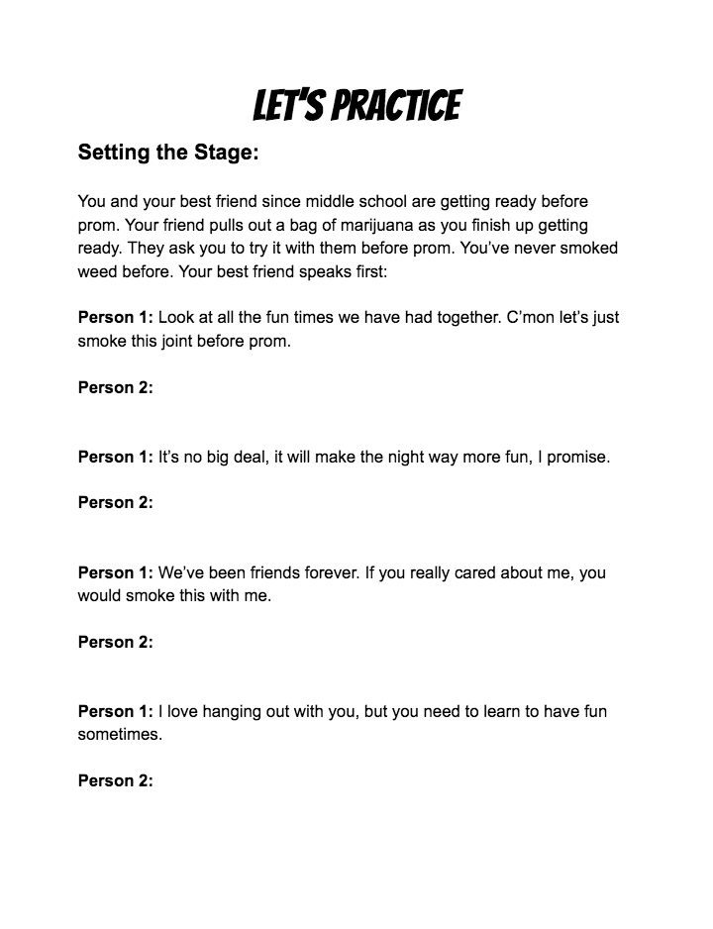
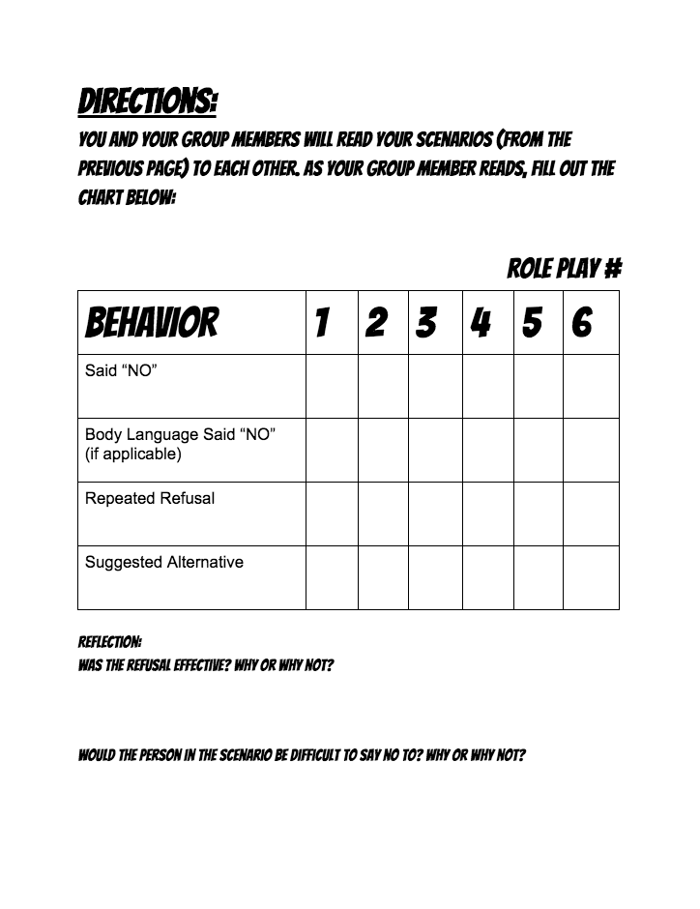
Let’s Practice

Slide 33
Reflection
Would the person in the scenario be difficult to say no to? Why or why not?

Slide 34
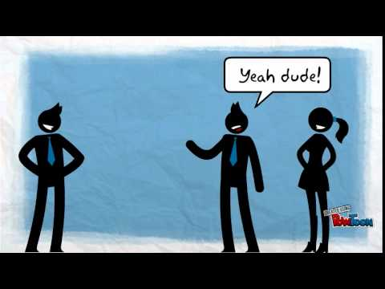

Slide 35


Refusal Skills Skits
In groups you are to come up with a skit to practice refusal skills
Follow instructions on your handout
Skits need to be 1-2mins in length
Each group member must speak
Fill in your “skits observation” sheet as your classmates present

Slide 36
