Slide 1
Costs of Drug Abuse

Slide 2
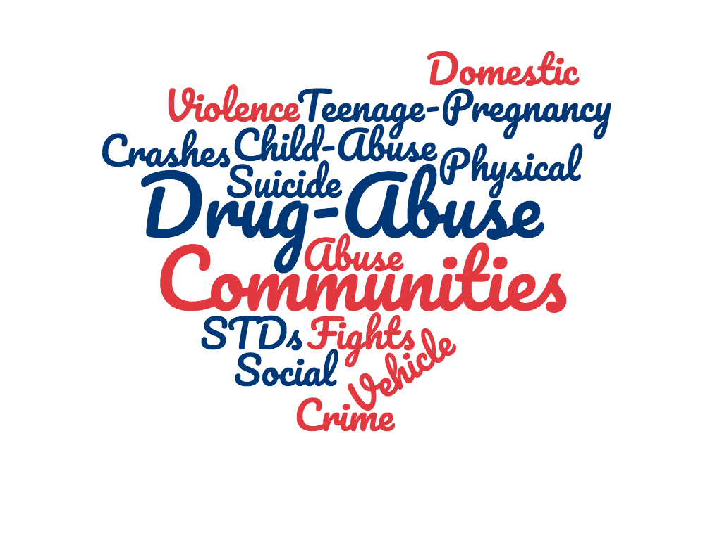
Drug Abuse Impacts:
Individuals
Families
Communities
Society

Slide 3
Effects of Drug Abuse are Costly:
Motor Vehicle Crashes
Physical Fights
Crimes
Homicide
Suicide
Teen Pregnancy
HIV/AIDS
STDs
Domestic Violence
Child Abuse
Notes:
https://www.healthypeople.gov/2020/topics-objectives/topic/substance-abuse

Slide 4
Costs of Substance Abuse
 | Health Care | Overall | Year Estimate Based on:
Tobacco | $170 billion | $300 billion | 2016
Alcohol | $27 billion | $249 billion | 2010
Illicit Drugs | $11 billion | $193 billion | 2007
Prescription Opioids | $26 billion | $78.5 billion | 2013
Notes:
Tobacco: https://www.cdc.gov/tobacco/data_statistics/fact_sheets/economics/econ_facts/index.htm
Alcohol: https://www.cdc.gov/chronicdisease/resources/publications/aag/alcohol.htm
Illicit Drugs: https://www.drugabuse.gov/related-topics/trends-statistics
Prescription Opioids: https://www.drugabuse.gov/related-topics/trends-statistics
https://www.drugabuse.gov/related-topics/trends-statistics

Slide 5
Create a list of negative consequences of drug use:
Notes:
Students can work in pairs and create a list of as many negative consequences of drugs as they can think of.
List:
Death, job loss, loss of friends, loss of family, drop in grades, dropout of school, jail, homelessness, unwanted pregnancies, physical health problems: cancers, heart disease, HIV, STIs....

Slide 6
References:
Tobacco: https://www.cdc.gov/tobacco/data_statistics/fact_sheets/economics/econ_facts/index.htm
Alcohol: https://www.cdc.gov/chronicdisease/resources/publications/aag/alcohol.htm
Illicit Drugs: https://www.drugabuse.gov/related-topics/trends-statistics
Prescription Opioids: https://www.drugabuse.gov/related-topics/trends-statistics

