Slide 1
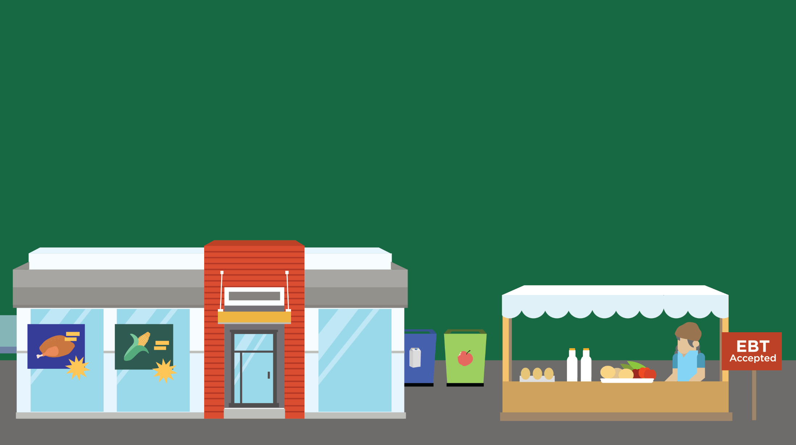
Lesson 14
The Hunger Gap
© 2016 Johns Hopkins University

Slide 2
Food Security Definition
Consistent access to enough safe, nutritious food for an active, healthy life, without resorting to emergency food programs, scavenging, or stealing.
Source: Andrews M, Nord M, Bickel G, Carlson S. Household food security in the United States, 1999. USDA ERS. 2000.
Photo credit: Michael Milli, CLF.

Slide 3
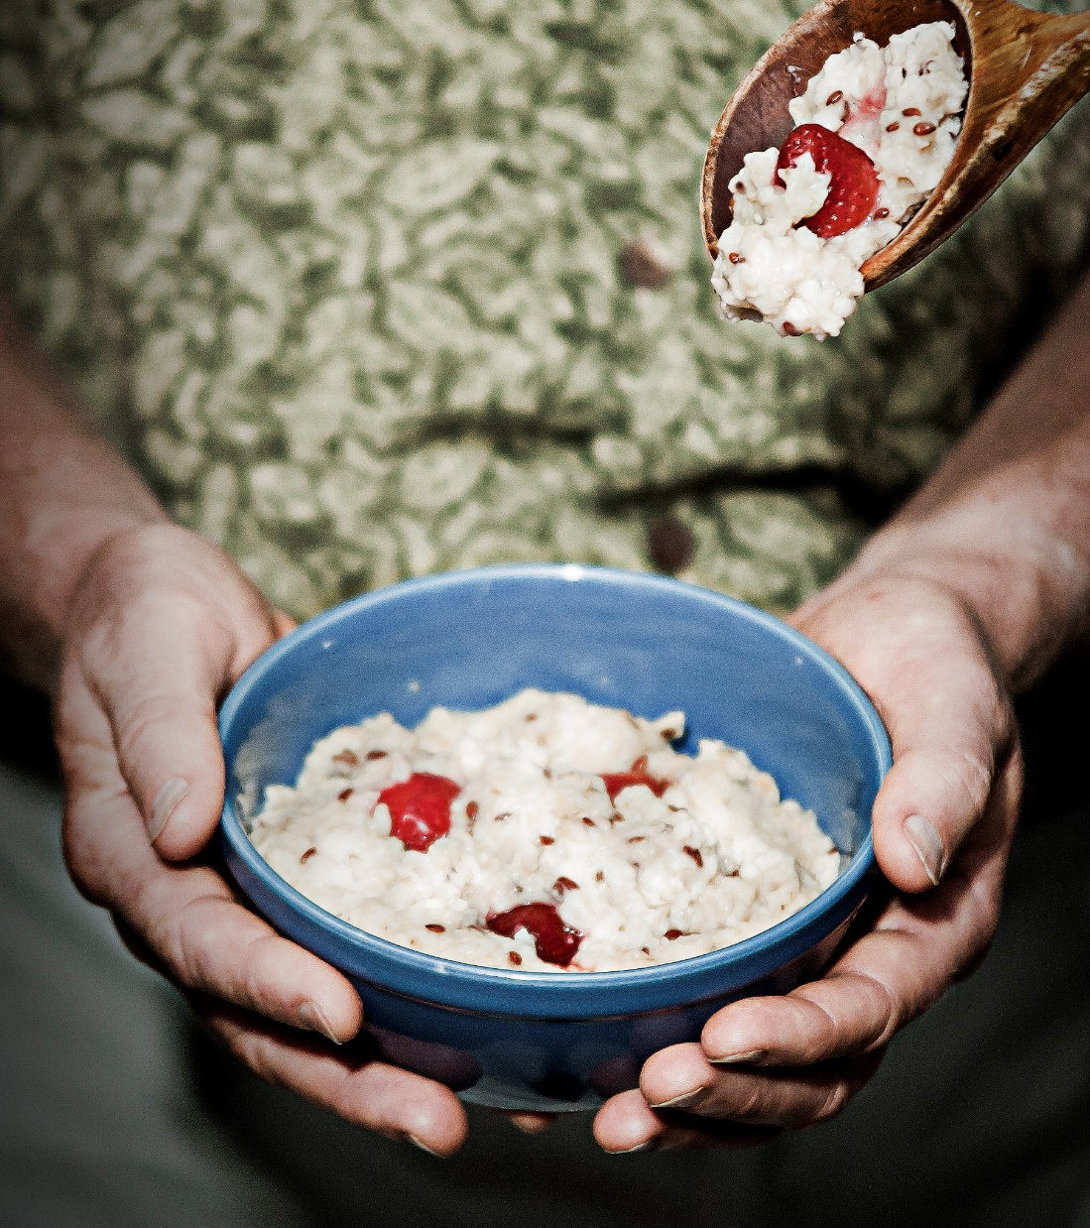
Household Food Security
Members of food-insecure households may:
Be forced to skip meals
Be unable to afford balanced meals
Worry their food will run out before they can afford to buy more
Eat less than they feel they should because they lacked money to buy more
Lose weight because there wasn’t enough money for food
Source: Coleman-Jensen A, Nord M, Andrews M, Carlson S. Household Food Security in the United States in 2010. USDA ERS. 2011.
Photo credit: Michael Milli, CLF.

Slide 4
Household Food Security
Almost one in seven U.S. households — over 17 million — suffer from food insecurity.
Source: Coleman-Jensen A, Gregory C, Singh A. Household Food Security in the United States in 2013. USDA ERS. 2014.
Photo credit: Michael Milli, CLF.

Slide 5
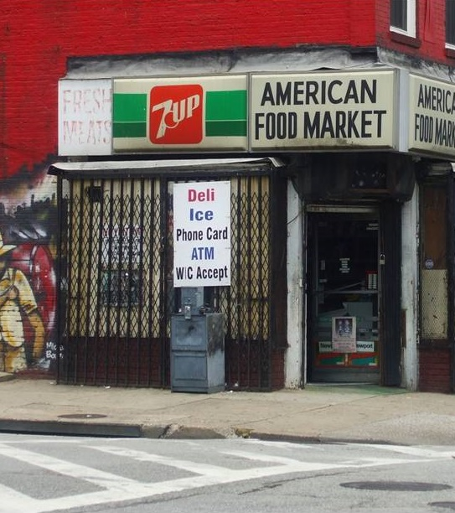
Food Deserts
Areas with limited access to healthy food, often defined using these four criteria:
Household income
Distance from a supermarket
Vehicle ownership
Availability of healthy food in local stores
Source: Johns Hopkins Center for a Livable Future. The Maryland Food System Mapping Resource. 2012: Documentation. http://www.jhsph.edu/clf/programs/food_mapping/documentation/
Photo credit: Spence Lean. Pigtown: All Things Baltimore, 2009. www.sustainablecitiescollective.com. Used with permission.

Slide 6
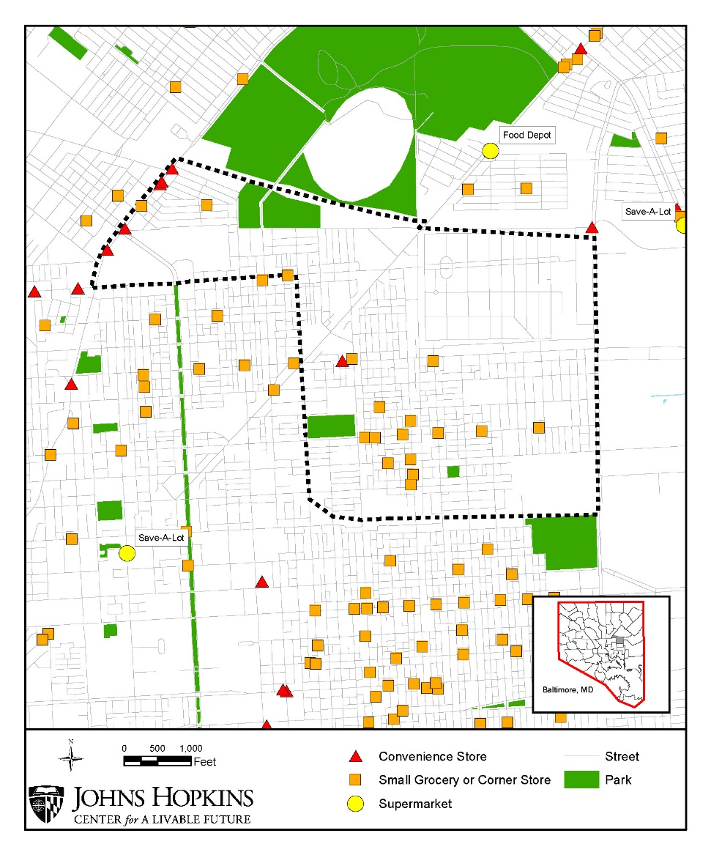
Community Food Availability Map: Clifton Park
Median household income: $25,737
Percent of households with no vehicles available: 44.2%
Image credit: Maryland Food System Map. Johns Hopkins Center for a Livable Future. http://mdfoodsystemmap.org/
Data source: Baltimore Neighborhood Indicators Alliance. Jacob France Institute. http://bniajfi.org/

Slide 7
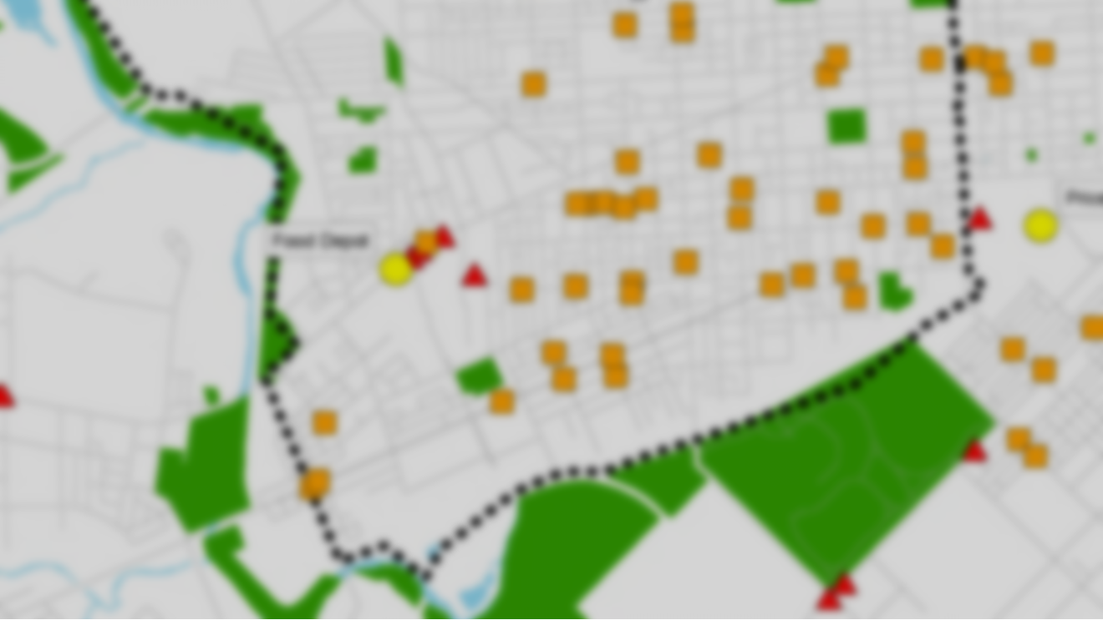
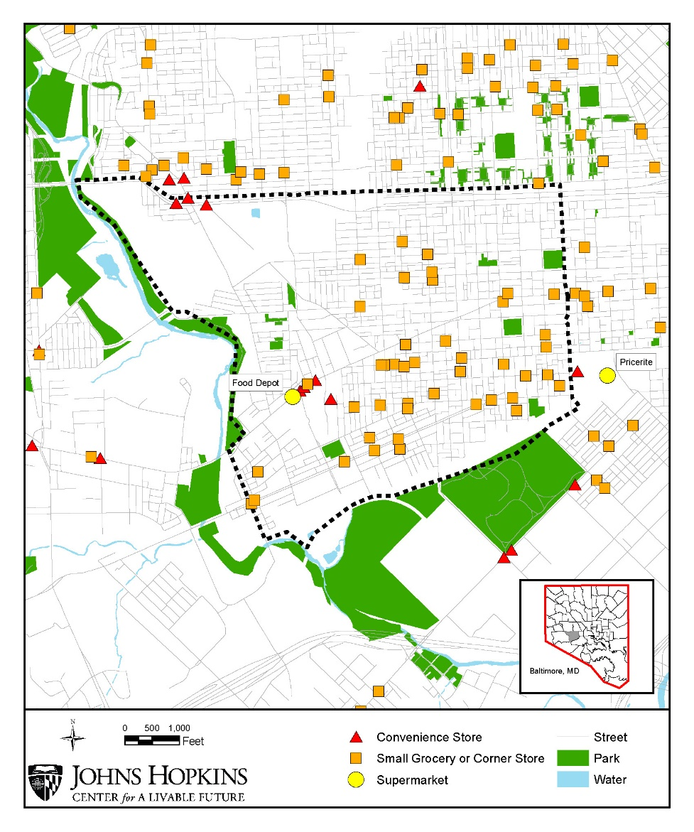
Community Food Availability Map: Southwest Baltimore
Median household income: $24,946
Percent of households with no vehicles available: 52.8%
Image credit: Maryland Food System Map. Johns Hopkins Center for a Livable Future. http://mdfoodsystemmap.org/
Data source: Baltimore Neighborhood Indicators Alliance. Jacob France Institute. http://bniajfi.org/

Slide 8
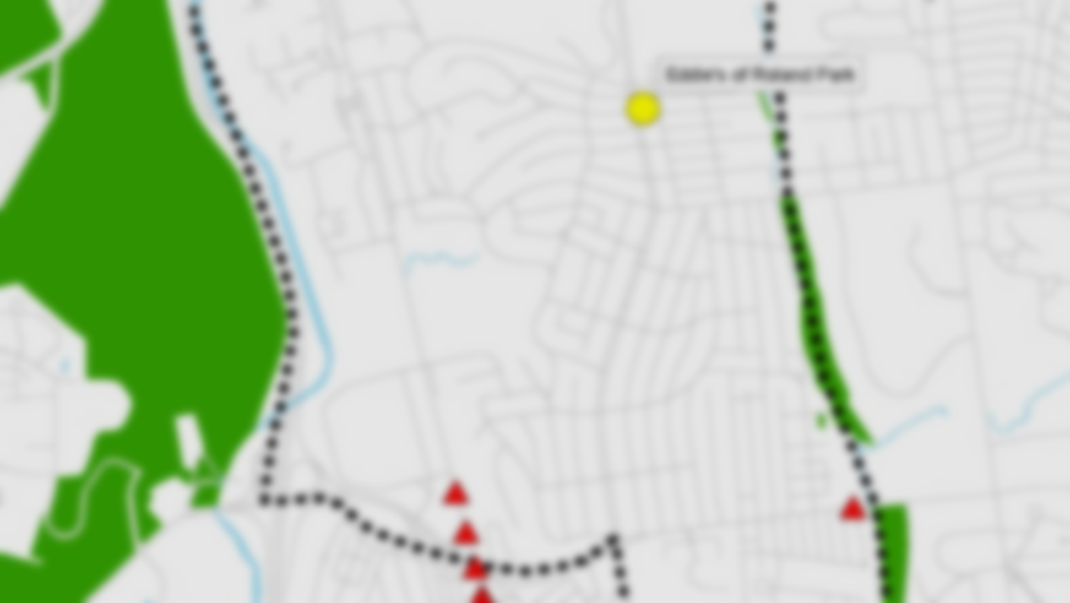
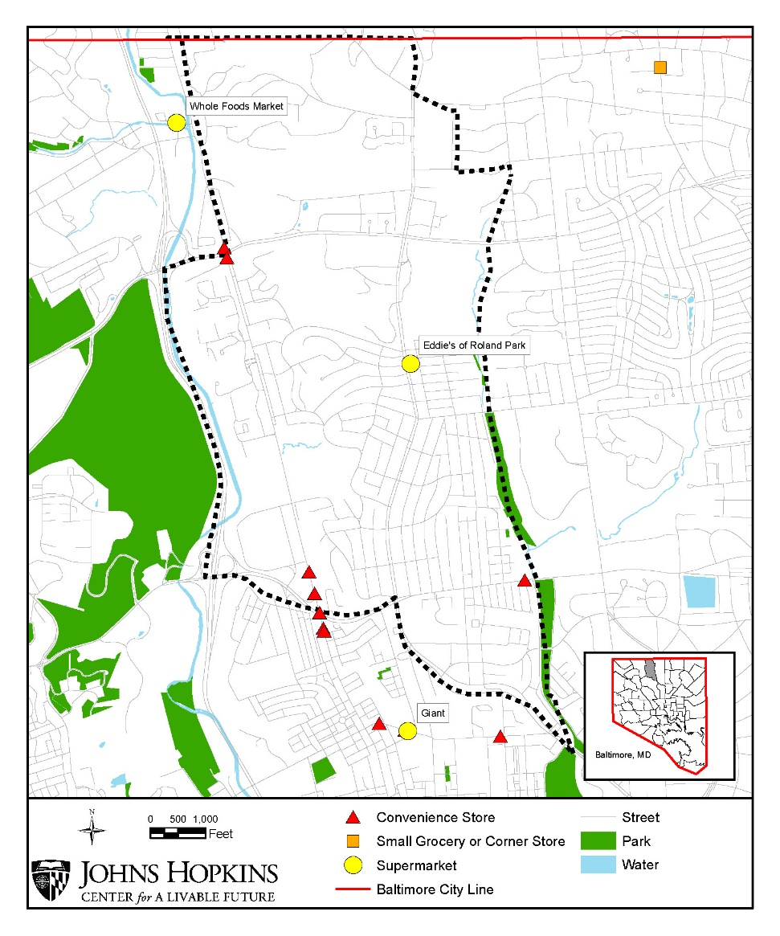
Community Food Availability Map: Roland Park
Median household income: $104,481
Percent of households with no vehicles available: 4.4%
Image credit: Maryland Food System Map. Johns Hopkins Center for a Livable Future. http://mdfoodsystemmap.org/
Data source: Baltimore Neighborhood Indicators Alliance. Jacob France Institute. http://bniajfi.org/

Slide 9
“To many people, hunger means not just symptoms that can be diagnosed by a physician; it bespeaks the existence of a social, not a medical problem.”
Source: President’s Task Force on Food Assistance. Report of the President’s Task Force on Food Assistance. Washington, DC; 1984. Photo credit: Michael Milli, CLF.

