Slide 1
The DANGERS
of Other Tobacco Products
Ver.2
2017

Slide 2
Nicotine and tobacco products
come in many forms other than cigarettes.
Today we will discuss the dangers found in Other Tobacco Products.
Notes:
Nicotine and tobacco products come in many forms other than cigarettes.
Today we will discuss the dangers found in Other Tobacco Products (often called OTPs).

Slide 3
HOOKAH

Slide 4
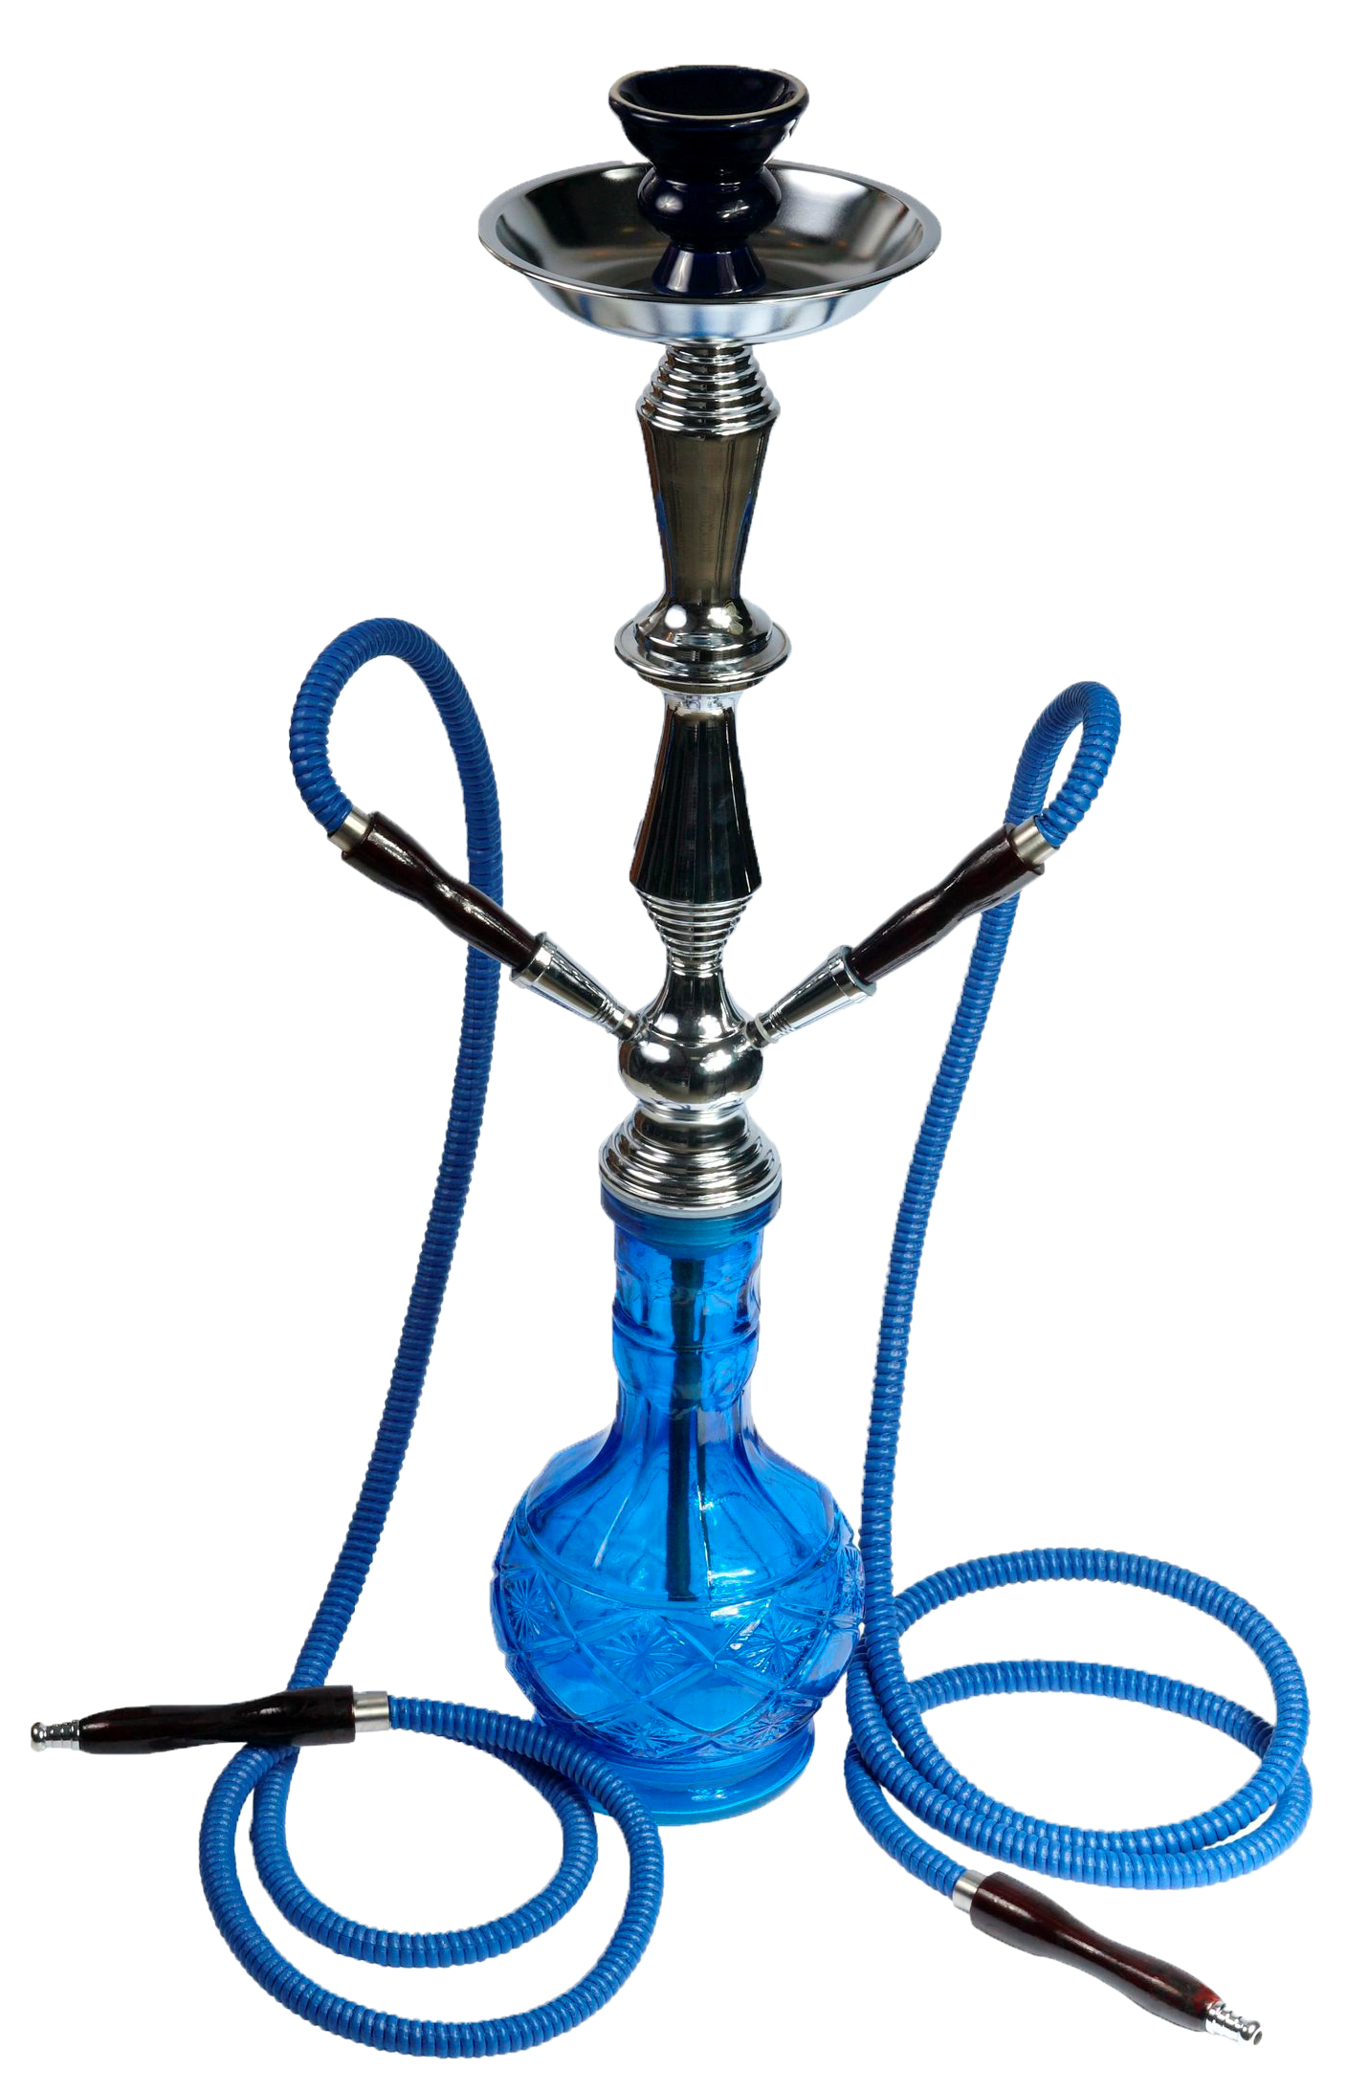
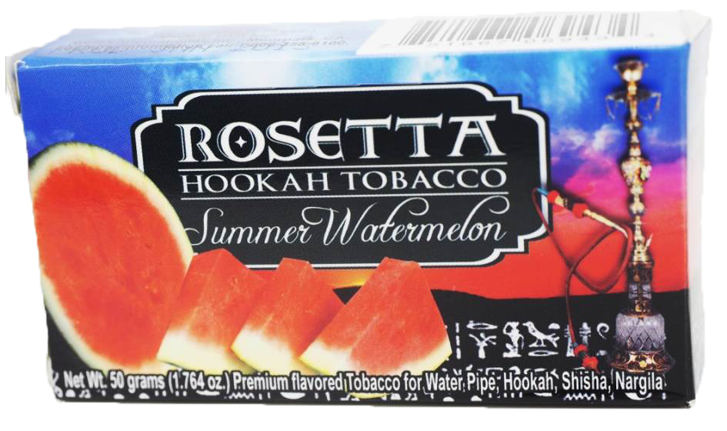
HOOKAH
Hookahs are equally damaging to your health as cigarettes
Notes:
Hookah users are actually exposed to more smoke than cigarette smokers due to their longer smoking sessions, which can last up to an hour in many cases. In fact, hookah users consume nearly 200 times the smoke compared to just one cigarette.
The CDC has reported that hookah smokers are at risk for many of the same cancers and diseases as cigarette smokers. The heated tobacco used contains sixty-nine particular carcinogens that have been linked to tumor production as well as cancers of the lungs, stomach, and kidneys.
The tobacco used in hookah (as with all tobacco products) contains nicotine. Nicotine is the addictive ingredient in tobacco.

Slide 5
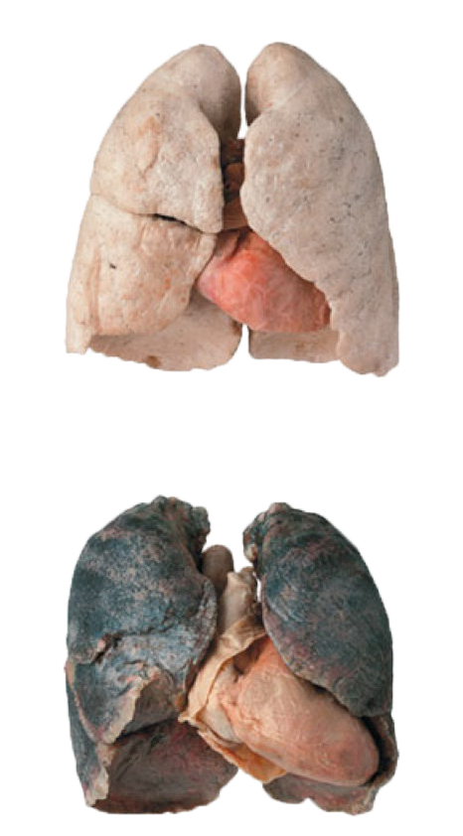
HOOKAH
Smoke from the heated tobacco in hookahs clogs the pores in your respiratory system.
Hookah users are exposed to more smoke than cigarette users.
The water moving through the pipes does NOT “clean” the smoke inhaled.
Notes:
According to data collected by the Centers for Disease Control and Prevention, smoke from the heated tobacco in the hookah contains over 4,000 different chemicals, some of which cause cancer, have been repeatedly proven to clog the pores in one’s respiratory system.
The water moving through the pipes does not “clean” or purify the tobacco smoke inhaled. Again, there is no safe way to use hookah or tobacco.

Slide 6
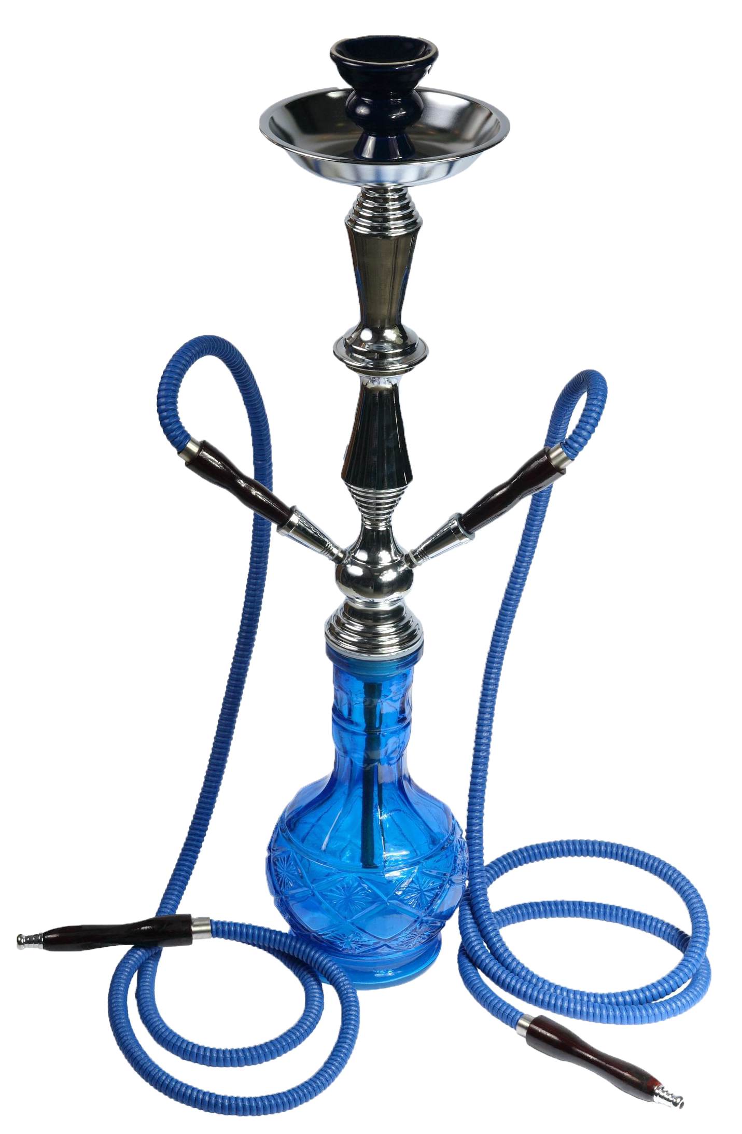
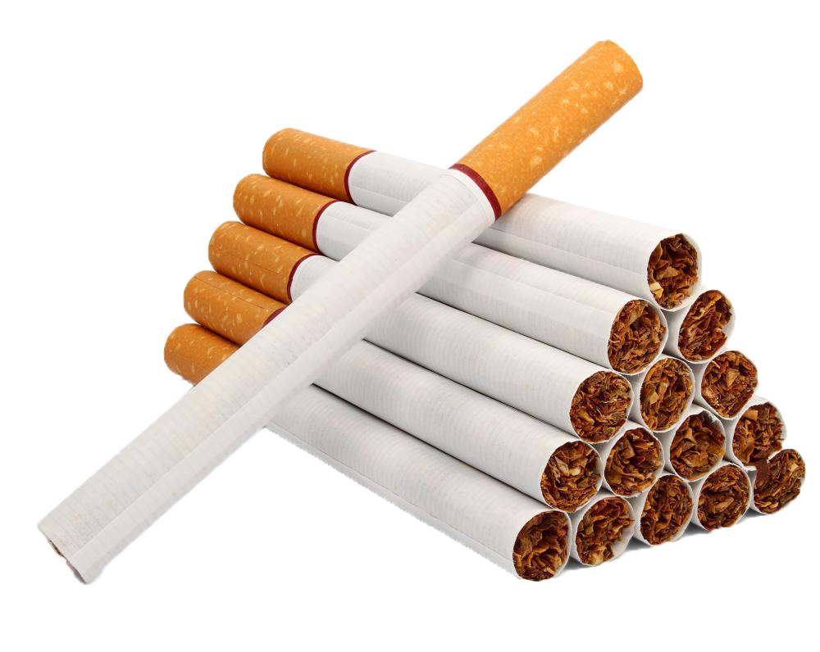
HOOKAH
VS
One Hookah session = 100 or more cigarettes
Notes:
The World Health Organization (WHO) conducted a study on the health effects of hookah, in which they found supporting evidence that just one hookah session is equivalent to smoking over 100 cigarettes.
Researchers explained that the dramatic difference is caused by the excessive amounts of puffs that hookah users take during a given session.

Slide 7
ELECTRONIC CIGARETTES

Slide 8
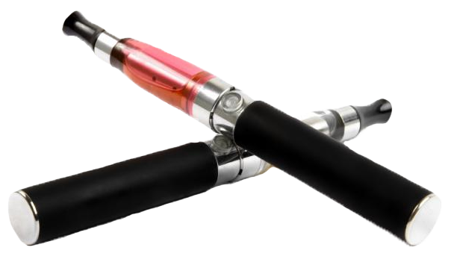
ELECTRONIC CIGARETTES
E-cigs do not contain tobacco, but they do use nicotine from tobacco.
Notes:
Another alternative tobacco product is called the electronic cigarette (e-cig or e-cigarette).
E-cigs are one of the latest devices that the tobacco industry has introduced to the public.
Electronic cigarettes do not contain tobacco, but they do use nicotine from tobacco plants.

Slide 9
ELECTRONIC CIGARETTES
E-cigs do not produce a harmless “vapor” – it is an aerosol or mist that contains nicotine and a number of chemicals.
The safety of e-cigs are currently being studied by the FDA.
Notes:
They do not produce cigarette smoke or vapor but rather an aerosol or mist that contains nicotine and a number of chemicals.
They have a heating element that atomizes a liquid solution known as e-liquid. E-liquids are usually a mixture of propylene glycol, glycerin, nicotine, and flavorings. Propylene glycol is used by the chemical, food, and pharmaceutical industries as an antifreeze. It is a solvent for food colors and flavors, and in the paint and plastics industries. Propylene glycol also is used to create artificial smoke or fog used in fire-fighting training and in theatrical productions.
The Food and Drug Administration (the FDA) regulates electronic cigarettes but they have not yet determined if these devices are safe.

Slide 10
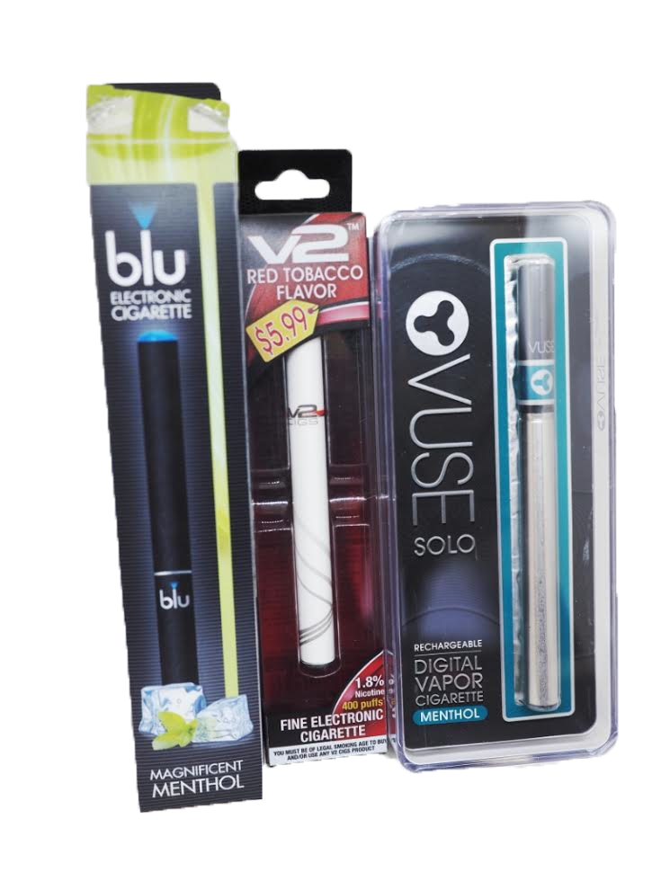
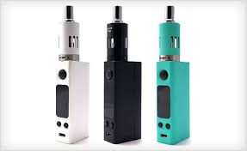
ELECTRONIC CIGARETTES
Nicotine levels have been found to be mislabeled on electronic cigarette packages.
Notes:
Electronic cigarette users say that a reason they like the product is because they can choose the level of nicotine they wish to inhale. However, there have been several cases of mislabeling the level of nicotine in a product. Therefore, they are not actually choosing AND in most cases do not know what they are even inhaling.
E-cigs still are addictive because they contain the ingredient nicotine. So, even if someone stops smoking cigarettes, they still may be addicted to nicotine contained in electronic cigarettes, which also is a toxic agent.

Slide 11
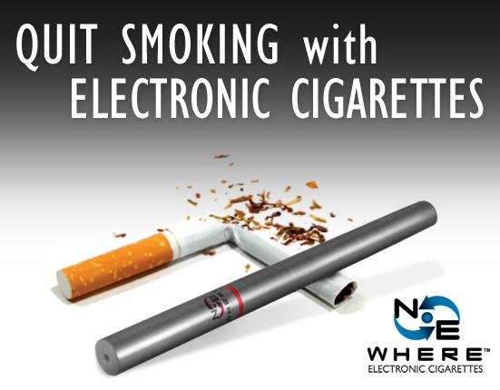
ELECTRONIC CIGARETTES
E-cigs have not been scientifically proven to help people quit using tobacco products.
Notes:
Although there are numerous discussions and claims that seem to say e-cigs help people stop smoking, there is NO scientific proof to support this claim.

Slide 12
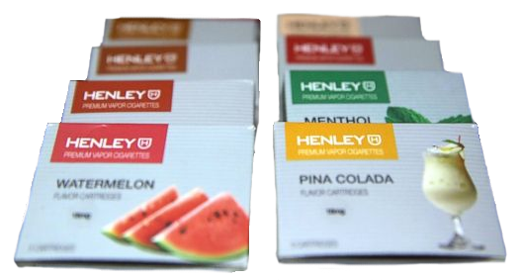
ELECTRONIC CIGARETTES
Advertised as
…BUT
REALLY…
Actual Products
Fruity flavors merely cover up the toxic danger of the tobacco product.
Notes:
To cover up or mask the toxic agents found in electronic cigarettes, tobacco companies encourage and promote the use of fruity flavors, which are particularly attractive to youth.
It is illegal to sell flavored cigarettes, however, there are no such restrictions for Other Tobacco Products. Although you cannot smell or taste the bitter and harsh tobacco, the toxic agents still can harm your health and lead to breathing complications, particularly with your sinuses, throat and lungs.

Slide 13
CIGARS

Slide 14
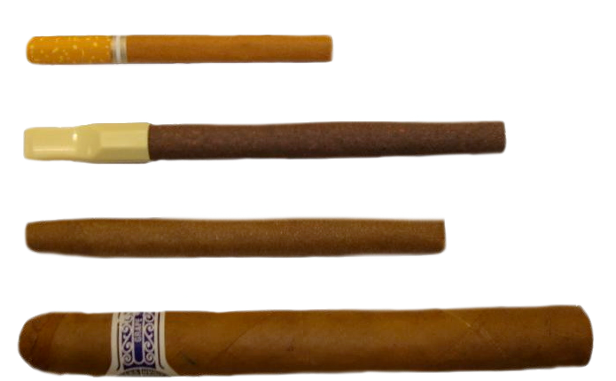
CIGARS
There are 3 major types of cigars:
Little Cigar, Cigarillo, Cigar
Notes:
Now, let’s look at cigars, another alternative tobacco product.
The FDA uses three primary classifications of cigars based on their weight.
The smallest cigar is known as a little cigars. They look very similar to a cigarette and many contain a filter on the end but these filters have not been scientifically shown to filter out the harmful agents of the cigar smoke.
The medium sized cigar is known as a cigarillo. These come in various sizes and some come with plastic or wood tips.
The largest is the most common cigar. These are the one’s that are associated with celebrations and celebrities.
Despite their size, they all are cigars. They all contain tobacco and nicotine. And they all are at least as dangerous and toxic as cigarettes and users are exposed to harmful toxicants.

Slide 15
CIGARS
Cigars are perceived as healthier than cigarettes, BUT, the only difference between the two is what they are wrapped in.
Cigars: Wrapped in tobacco
Cigarettes: Wrapped in paper
Notes:
It is important to know that even though we may think cigars are a healthy alternative to cigarettes, they are equally as dangerous.
The only difference between cigars and cigarettes is the size and the wrapper. Cigars are wrapped in tobacco, and cigarettes are wrapped in paper that doesn’t contain tobacco.
Both cigars and cigarettes contain the addictive ingredient nicotine.

Slide 16
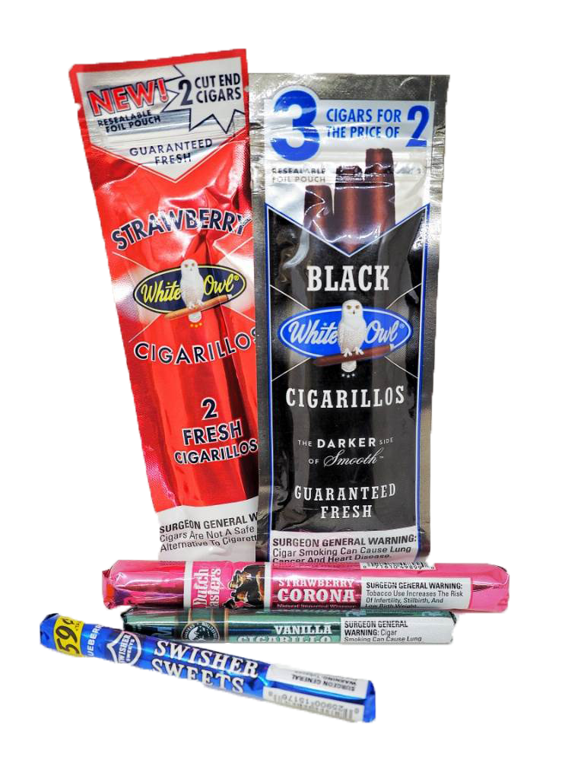
CIGARS
The tobacco industry packages their products to appear as candy or other sweets.
Notes:
Like other alternative tobacco products, the tobacco industry packages their products to appear similar to candy or other sweets.
The sweet flavors such as strawberry and vanilla do not make cigars safer. The flavors only mask the bitter and harsh smell and taste of the cigars – they do not mask the toxic, harmful effects.
It is illegal for companies to sell fruity and candy flavored cigarettes but it is NOT illegal for tobacco companies to add these flavors to cigars and other tobacco products.

Slide 17
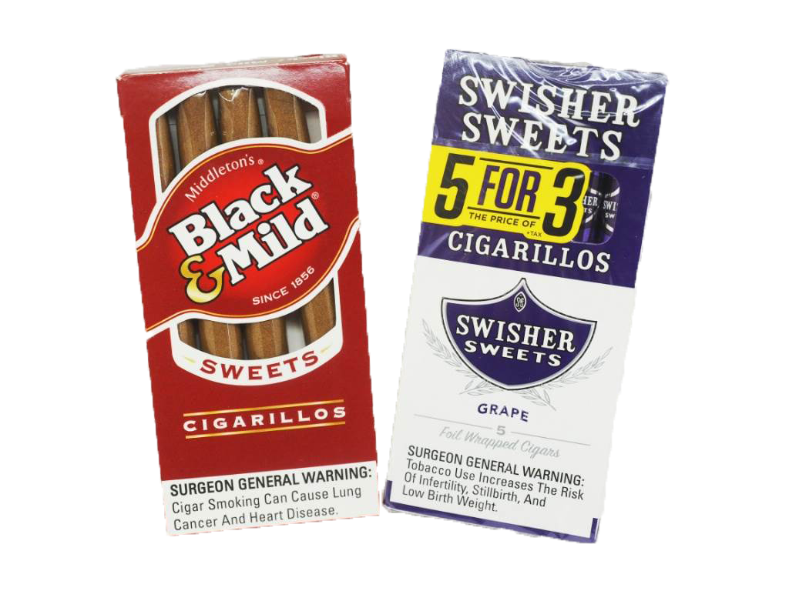
CIGARS
It is common for the tobacco industry to promote their products as affordable.
They are taxed differently and packaged differently to be less expensive.
Notes:
It also is common for the tobacco industry to promote their products less expensive. This is a tactic to try to persuade people to try these products with the hope that they will want to use them again and again. This tactic also preys on people who do not have a lot of money to spend.
The tobacco industry also has figured out how to exploit tax laws to sell more cigars. They package their products in unique ways to avoid tax laws in order to reduce the cost of their product and get more people to use them.

Slide 18
SMOKELESS TOBACCO

Slide 19
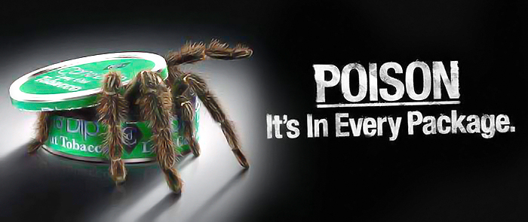
SMOKELESS TOBACCO
Smokeless tobacco products are equally as addictive as traditional tobacco products.
Notes:
Smokeless tobacco, which is more commonly known as chewing or spit tobacco, is a tobacco product that is not smoked, but the risks associated with them are equally as dangerous and addictive.

Slide 20
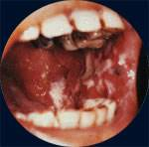
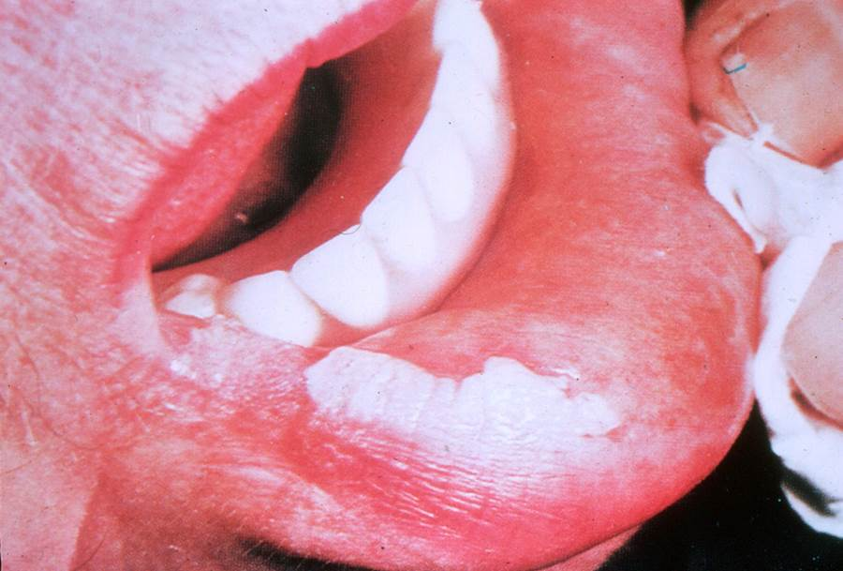
SMOKELESS TOBACCO
Smokeless tobacco products deliver more nicotine in a shorter time span.
Smokeless tobacco causes tooth decay.
Over 70% of smokeless tobacco users suffer from the disease Leukoplakia.
Chewing tobacco, dip, and snuff have been linked with esophageal, mouth, and pancreatic cancer.
Notes:
Smokeless tobacco products can deliver more nicotine than cigarettes.
One of the most common side effects experienced by smokeless tobacco users is excessive tooth decay. In addition to the tooth decay, the tobacco also causes gums to pull always from the teeth, resulting in permanent gum loss.
Although many of the common health effects of smokeless tobacco products attack the mouth, there are more severe risks associated with them as well. Medical professionals have linked many of the chemicals found in chewing tobacco, dip, and snuff with esophageal, mouth, and pancreatic cancer.

Slide 21
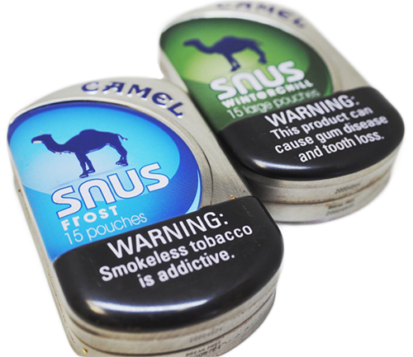
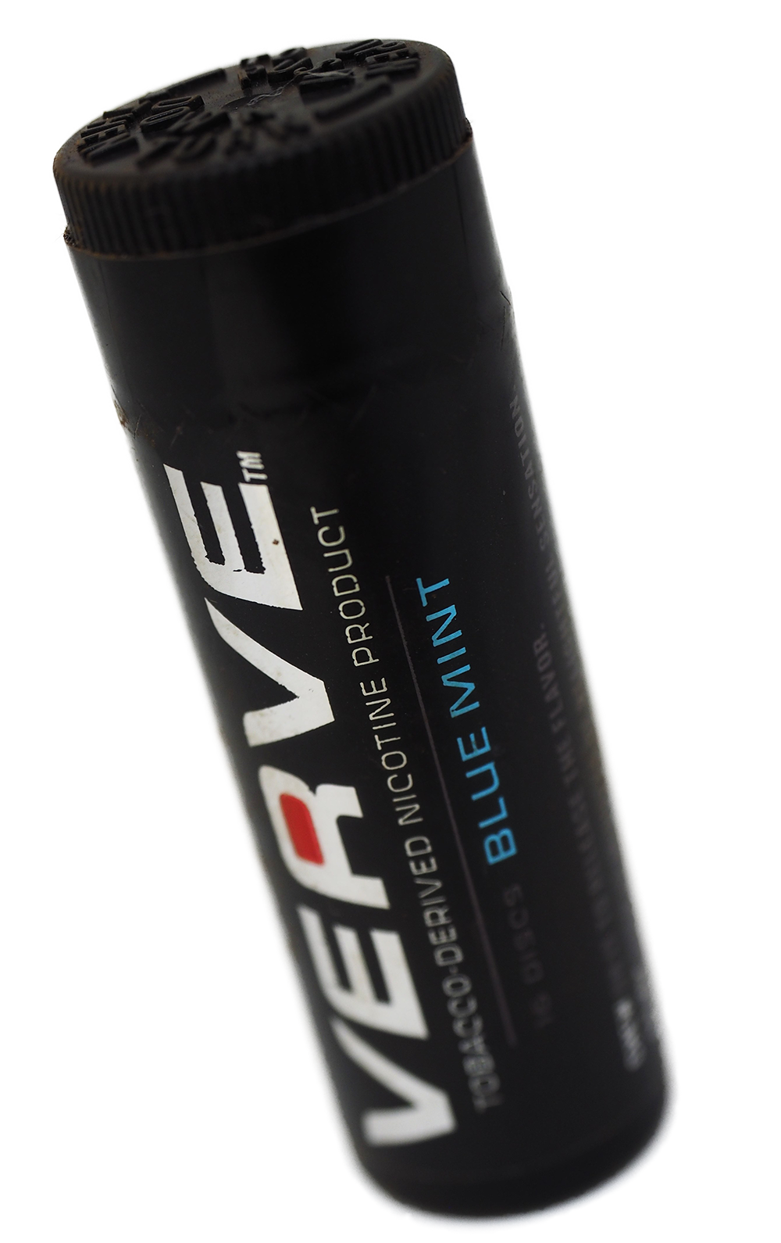
SMOKELESS TOBACCO
Some smokeless tobacco products are also spitless…
…while other tobacco-containing products masquerade as mints.
Notes:
Smokeless tobacco products come in a variety of forms to promote use among kids or those who normally would not try them.
Some smokeless tobacco products are spitless and other tobacco-containing smokeless products masquerade as mints.
Even though it may not smell or taste like tobacco, it still contains nicotine, is very addictive, harmful and can cause cancer.

Slide 22
SUMMARY
Hookah, e-cigarettes, cigars, and smokeless tobacco products contain toxic chemicals, including nicotine.
Tobacco companies package products to make them appear healthy and safe.
Candy flavors only mask the bitter taste and harmful effects of tobacco products.
There is NO safe way to use the tobacco products reviewed in this presentation.
Notes:
So let’s summarize what we have learned today.
Hookah, e-cigarettes, cigars, and smokeless tobacco products contain toxic chemicals, including nicotine.
Tobacco companies package products to make them appear healthy and safe.
Candy flavors only mask the bitter taste and harmful effects of tobacco products.
There is NO safe way to use the tobacco products reviewed in this presentation.

