Slide 1
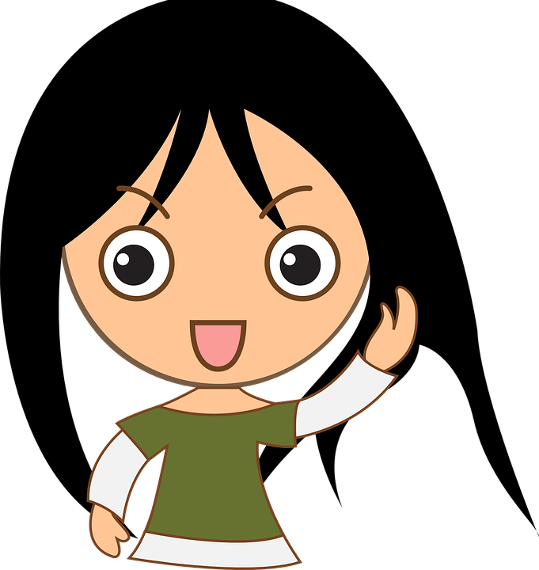
All About Me
Harmful Substances
Let’s learn about Health!

Slide 2
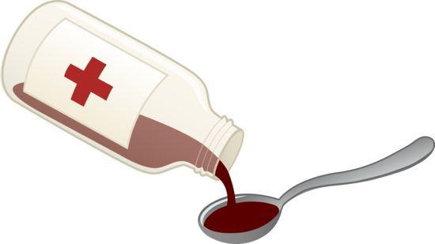
Harmful household products
&
Medicines

Slide 3
Harmful Household Products

Slide 4
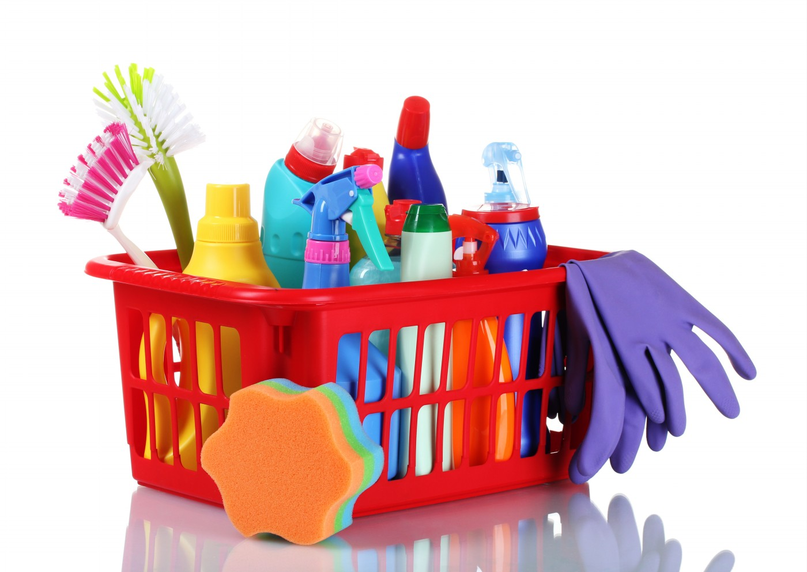
What Should I Do?
Mom and dad love it when I help clean the house. Cleaning the windows is the best part. I wear gloves to protect my hands from chemicals, and I only use the cleaning products when mom or dad are watching me. While I know these cleaning products could be harmful, I wonder what they taste like. My friend once told me she tried one as a dare. Maybe I should try one too….
What should I do?
https://www.youtube.com/watch?v=YjOMYqww9VQ&list=PLYXC5W6Ad0oqMeVSLk-X04Te5OW5o0m-B

Slide 5
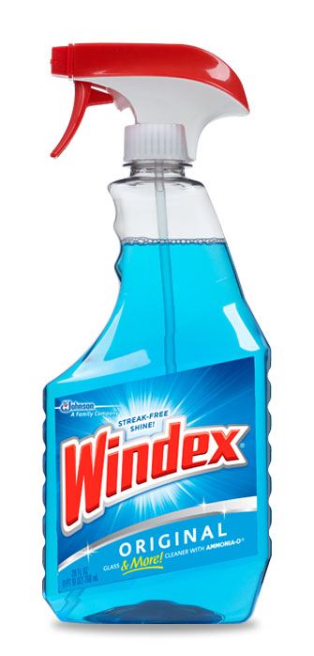
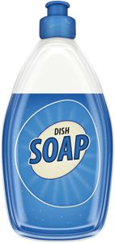
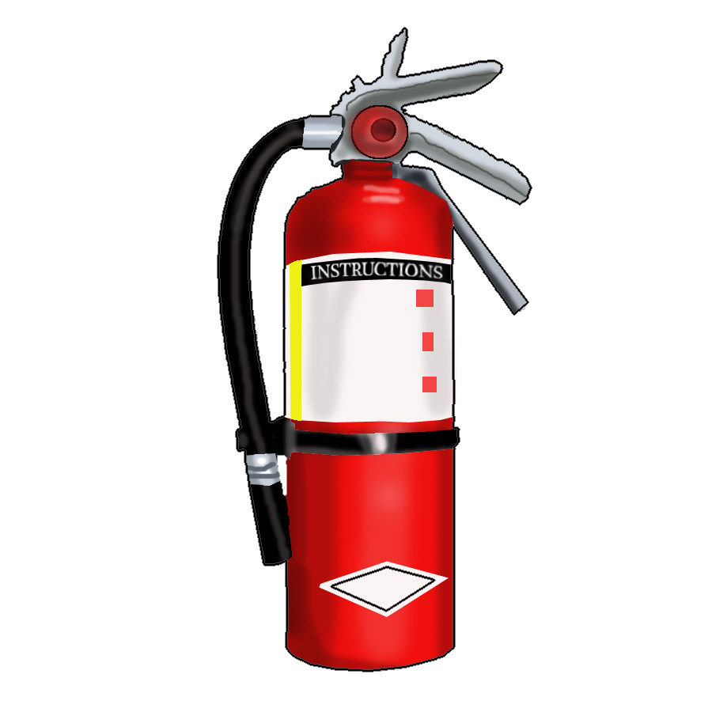
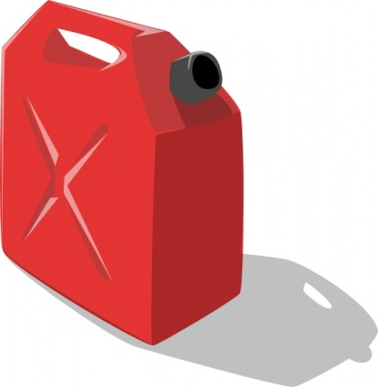
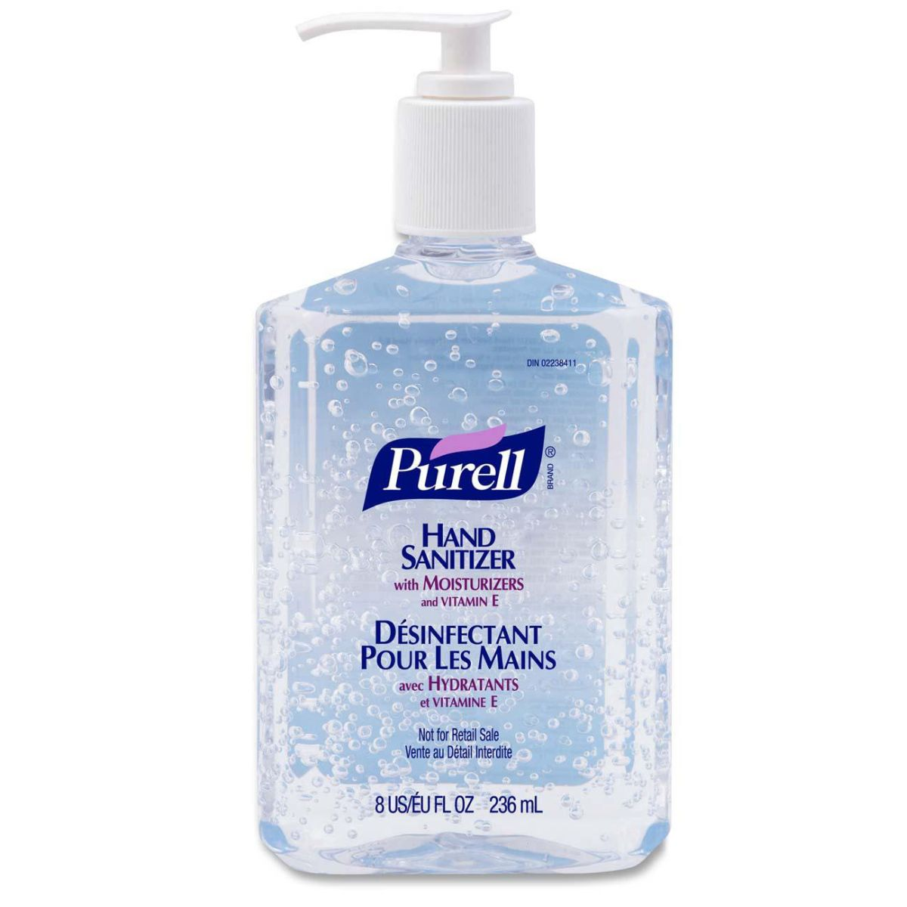
Safe or Unsafe?

Slide 6
Medicine

Slide 7
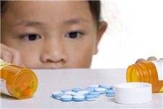
What Should I do?
I’ve been sick for 3 days and really want to be at school with my friends. I know mom is ready to be back at work too. This morning, I walk into the bathroom and find grandma’s pills on the counter. If these pills make grandma feel better, I wonder if the pills will make me feel better.
What should I do?

Slide 8
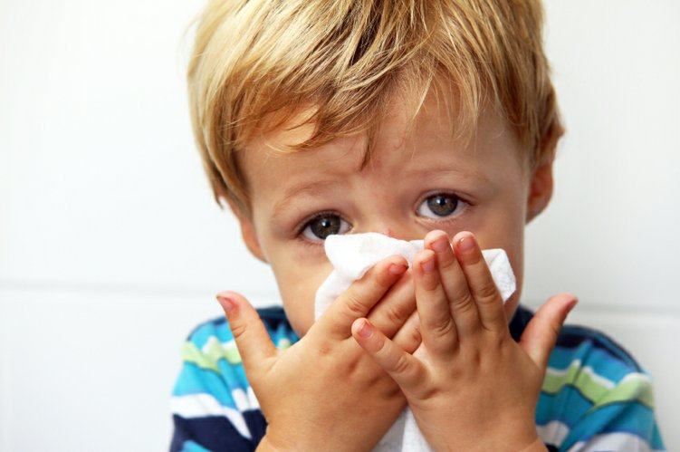
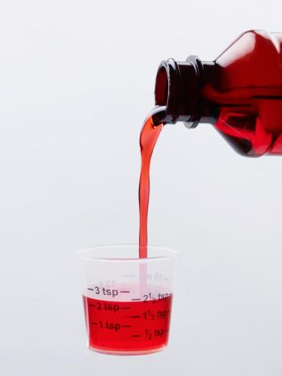
What Should I do?
I love my little brother Sam. Sam is sick. Mom is busy on an important phone call, but I know what will make Sam feel better. I get the cough medicine and begin to pour it in the cup. I’m not sure if I should be doing this.
What should I do?

Slide 9
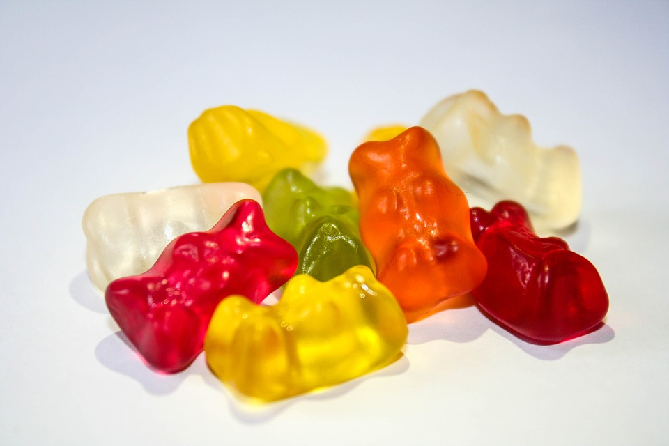
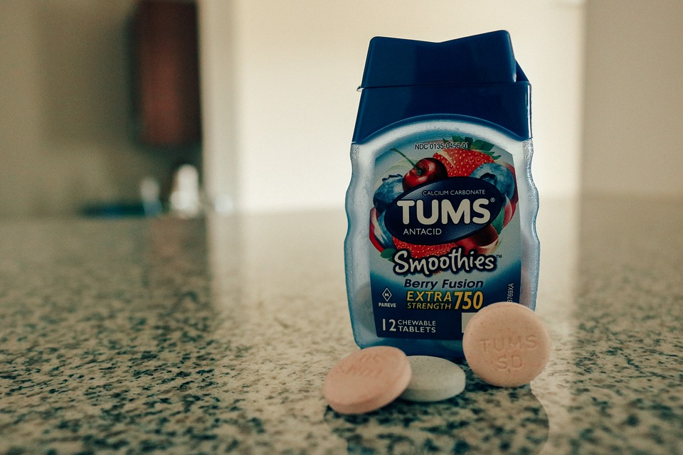
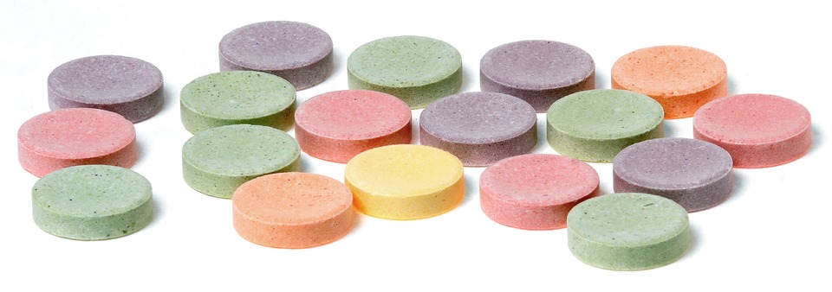
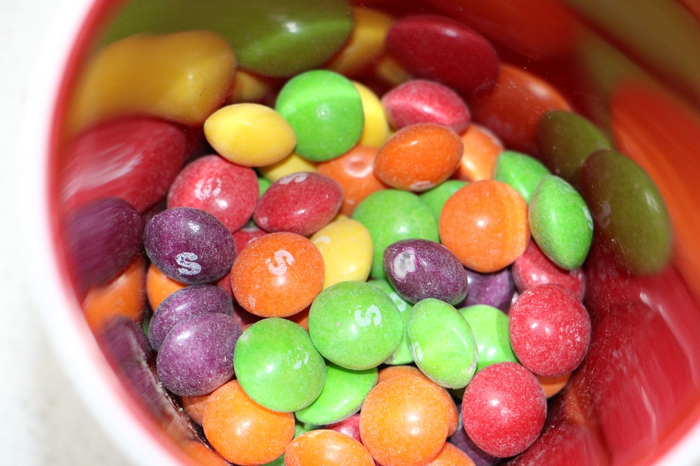
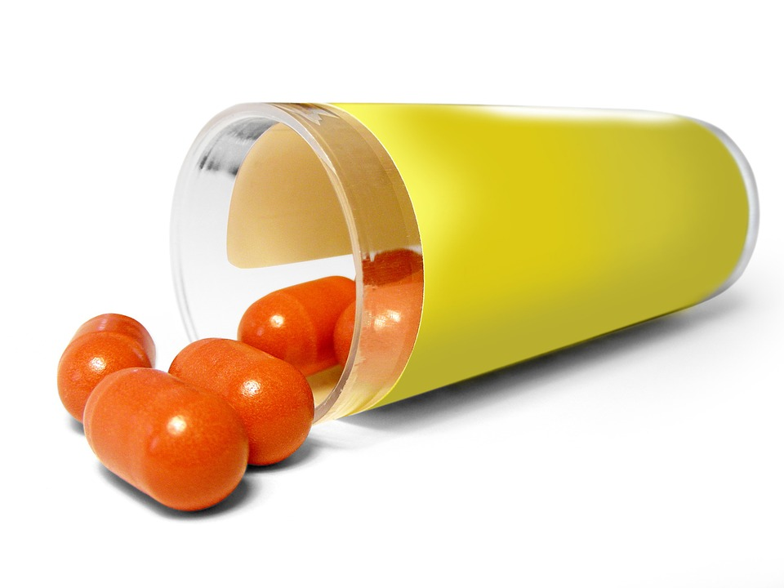
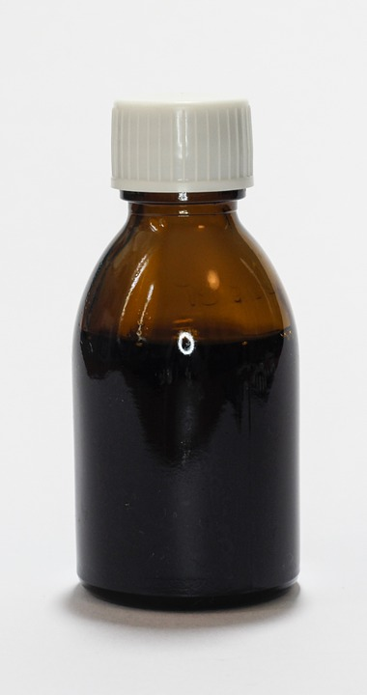
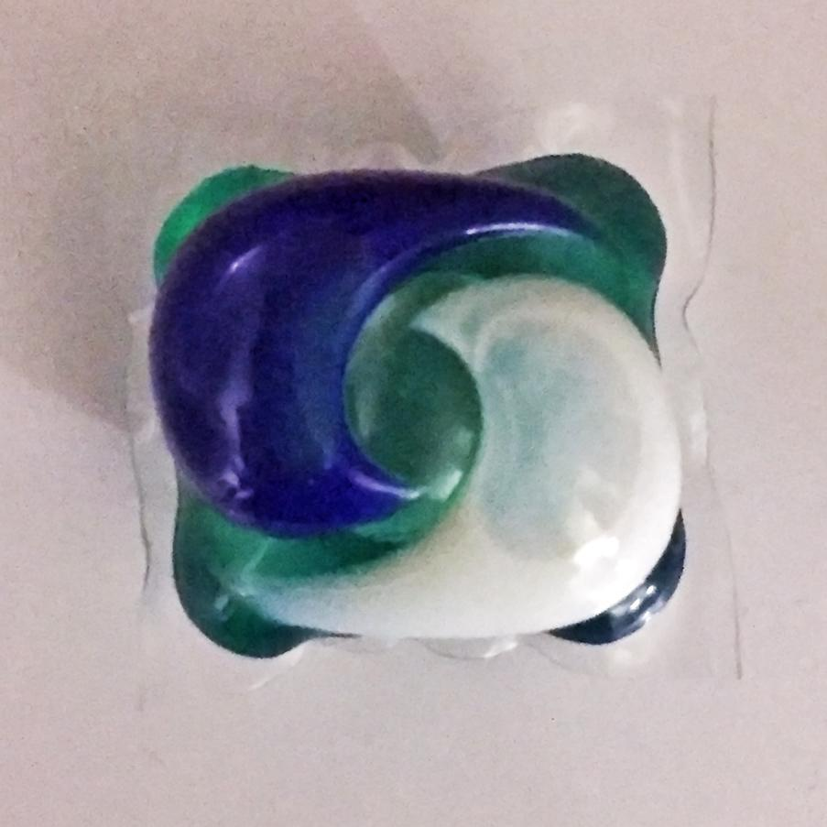
Is this safe to put in my mouth?
Smarties or pill?
Gummy bear or vitamin?
Tide POD

Slide 10
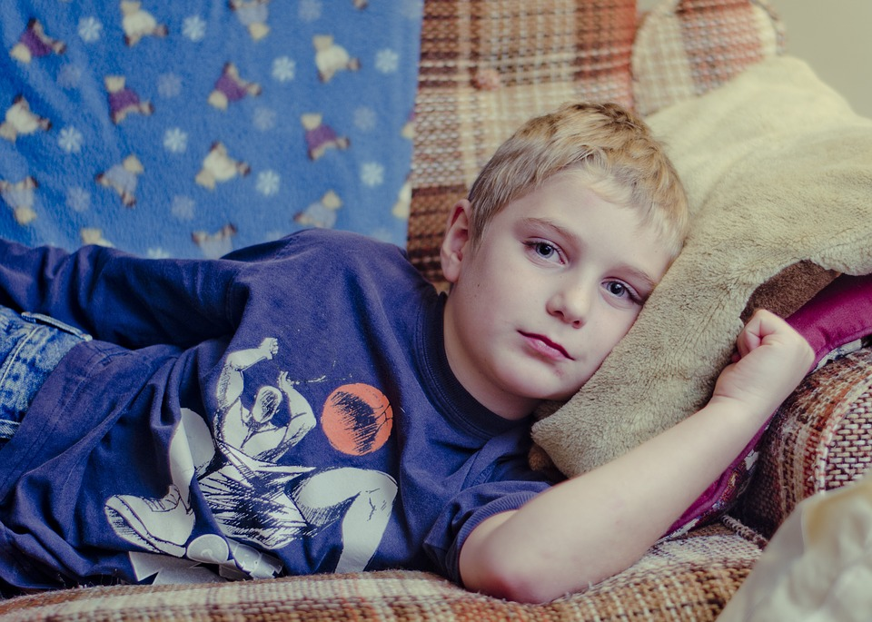
What could happen to me?
Sick
Really sick

Slide 11
Let’s Keep Thinking...

Slide 12
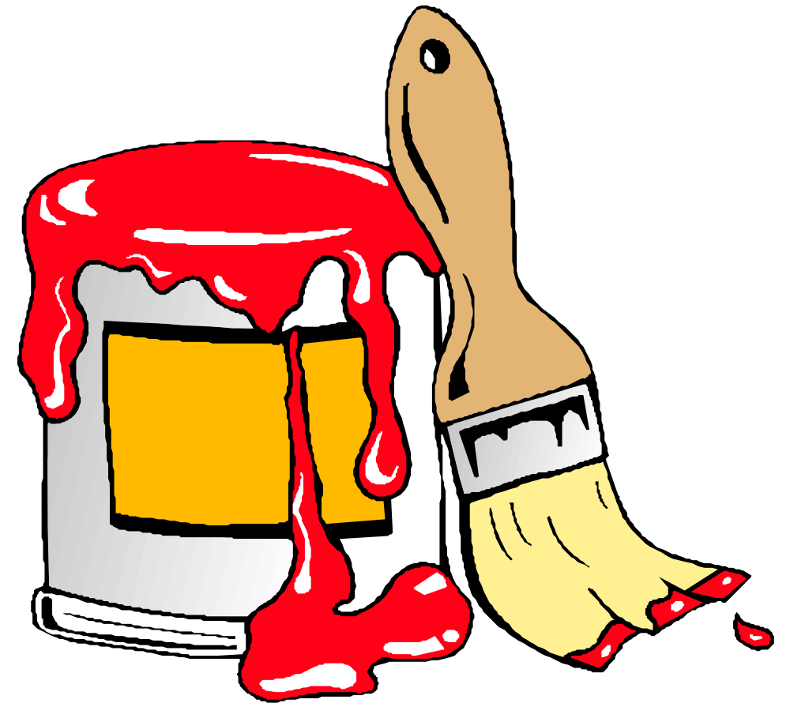
Should I Smell This?

Slide 13
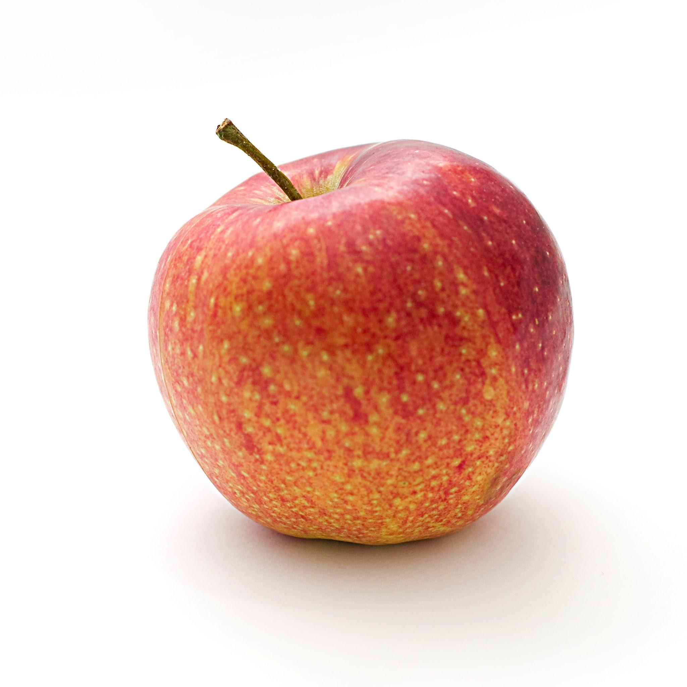
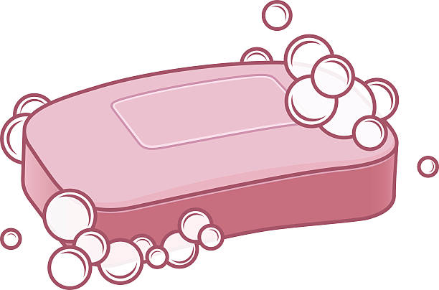
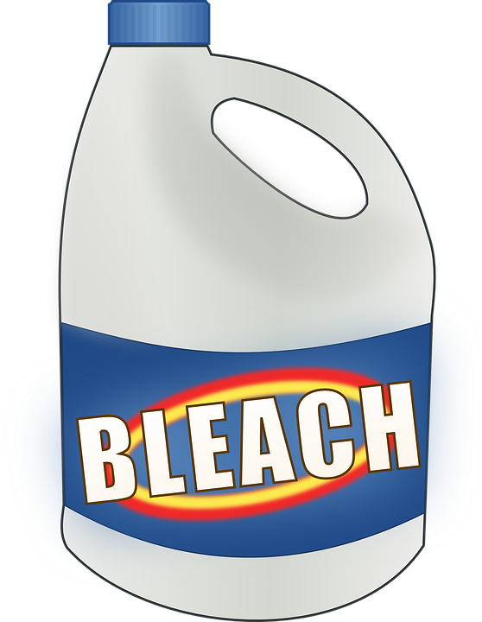
Should I Taste This?

Slide 14
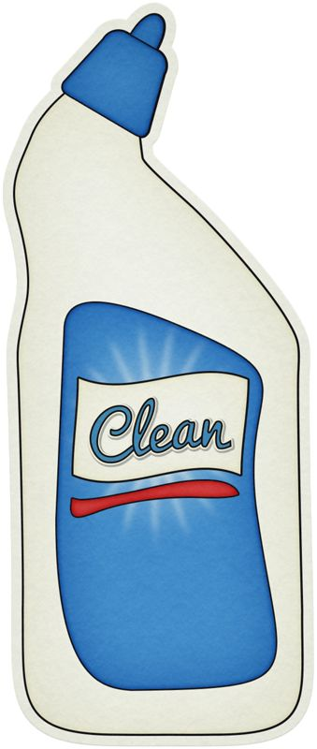
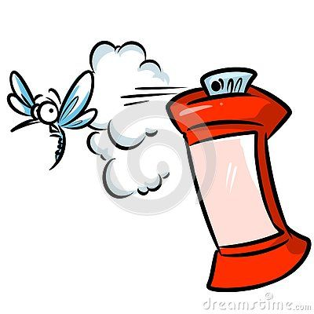
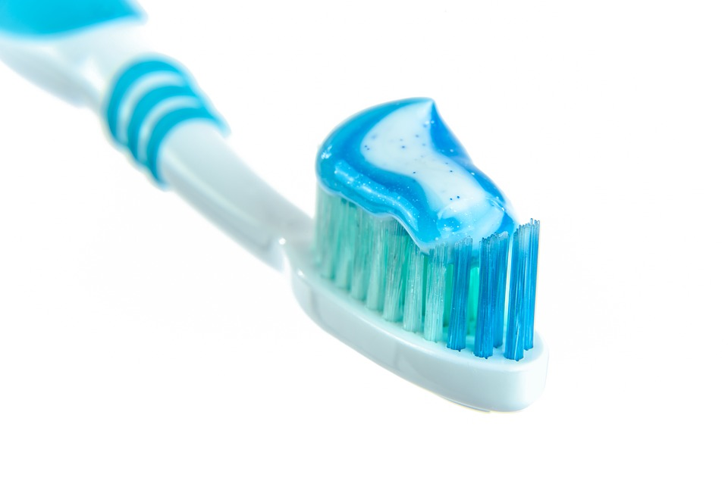
Should I Touch This?

Slide 15
Who can I talk to if I have a question?
trusted adult
grandparent
mom
dad
doctor
teacher

Slide 16
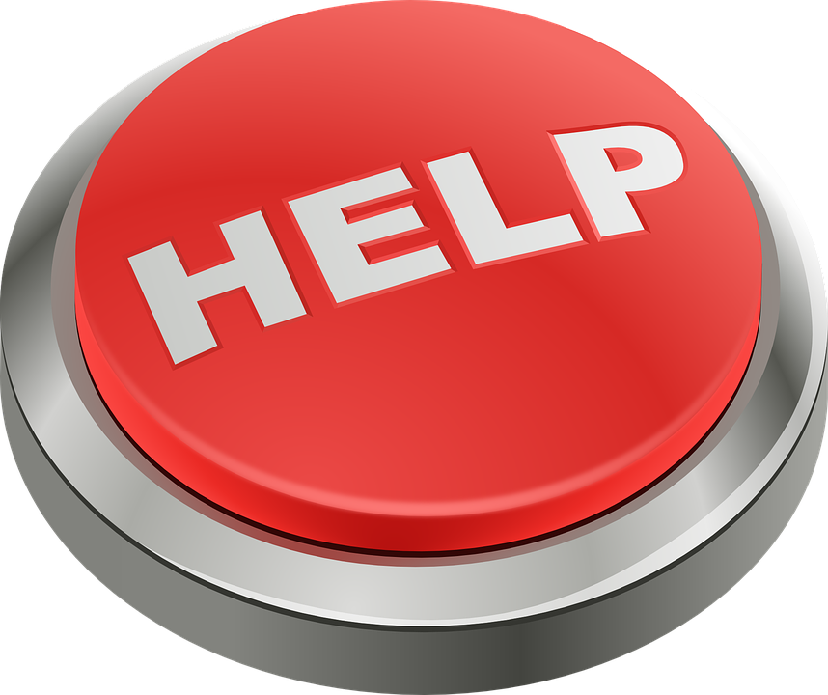
What to do if there is an emergency
Tell a parent
Call 911 if no parent is available
State your name and other information that you know so police can find your location
https://www.youtube.com/watch?v=zXXbnU-7EfA

Slide 17
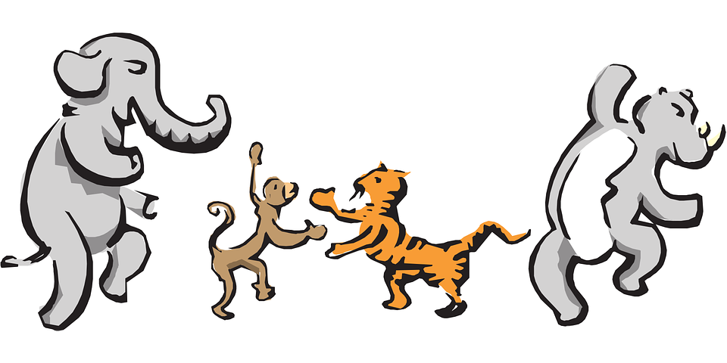
Let’s Move!
https://www.youtube.com/watch?v=HbZosS4dX3g

Slide 18
The End
Take care of yourself & Others

